Slide 1


Safety Coordinator I
The Ground Floor
Notes:
1. Welcome everyone, to today’s Coordinator training class
2. Introduce LGRMS Staff and Association(s) Staff in attendance,
3. Since this is a safety class, where are the nearest exits, restrooms, if available the wifi password(s)
4. Ground rules for class: Please silence all cell phone and electronic devices if you need to make or take a call please step outside. Breaks will be given throughout today’s training.

Slide 2

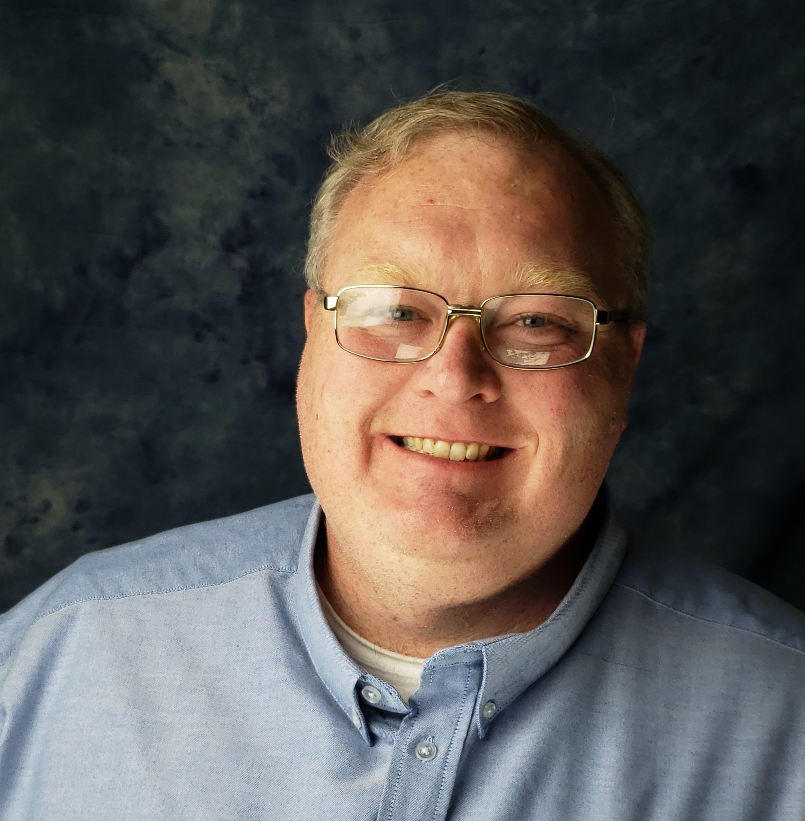
Chris ryan
Risk control consultant,
Western region
Notes:
Introduce yourself and some things about you.
a. How long with LGRMS
b. What you did before this job and what you did there.
c. Some of your credentials.
2. Have the class introduce themselves
a. Name
b. Their job title
c. How long
d. How did they become the new Safety Coordinator.

Slide 3
What is workplace safety
Safety Rules
Audits/Self-Inspections
Hazard Identification
Accident/Incident Investigations
Safety Training
Fleet Safety
Safety Practices
Notes:
Workplace safety is about preventing injury and illness to employees in the workplace.
Safety Rules: Do not develop them yourself. Each department should have their own and the workers should develop them.
Audits/Self-Inspections: Routinely performed on all property, vehicles, and equipment.
Hazard Identification: Dangers to employees and the general public, as well as exposures to physical assets.
Accident/Incident Investigations: Performed to correct the Root Cause.
Safety Training: Routinely conducted often based on loss trends
Fleet Safety: Designed to keep the fleet running well with vehicle maintenance; are all of the safety features working(seatbelts, brake lights etc.)
Safety Practices: This can be the culture of your organization. How many employees to you have, can they get together easily to meet, is it the same across your organization.

Slide 4
What you should know!
By the end of the session, you should be able to use the LGRMS website.
Understand the general requirements to apply for either the ACCG/GMA Safety Grant Programs or the ACCG Safety Incentive Discount Program,.
Know the general responsibilities of what a safety coordinator does for their City or County.
LGRMS Website and how can we help?
  Website – Http://www.lgrms.com
  Staff information
  Member section
  Sample policies
  Webinars
  Other Resources
Notes:
Show them how to get in and utilize the LGRMS website

Slide 5
Safety grant/incentive discounts
General requirements for the ACCG/GMA Safety Grant Programs and ACCG Safety Incentive Discount.
  Signed Designated Safety Coordinator Resolution
  Signed Safety Policy Statement
  If applicable current in response to recommendations made by LGRMS during onsite visit
  Have documented minimum quarterly Safety meetings/trainings
  Documented Bi-annual self-inspections (performed by each department)
  Mandatory Seatbelt Policy
Notes:
Safety Coordinator-Must attend 1 Safety Coordinator Training per year until all have 3 have been completed.
Signed Safety Policy Statement-By the top elected official. It shows that top management supports for the safety program.
Describe recommendation letter. How and where we found the problems? Responses from past recommendations should be answered by the City/County/Authority 90 days after they receive them. Responses could be completion or a schedule of when the recommendation will be taken car of.
Describe Quarterly Meetings – even though the grants and incentive only requires quarterly, we recommend monthly. It is easier to make up a month than a quarter meeting. These meetings can be anything a tail gate, monthly safety theme to a meeting about how to prevent the same type of accident.
Self-inspection form located on the lgrms website and provided monthly in the SHARE publication
Mandatory Seatbelt policy can be found on the lgrms website.

Slide 6
Types of Training
General
No Measure of skills, knowledge, or attitude
Task Specific
Universal to All
Example would be seat belt use policy
Specific
Skills, knowledge, and attitude are measured
Employees must meet criteria to continue.
Notes:
Regional Training- Health Promotions Training will not count towards requirement. These trainings are located on our website in the training calendar and can be done by our staff or the pool’s attorneys.
Focused- In house training ie, DDC, Harassment, LGRMS provided, etc. Usually done by a member of our staff.
Webinar-Discuss Types – to count as the extra class requirement, but it must add up to 3-hours.

Slide 7
Training Requirements
Participation by any member employee in at least one LGRMS Training Program within the past year
  Regional Training
  Focused Training
  Webinar (3 hour minimum)
Notes:
Regional Training- Health Promotions Training will not count towards requirement. These trainings are located on our website in the training calendar and can be done by our staff or the pool’s attorneys.
Focused- In house training ie, DDC, Harassment, LGRMS provided, etc. Usually done by a member of our staff.
Webinar-Discuss Types – to count as the extra class requirement, but it must add up to 3-hours.

Slide 8
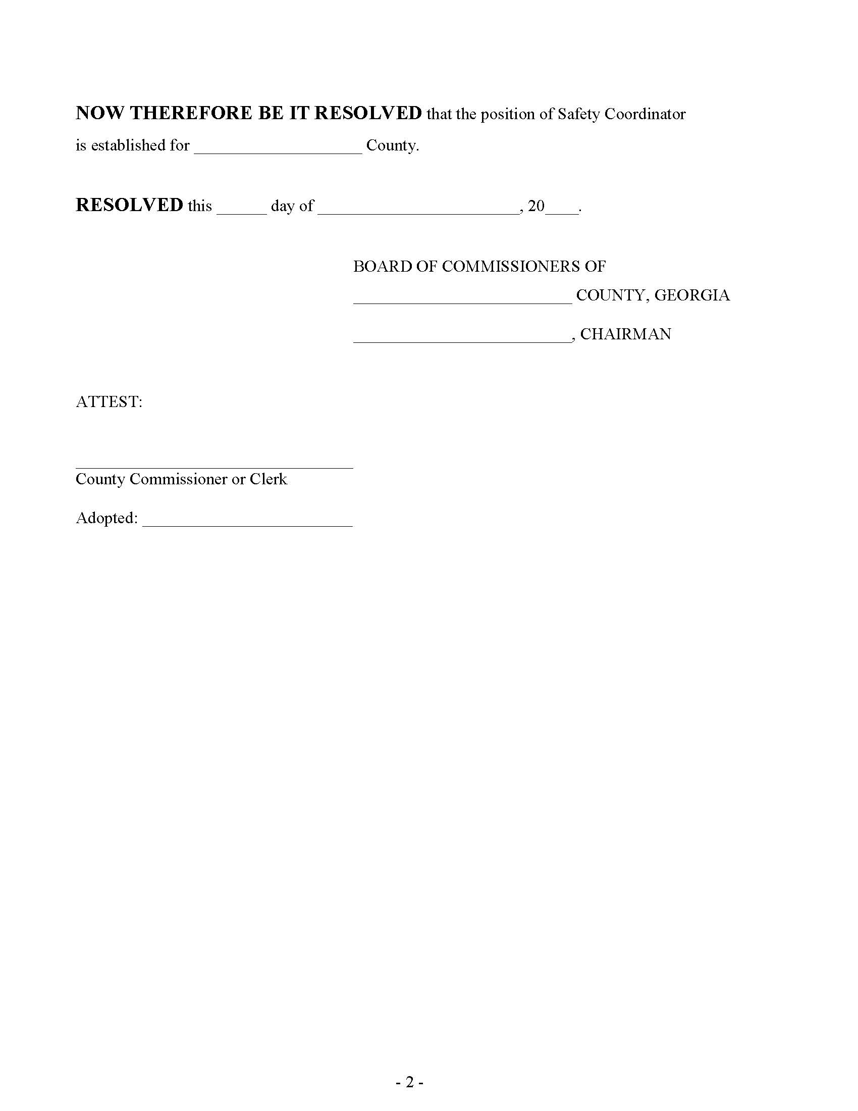
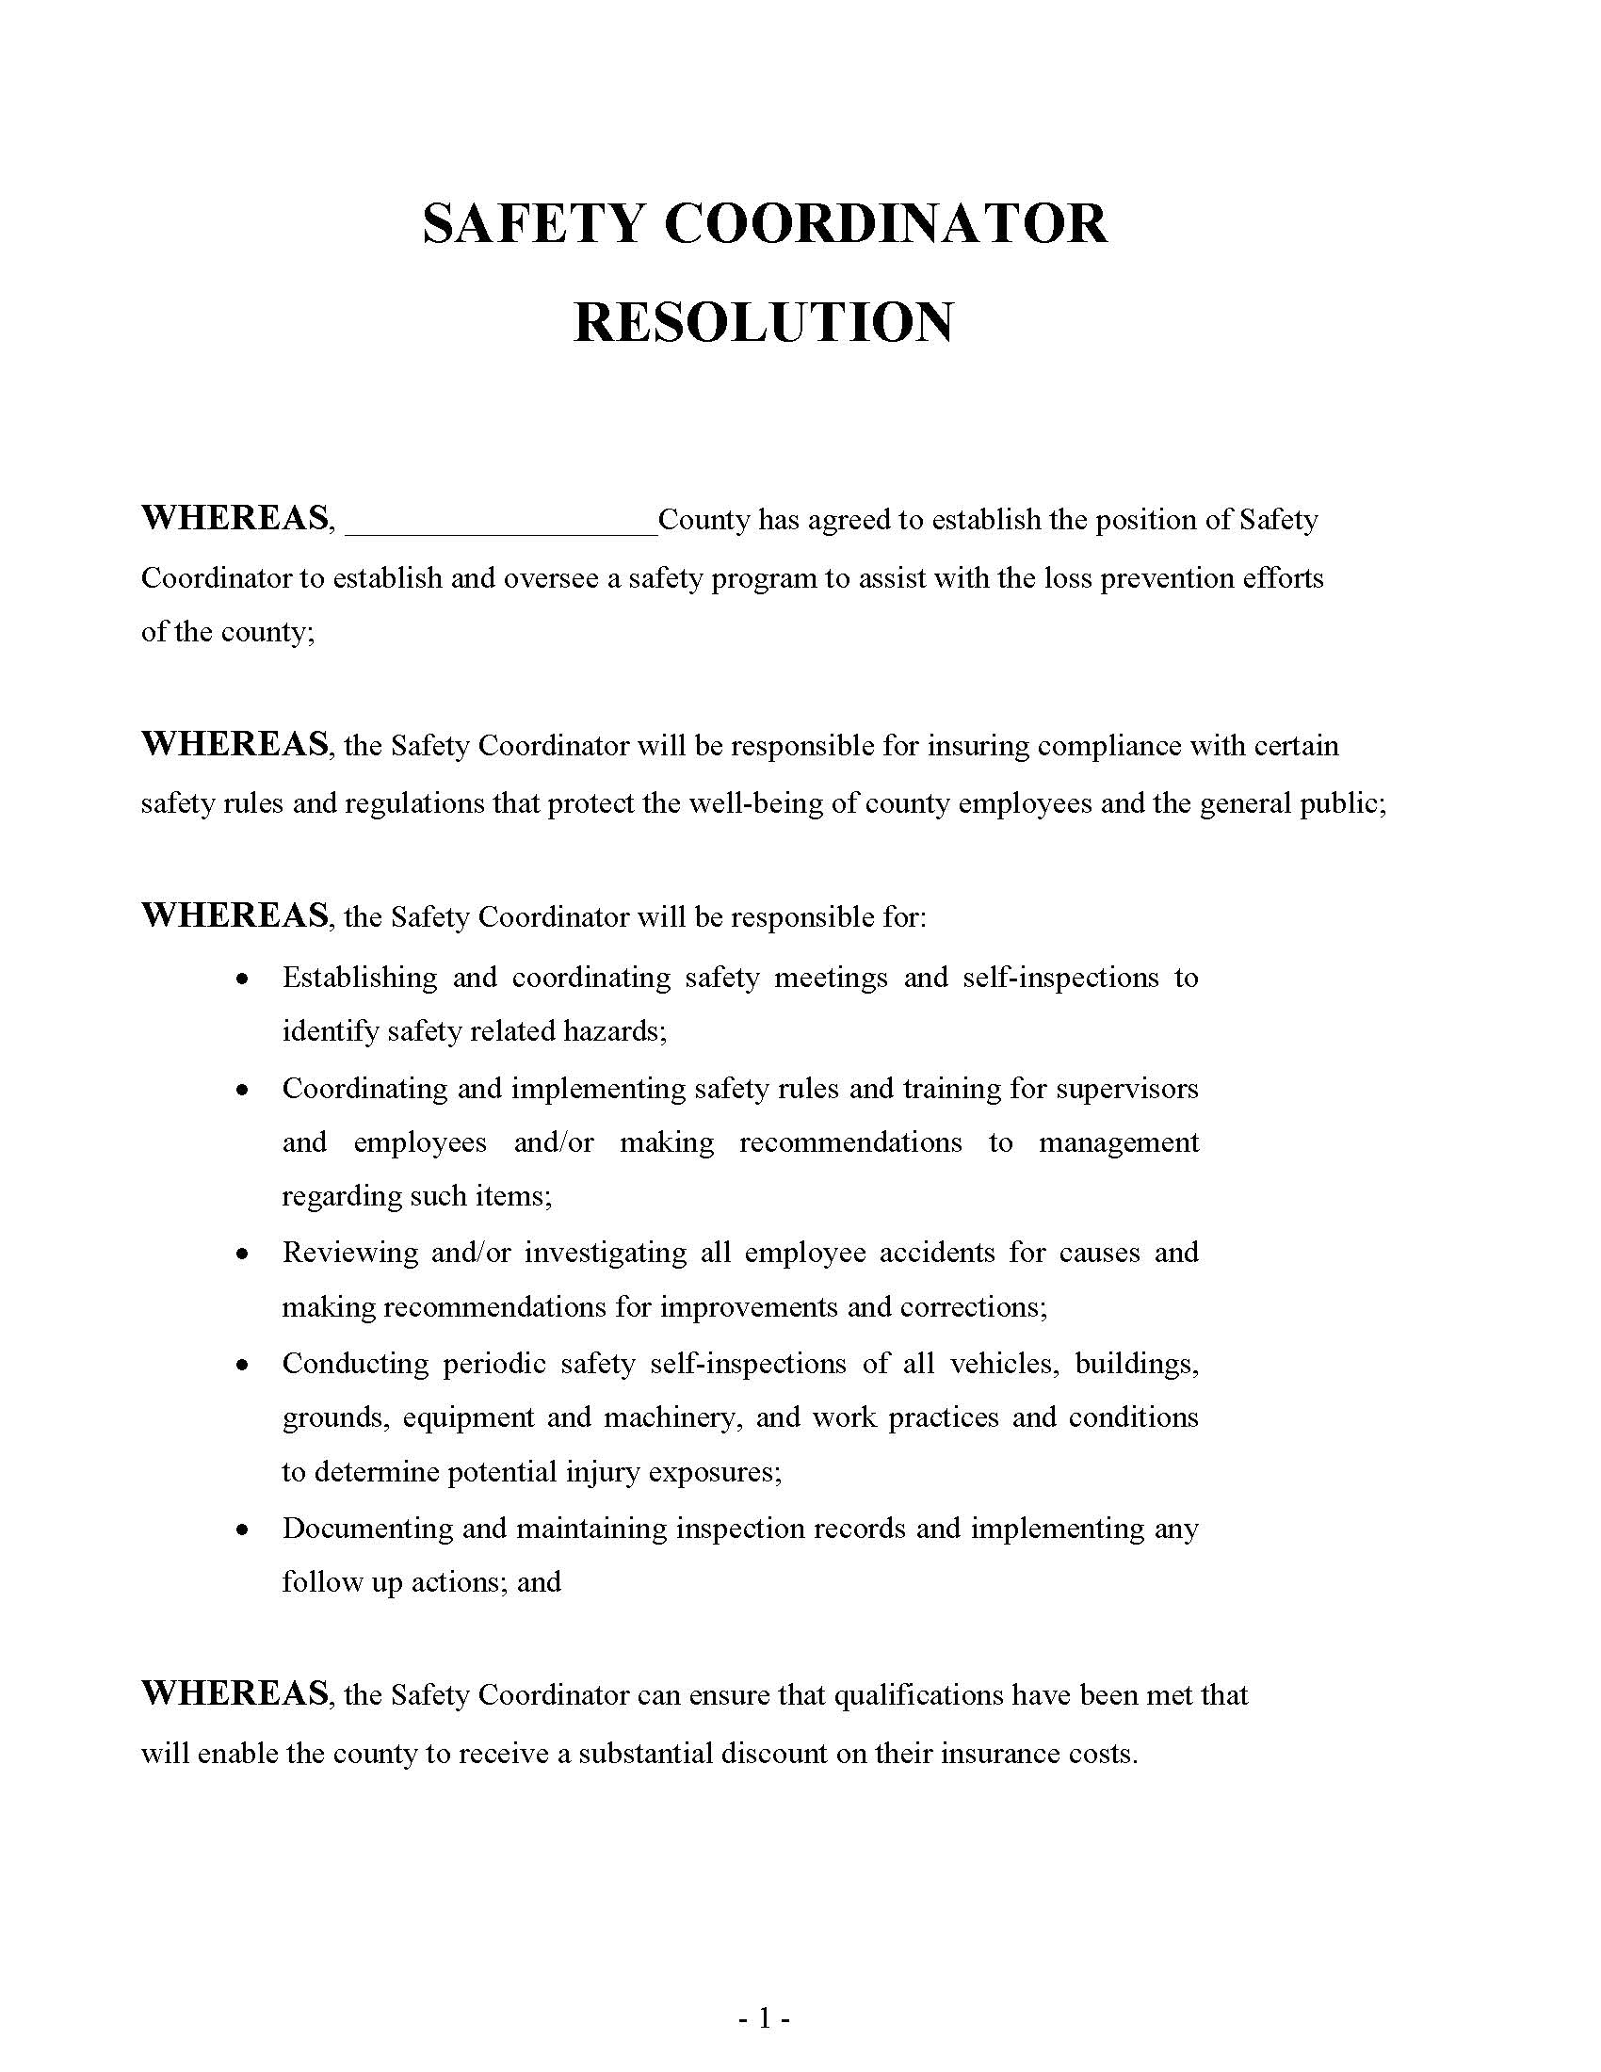
Signed Safety Coordinator
Resolution
Notes:
Read the resolution. This will show who is the safety coordinator and maybe will could become the safety coordinator if that person leaves the City/County/Authority.

Slide 9
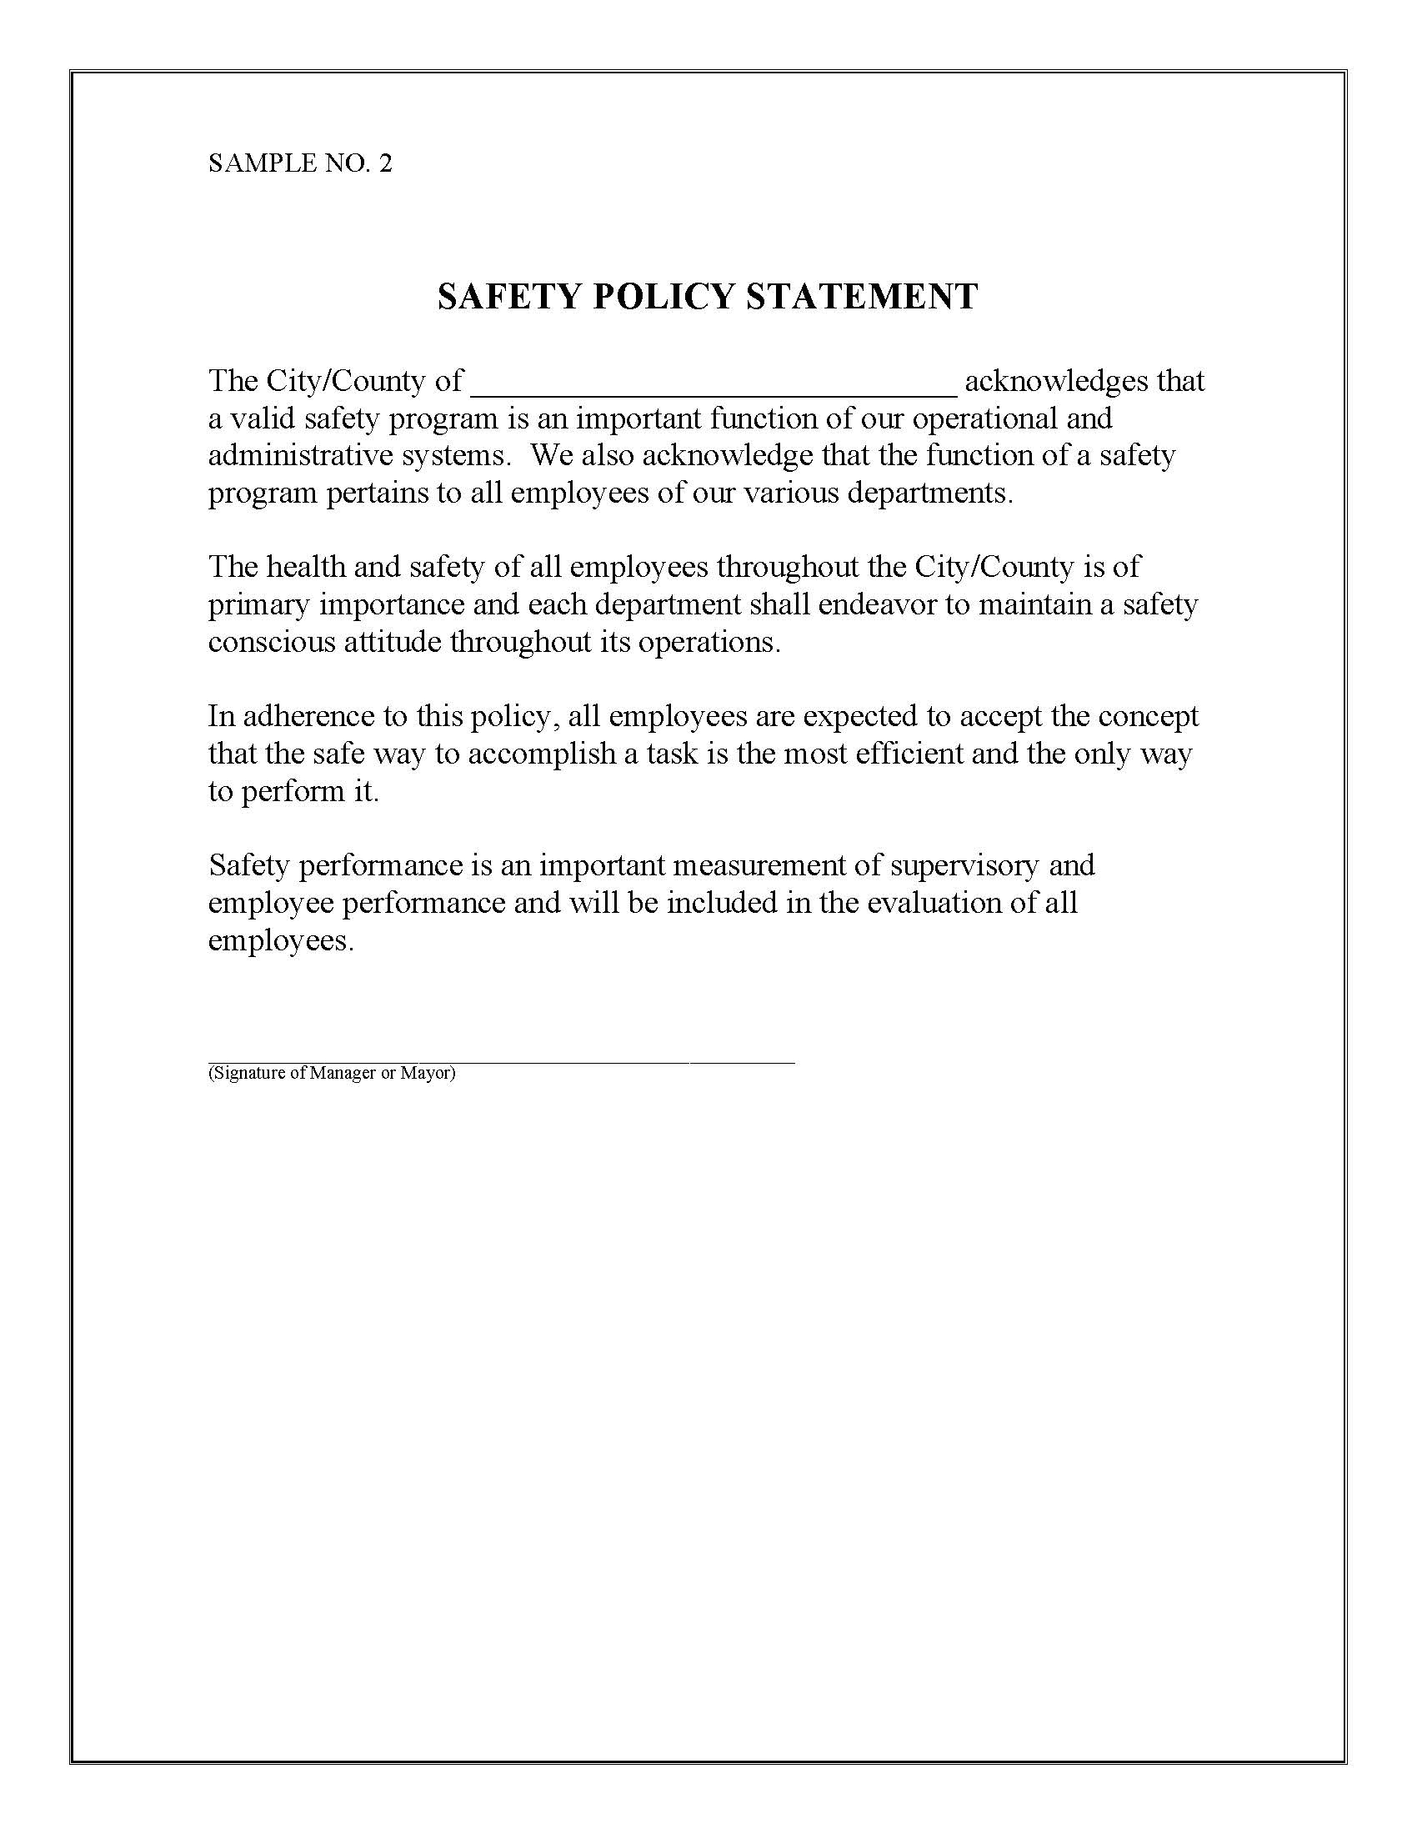
Signed safety Policy Statement
Notes:
Read the resolution.

Slide 10
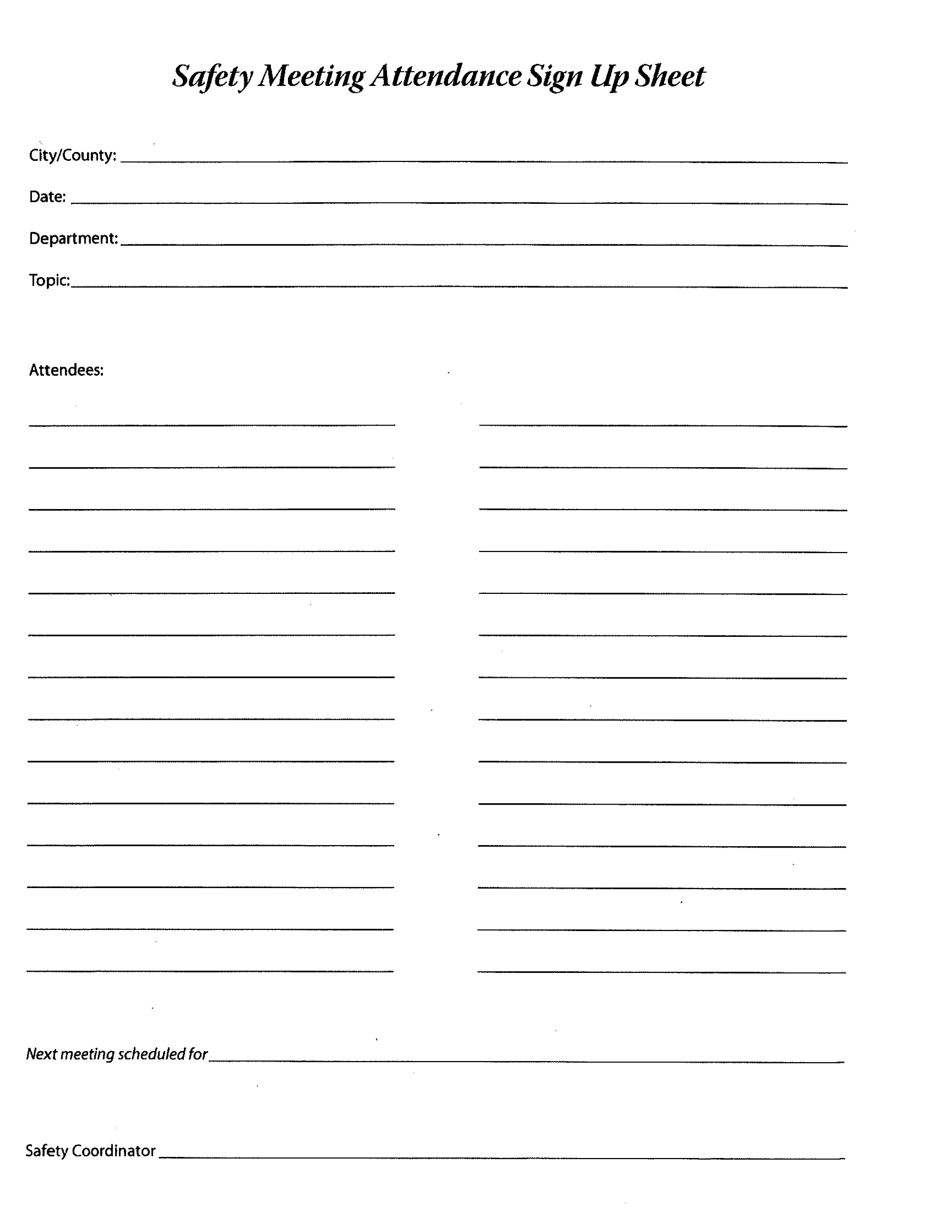
Safety Meeting Sign-In
Notes:
These are used to document any safety meeting held. It shows the date, department and topic of the meeting. It also shows the attendees of the meeting.

Slide 11
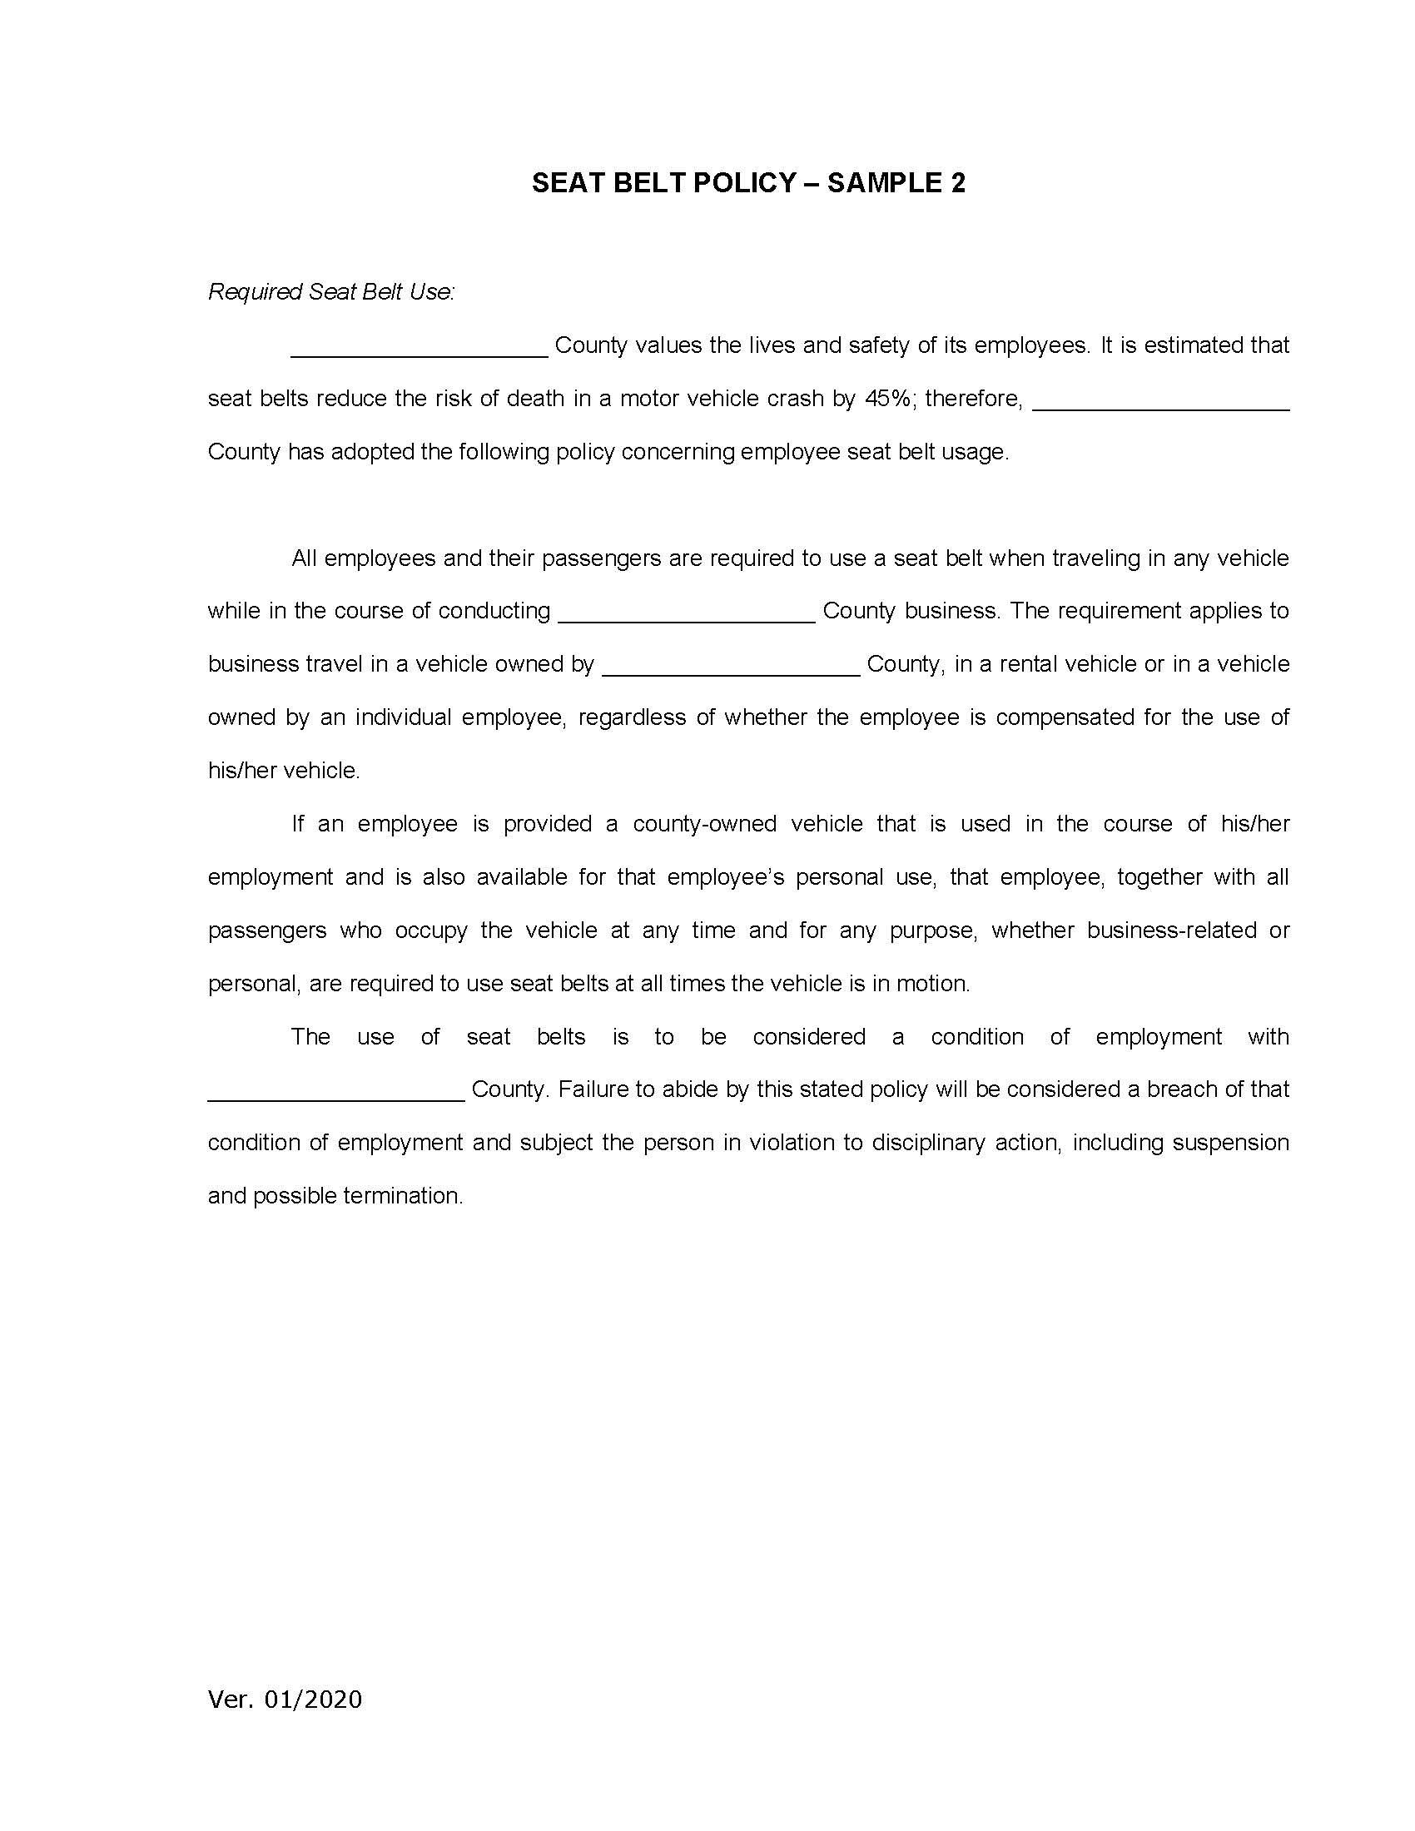
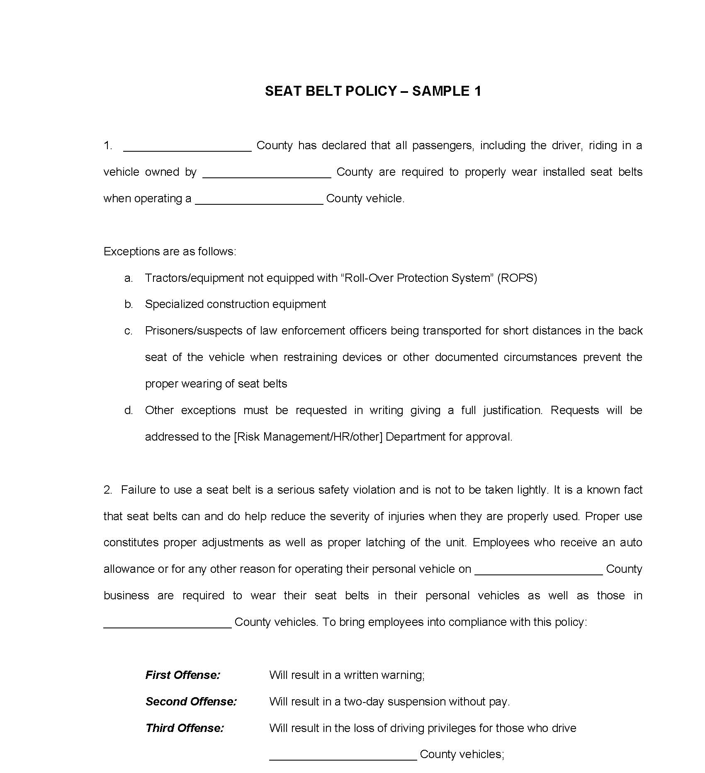
Mandatory Seatbelt Policy Samples
Notes:
Read one of these samples. What is the right way to wear a seatbelt? You will be surprised how you see your employees utilizing them. If a vehicle does not have a seatbelt, should an employee use it.

Slide 12
Breakout Session
As the Safety Coordinator your Field Representative contacts you to set up a visit. One department based on Accident Trends has significant losses and to this point has done little on safety (Police, Sheriff, Parks, Public Works, Pers, etc).
What are some challenges (Road blocks in working with them)?
How could you overcome the roadblocks?
Notes:
The Safety Coordinator will ensure that appropriate documentation is posted, periodic inspections on all member vehicles, buildings & grounds, equipment & machinery, and work practices & procedures. LGRMS can provide members with checklists and other assistance to help comply with this requirement.
SC is not necessarily the person who does or initiates these, (could be supervisor or management). SC should be part of the process in assisting in implementing or providing guidance on how to implement or use.
Self Inspections- provide schedule, coordinate inspection. Buildings should be done bi-annually. Vehicles should be done daily. Law enforcement will conduct vehicle inspections multiple times per day.
Accident investigation- consolidating reports, being an objective 3rd party, ensuring completeness of report, follow up on corrective measures??? (local management may operate differently). You might or might not have this responsibility. Usually done by department head or vehicle might be completed by law enforcement
Safety Hazards-Help in identifying existing and potential hazards /recommend remediation. Hazards can be big or small (cord across the floor)
(Group Discussion) Provide three roadblocks you may face when working with other departments, and how could you overcome them.

Slide 13
Responsibilities of the Safety Coordinator
The Safety Coordinator is responsible for working with management to coordinate the actions below.
  Contact Point
  Communications
  Coordinate Safety Training and Implement Safety Rules
  Coordinate Department Quarterly Safety Meetings
Notes:
Contact Point-Who is your primary person to report to? What did they say they wanted you to do? Keep their name out of the local paper or internet.
(Group discussion on other things to do as a contact person); Some roles- oversees safety activities, identify unsafe conditions, suggest standards-PPE/work practices etc, oversees safety committee activities, advise /recommend / problem correction to management. Help in setting up our risk visits and maybe ride around with us. Help develop a safety committee/accident review committee
Discuss different safety/accident review committees.
Communications- You will be on the contact list to receive electronic SHARE publication and other LGRMS notifications.
(Group Discussion): What can SC do to communicate with their own employees
(some thoughts if group did not come up with):: payroll flyers, bulletin boards, safety news, puzzles, contests, etc
Key for safety coordinator is understanding role and building relationships with each department.
Training-identifying what is needed and where to get
Safety Rule-encourage adoption/ help in development by facilitation
Quarterly Safety Meetings- Encourage the departments to hold meetings and if they don’t have a topic, they could use a topic provided in the SHARE publication

Slide 14
Responsibilities continued
Assist in Implementing Safety Inspections
Assist in Implementing Accident Investigations
Assist in Identifying Safety Hazards
Notes:
The Safety Coordinator will ensure that appropriate documentation is posted, periodic inspections on all member vehicles, buildings & grounds, equipment & machinery, and work practices & procedures. LGRMS can provide members with checklists and other assistance to help comply with this requirement.
SC is not necessarily the person who does or initiates these, (could be supervisor or management). SC should be part of the process in assisting in implementing or providing guidance on how to implement or use.
Self Inspections- provide schedule, coordinate inspection. Buildings should be done bi-annually. Vehicles should be done daily. Law enforcement will conduct vehicle inspections multiple times per day.
Accident investigation- consolidating reports, being an objective 3rd party, ensuring completeness of report, follow up on corrective measures??? (local management may operate differently). You might or might not have this responsibility. Usually done by department head or vehicle might be completed by law enforcement
Safety Hazards-Help in identifying existing and potential hazards /recommend remediation. Hazards can be big or small (cord across the floor)
(Group Discussion) Provide three roadblocks you may face when working with other departments, and how could you overcome them.

Slide 15
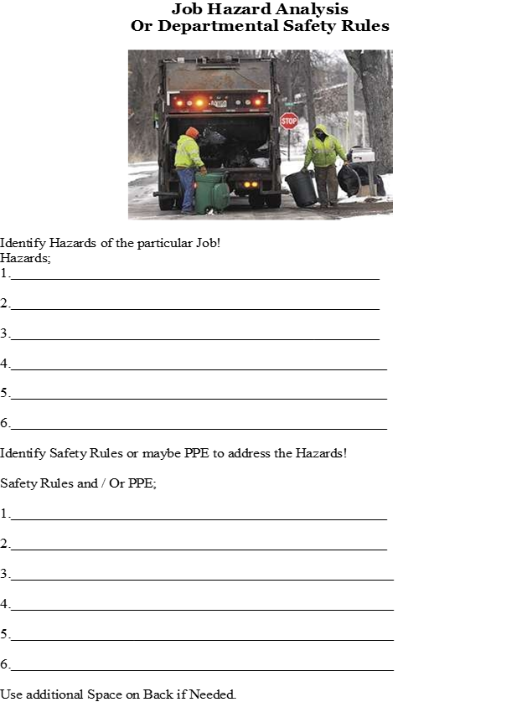
Identifying safety Hazards
Notes:
Breakout session to identify safety hazards and PPE they need to use.

Slide 16
You’re not expected to do it by yourself
Who can help you?
  LGRMS Risk Consultants
  Your own talented people
  Pool Management and Services Team
  Safety Committee
Notes:
LGRMS recommends you start a safety committee. The committee should be made up of a representatives from each department/office. These meetings should include representatives within the organization who can conduct a root cause analysis and document recommendations for improvements to prevent or minimize future occurrences. Records are to be maintained for proof of compliance and follow-up actions implemented.

Slide 17
What’s happening in your city or county?
What type of claims is your city of county having in workers’ comp by cause or department/office?
What type of claims is your city of county having in liability by cause or department/office?
Notes:
Your Field Rep can provide you with a Loss Analysis report to identify loss trends and to prevent similar
claims.

Slide 18
Local Government Trends
 | WC Claims by Department
Department/Office | Total Incurred | # of Claims
Law Enforcement | $34,781,864 | 5,027
Public Works | $17,065,921 | 2,293
Fire | $13,133,301 | 1,925
Other | $8,596,879 | 1,919
Water/Wastewater | $5,412,663 | 698
EMS | $4,775,043 | 528
Parks and Recreation | $3,331,892 | 498
Sanitation | $3,122,513 | 359
Jail | $2,916,942 | 698
Admin | $2,439,239 | 570
Utility | $1,987,773 | 231
Notes:
The Other department/office include housing authority, admin, unknow/other public transit, animal control school maintenance, airport and departments <1%. The Jail is just an ACCG department.

Slide 19
Local Government Trends
 | WC Claims by Cause
Cause | Total Incurred | # of Claims
Ergonomic | $20,927,989 | 2,281
Non-Category | $20,885,053 | 5,693
Slip, Trip & Fall | $17,617,338 | 2,207
Motor Vehicle | $16,782,784 | 1,486
Law Enforcement Ops | $14,362,018 | 2,175
Fire Ops | $6,402,823 | 336
Other | $560,755 | 258
Notes:
The Other cause include unknow/other and it is just an GMA cause. The Non-Category include caught between an object, struck by an object, exposures

Slide 20
Local Government Trends
 | Liability Claims by Department
Department/Office | Total Incurred | # of Claims
Law Enforcement | $61,273,256 | 5,065
Admin | $35,449,505 | 1,716
Public Works | $18,111,767 | 3,040
Other | $10,928,484 | 1,053
Water/Wastewater | $7,949,955 | 691
Fire | $6,739,390 | 478
Sanitation | $5,826,794 | 279
Parks and Recreation | $5,220,847 | 466
Jail | $3,801,717 | 220
EMS | $3,010,624 | 266
.
Notes:
The Other department/office include election district, schools, blank, public transit, court, airport, elected office, building maintenance, animal control, EMA and department <1%. In the other department election district and schools are GMA .

Slide 21
Local Government trends
$14,505,055 | Liability Claims by Cause
Cause | Total Incurred | # of Claims
Motor Vehicle | $65,062,530 | 7,255
Property | $47,497,692 | 2,452
LE Ops | $14,505,055 | 459
Roads | $6,277,502 | 1,266
General Liability | $5,323,797 | 889
Jail Ops | $5,244,663 | 232
Officer/Admin | $4,272,109 | 142
Officials | $4,222,679 | 141
Human Resources | $4,100,915 | 165
Other | $1,582,094 | 270
Parks and Recreation | $225,232 | 80
Notes:
The Other cause include Cyber, Fire/EMS, Public Transit and not classified. ACCG causes are cyber and Fire/EMS and GMA causes are public transit and not classified.

Slide 22
Benefits of Safety Program
It’s about protecting the public entity’s most valuable asset: its workers.
  Reduces the amount of money paid out in health insurance benefits,
  Reduces workers’ compensation benefits
  Reduces the cost of wages for temporary help.
  Savings the cost of lost-work hours (days away from work or restricted hours or job transfer),
  Time spent in orienting temporary help, and the programs and services that may suffer due to fewer employees, stress on those employees who are picking up the absent workers’ share or, worse case, having to suspend or shut down a program due to lack of personnel.
Notes:
Discuss the reduction in cost for health insurance and workers compensation when there’s a reduction in claims.
Discuss the loss of production by having to use temporary help or injured worker not being replaced.

Slide 23
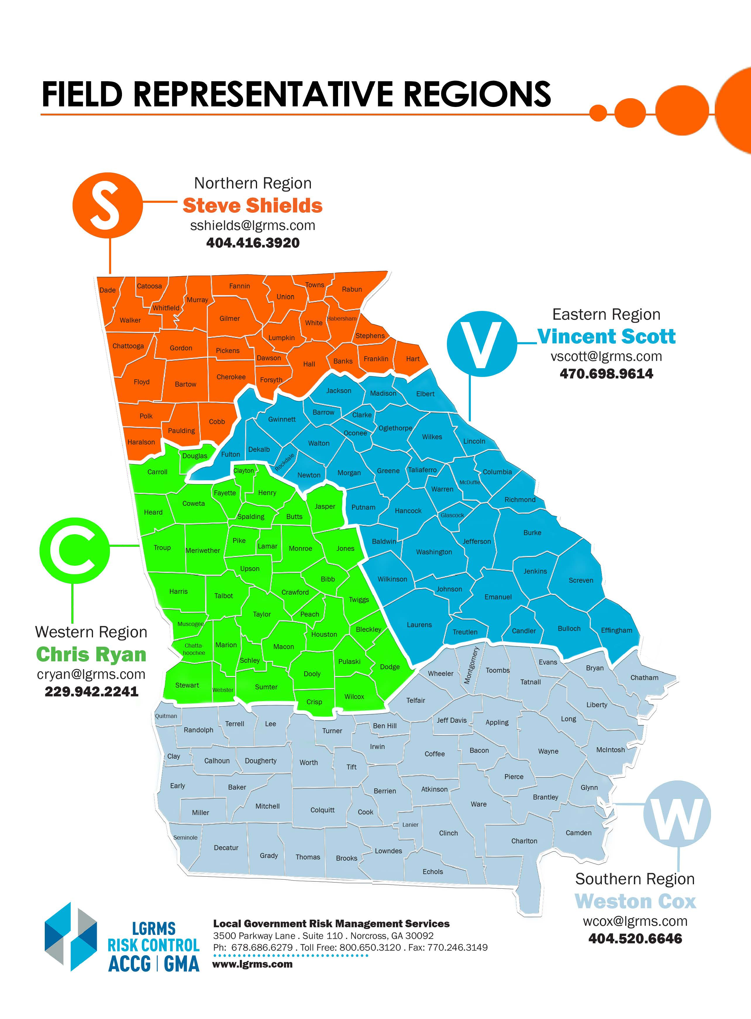
Risk Consultant Territory Map

Slide 24
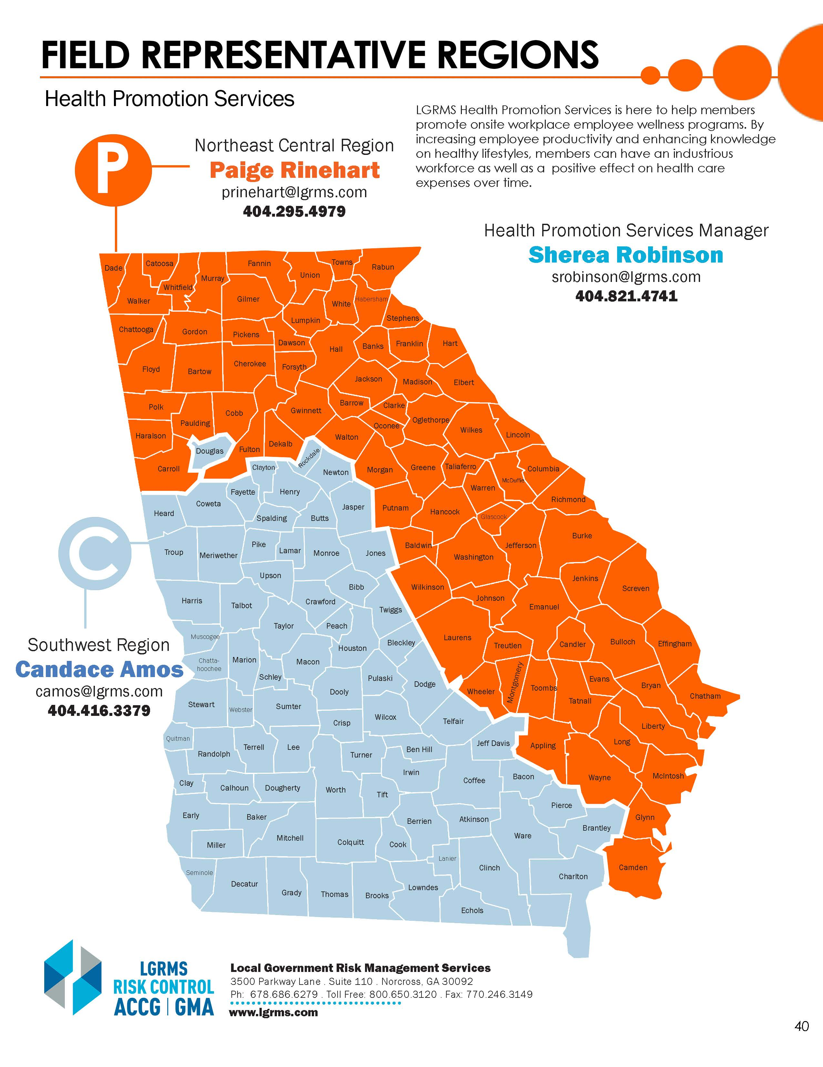
Health Promotion Territory Map

Slide 25
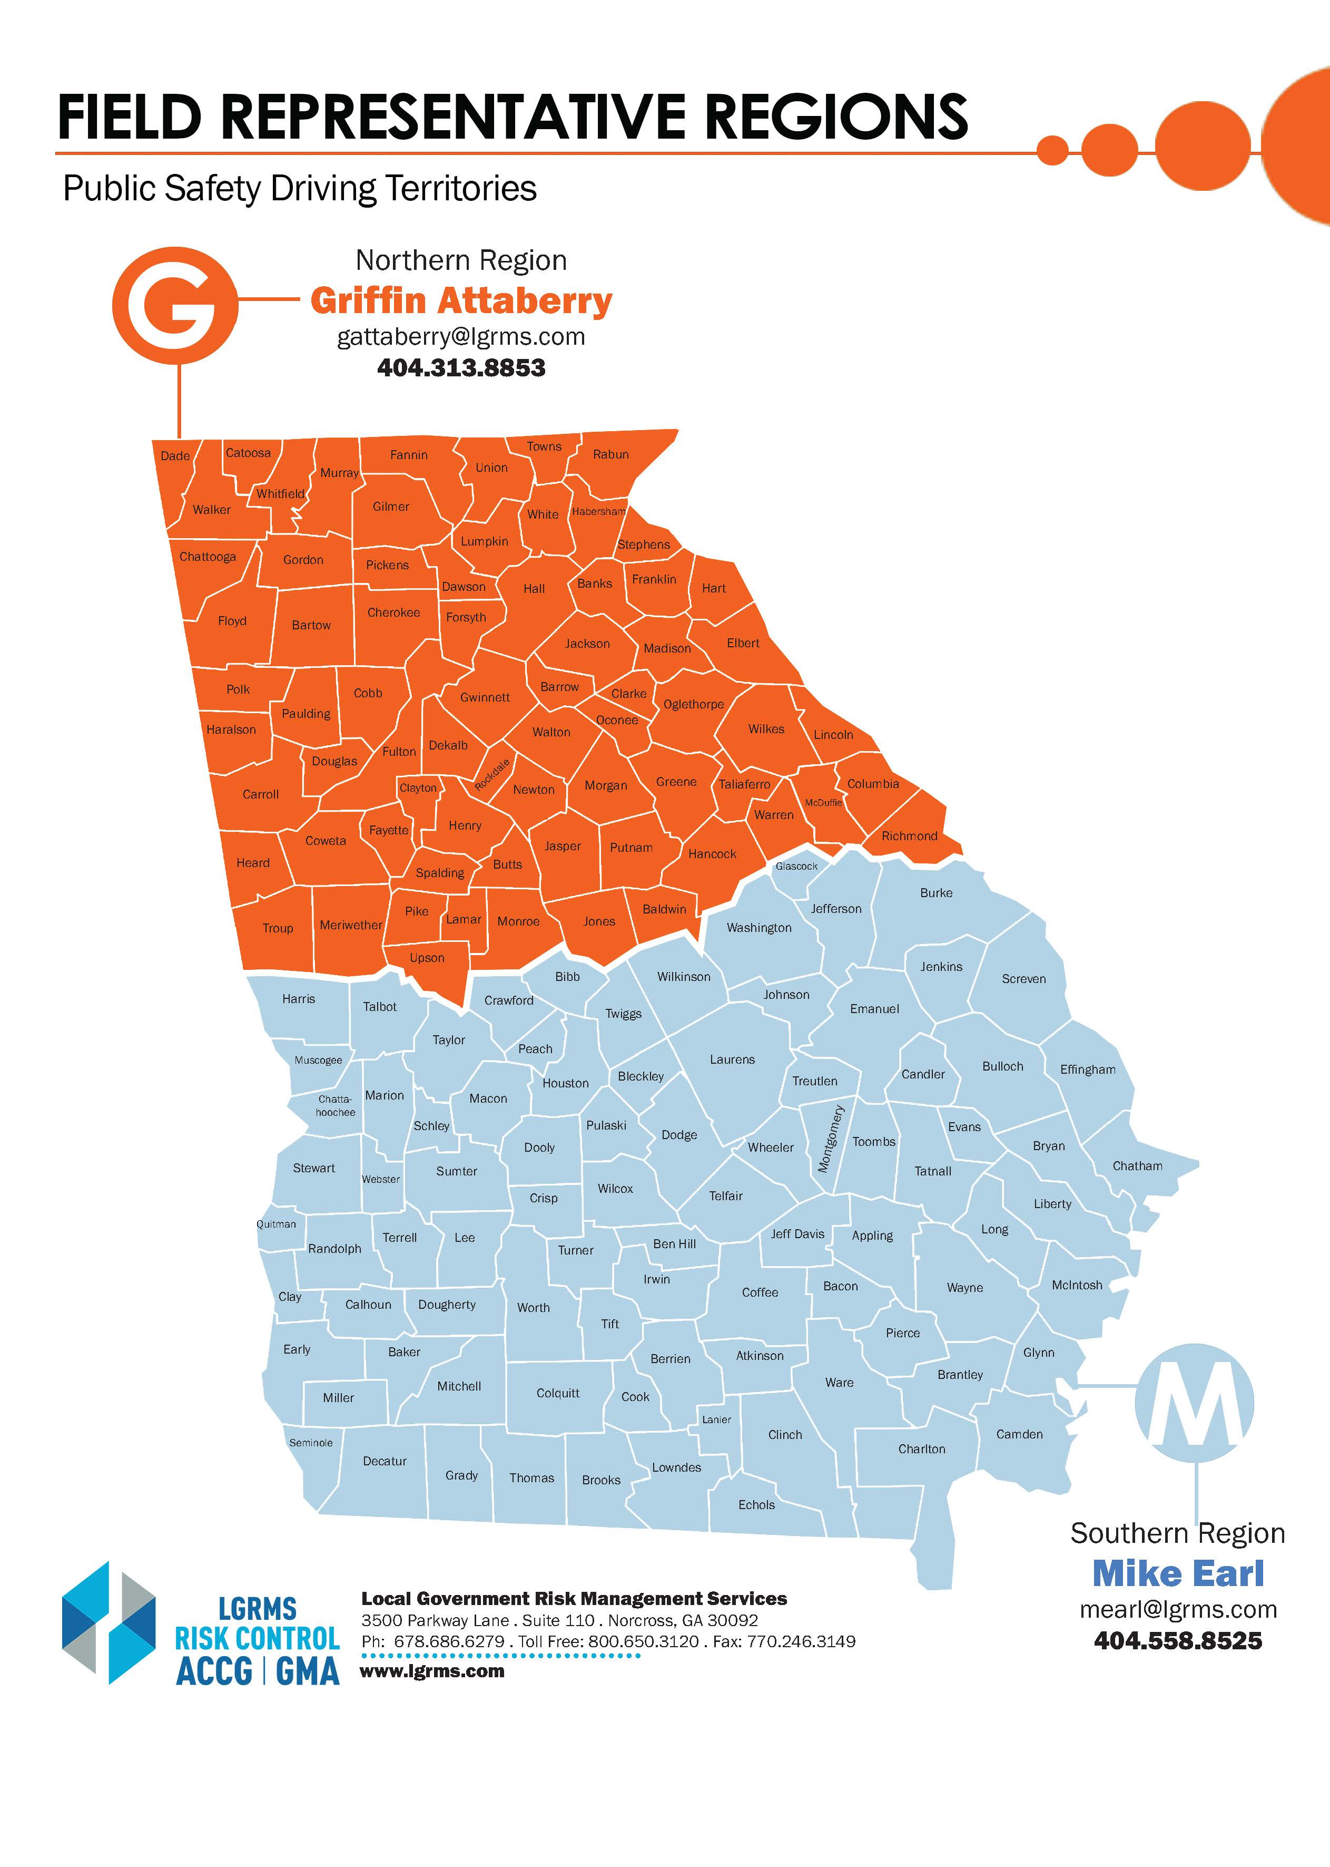
Public Safety Risk Consultant Territory Map

Slide 26
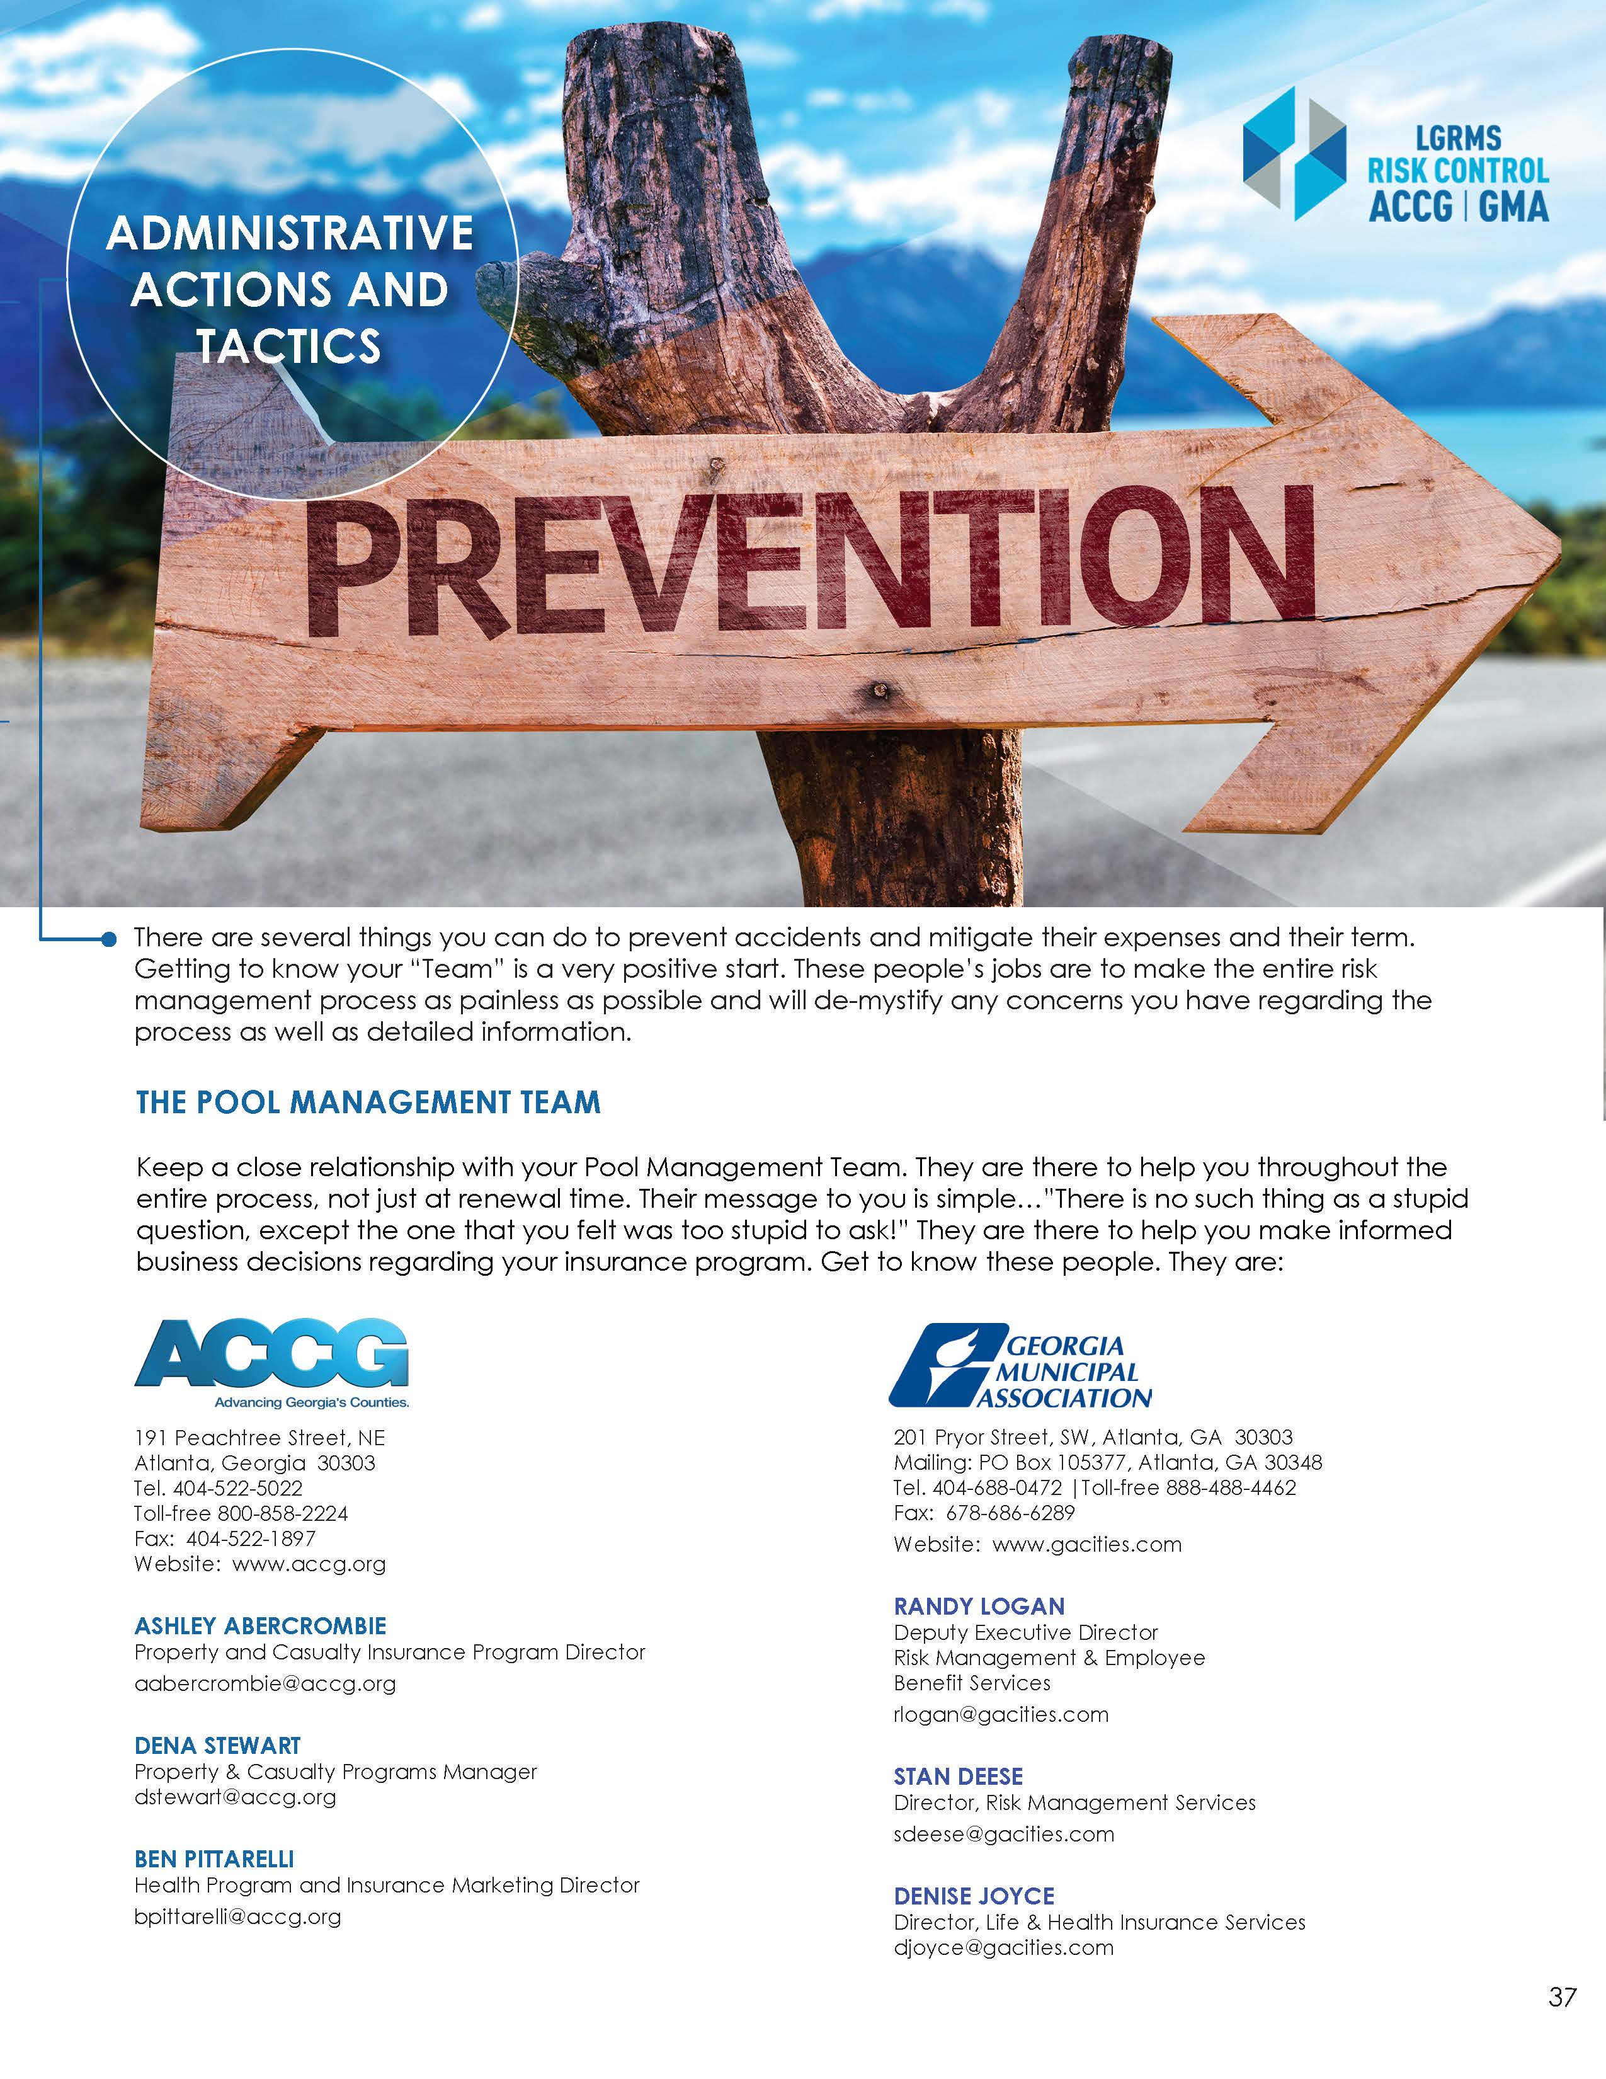
Pool management Contact Lists

Slide 27
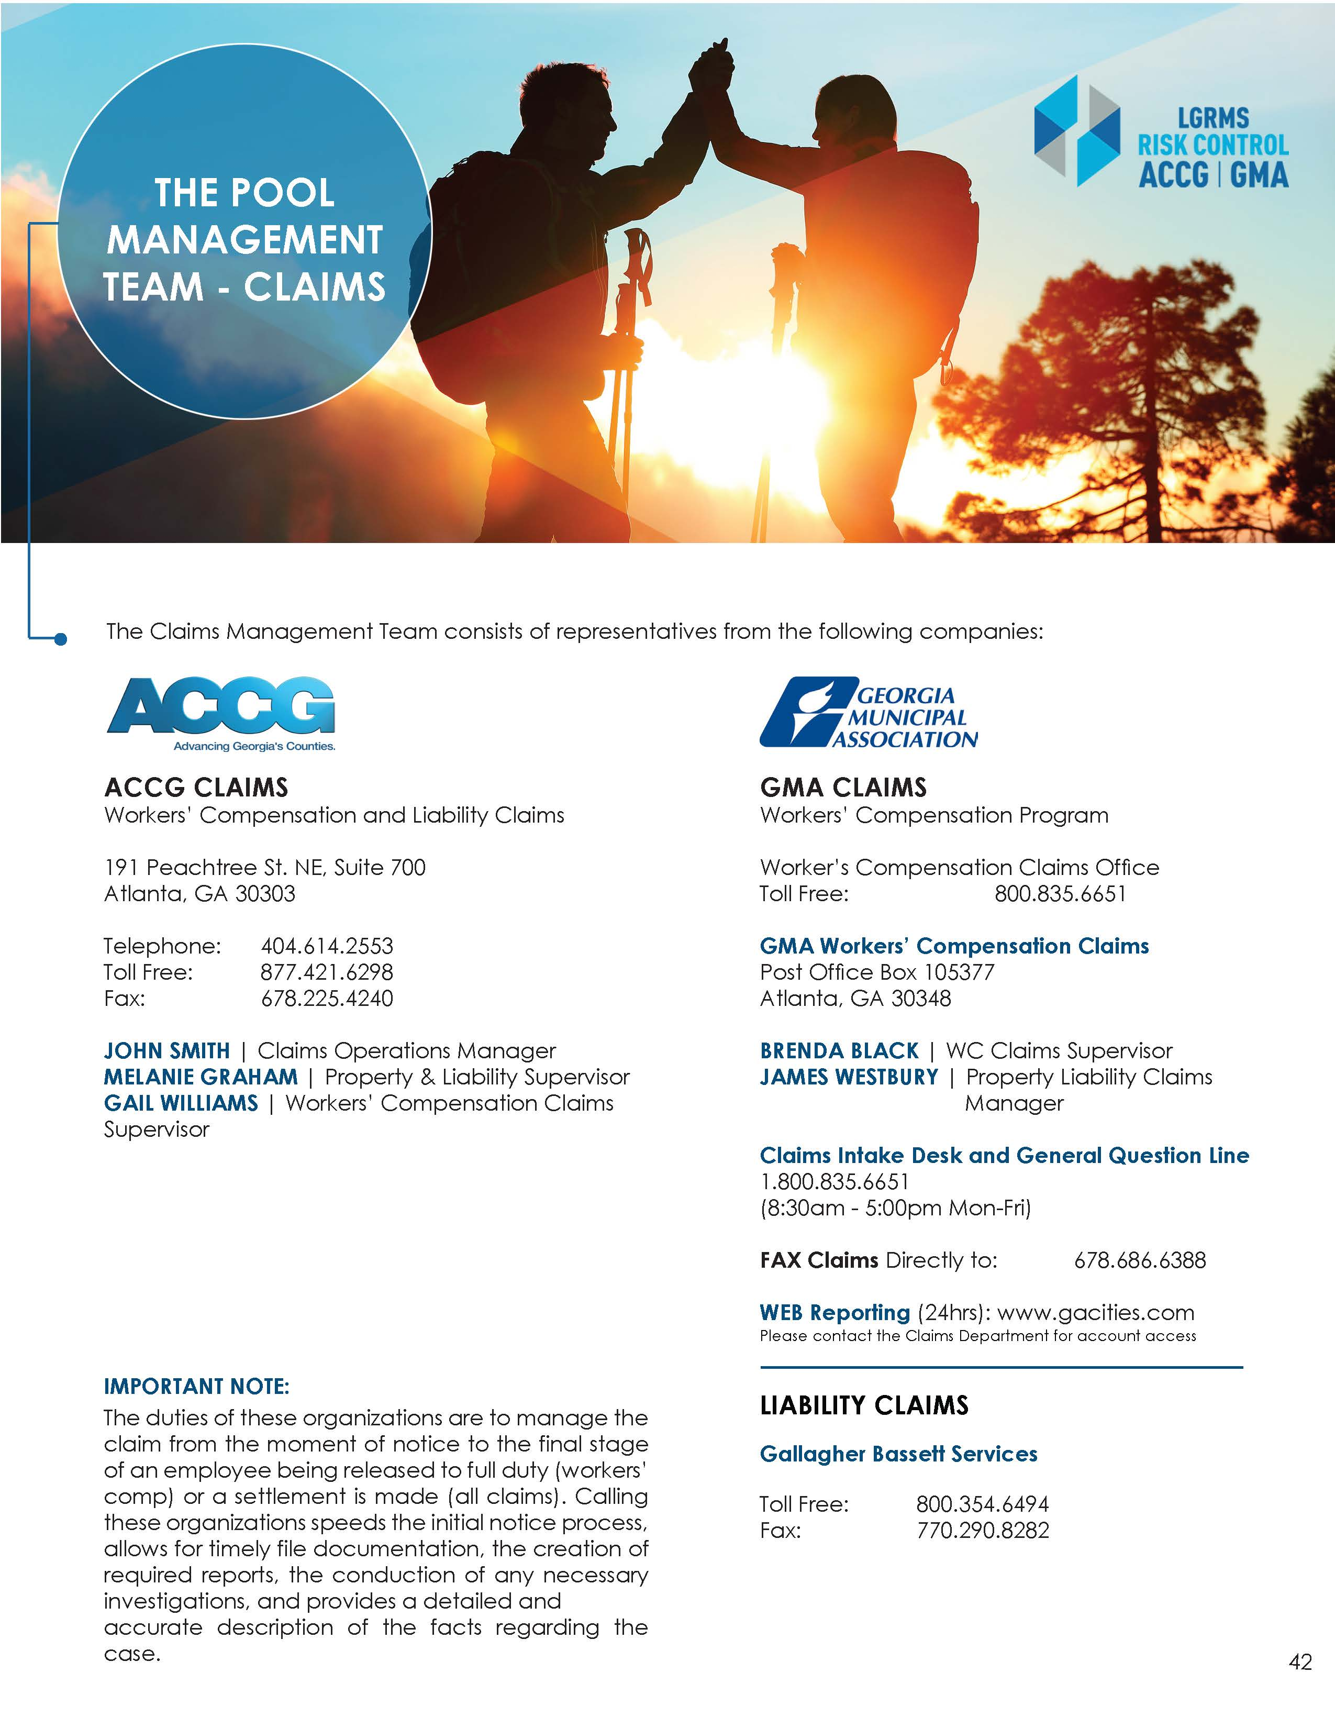
Pool management claims Contact Lists

Slide 28
What is to come?
Safety Coordinator II – Safety Rules/Safety Hazards & Self-Inspections
Safety Coordinator III – Safety Motor Vehicle Fleet Safety & Driver Safety
Safety Coordinator IV – Accident Investigation Analysis/Safety Action Plan
Safety Coordinator V – Risk Assessment/Job Hazard Analysis
Safety Coordinator VI – Dennis’ presentation

Slide 29
HOMEWORK – Please bring to next class
Signed safety policy statement
Currently Posted Safety Rules

Slide 30


Thank you and drive back safely!
Please drive home safely…
Local Government Risk Management Services
800-650-3120
www.lgrms.com
This Photo by Unknown Author is licensed under CC BY-NC

