Slide 1


Safety Coordinator module 2
Safety rules
Safety hazards
Self-inspections
Notes:
1. Welcome everyone, to today’s Coordinator training class
2. Introduce LGRMS Staff and Association(s) Staff in attendance,
3. Since this is a safety class, where are the nearest exits, restrooms, if available the wifi password(s)
4. Ground rules for class: Please silence all cell phone and electronic devices if you need to make or take a call please step outside. Breaks will be given throughout today’s training.

Slide 2

Safety coordinator module 2
Joined LGRMS as a Loss Control Consultant in April of 2018.
BS in Environmental Science/ MS in Occupational Safety & Health
15 years experience working with local and state governments.
National Safety Council Instructor
vscott@lgrms.com
Notes:
1. Welcome everyone, to today’s Coordinator training class
2. Introduce LGRMS Staff and Association(s) Staff in attendance,
3. Since this is a safety class, where are the nearest exits, restrooms, if available the wifi password(s)
4. Ground rules for class: Please silence all cell phone and electronic devices if you need to make or take a call please step outside. Breaks will be given throughout today’s training.

Slide 3
Goals
At the end of this session, you will you have the working knowledge to promote safety rules, identify safety hazards and perform self-inspections.
Notes:
Objective – Provide the skill and knowledge to promote safety rules, identify safety hazards and perform self-inspections. Remember the attendees may never had the responsibility before.

Slide 4
A successful Safety Program
Set Safety as a Top Priority
Lead by Example
Written Safety Rules
Identify Hazards
Implement a Reporting System
Notes:
1. Designating a Safety Coordinator
2. Signed Safety Policy Statement
3. Safety Rule-encourage adoption/ help in development by facilitation
4. Help in identifying existing and potential hazards/recommend remediation
5. Do employees/supervisors know the reporting procedures

Slide 5

Safety Rules
Notes:
Allow 10 minutes and have each table present Safety Rules. Instructor may want each table to give one rule at a time.

Slide 6
Safety Rules
What rules did you come up with?
Notes:
Discuss the member’s safety rules and determine if they are general, departmental, operational, etc.

Slide 7
General Safety Rules
Keep work areas clean
Use proper tools for the job
Always wear proper PPE for the work task
Never work on Live equipment
Properly label/store chemicals
Report potential hazards to other employees
Notes:
Good housekeeping can go a long way in preventing injuries
Using the wrong tool for the job can result in injuries or damage to equipment
PPE is the last line of defense when protecting yourself from a hazard
Always follow proper tag-out procedures
Improper labeling and storage can lead to fire losses or corrosion
Never assume that a coworker understands the hazards of a task

Slide 8
Departmental Safety Rules
Report any unsafe acts/conditions.
Obey all laws.
Follow dress codes.
Follow drug and alcohol policy

Slide 9
Operational Safety Rules
Use correct tools and equipment.
Lift and handle materials properly.
Wear protective equipment.
Operate only equipment trained on.

Slide 10
Public Safety-safety rules
Follow SOPs & SOGs
Annual Mandated Training
Wear your Seat Belts
Use PPE

Slide 11

ALL EMPLOYEES MUST BE TRAINED ON SAFETY RULES!
This Photo by Unknown Author is licensed under CC BY-SA
Notes:
New Hire/Orientation
Provide training so that everyone is on the same page regarding the changes.

Slide 12

Safety Training
New Hire Orientation
Department Safety Meetings
Mandated/Refresher Training
Toolbox Talks

Slide 13

ALL EMPLOYEES MUST BE TRAINED ON SAFETY RULES!
General and Specific Safety Topics
Focus on Prevention
Targeted based on Loss Analysis
Plan for Everyone to be Trained
Keep it Fresh and Up to Date
Notes:
Types of Training
•General Safety Education: General safety information is communicated to employees. No measurement of Skills, knowledge, attitudes (SKA's) are required.
•Specific Safety Training: Specific safety information and instruction on performing safe procedures and practices. SKA's are measured/tested. Employees must meet established criteria for SKA's to successfully complete the course.

Slide 14

Let’s take a break

Slide 15


Safety
A Service Organization of the Association County Commissioners of Georgia and the Georgia Municipal Association
Notes:
Workplace Accidents - Prevent It

Slide 16
National statistics
5,333 workers were killed on the job in 2019 according to Bureau of Labor Statistics.
On average, more than 100 a week or more than 15 deaths every day.

Slide 17
National statistics Continued
There were 2,800,000+ non-fatal workplace injuries and illnesses in 2019.
795,206 cases that resulted in days away from work.

Slide 18
What’s happening in your city or county?
What type of claims is your city of county having in workers’ comp by cause or department/office?
What type of claims is your city of county having in liability by cause or department/office?
Notes:
Your Field Rep can provide you with a Loss Analysis report to identify loss trends and to prevent similar
claims.

Slide 19
Local Government Trends
 | WC Claims by Department
Department/Office | Total Incurred | # of Claims
Law Enforcement | $34,781,864 | 5,027
Public Works | $17,065,921 | 2,293
Fire | $13,133,301 | 1,925
Other | $8,596,879 | 1,919
Water/Wastewater | $5,412,663 | 698
EMS | $4,775,043 | 528
Parks and Recreation | $3,331,892 | 498
Sanitation | $3,122,513 | 359
Jail | $2,916,942 | 698
Admin | $2,439,239 | 570
Utility | $1,987,773 | 231
Notes:
The Other department/office include housing authority, admin, unknow/other public transit, animal control school maintenance, airport and departments <1%. The Jail is just an ACCG department.

Slide 20
Local Government Trends
 | WC Claims by Cause
Cause | Total Incurred | # of Claims
Ergonomic | $20,927,989 | 2,281
Non-Category | $20,885,053 | 5,693
Slip, Trip & Fall | $17,617,338 | 2,207
Motor Vehicle | $16,782,784 | 1,486
Law Enforcement Ops | $14,362,018 | 2,175
Fire Ops | $6,402,823 | 336
Other | $560,755 | 258
Notes:
The Other cause include unknow/other and it is just an GMA cause. The Non-Category include caught between an object, struck by an object, exposures

Slide 21
Local Government Trends
 | Liability Claims by Department
Department/Office | Total Incurred | # of Claims
Law Enforcement | $61,273,256 | 5,065
Admin | $35,449,505 | 1,716
Public Works | $18,111,767 | 3,040
Other | $10,928,484 | 1,053
Water/Wastewater | $7,949,955 | 691
Fire | $6,739,390 | 478
Sanitation | $5,826,794 | 279
Parks and Recreation | $5,220,847 | 466
Jail | $3,801,717 | 220
EMS | $3,010,624 | 266
.
Notes:
The Other department/office include election district, schools, blank, public transit, court, airport, elected office, building maintenance, animal control, EMA and department <1%. In the other department election district and schools are GMA .

Slide 22
Local Government trends
$14,505,055 | Liability Claims by Cause
Cause | Total Incurred | # of Claims
Motor Vehicle | $65,062,530 | 7,255
Property | $47,497,692 | 2,452
LE Ops | $14,505,055 | 459
Roads | $6,277,502 | 1,266
General Liability | $5,323,797 | 889
Jail Ops | $5,244,663 | 232
Officer/Admin | $4,272,109 | 142
Officials | $4,222,679 | 141
Human Resources | $4,100,915 | 165
Other | $1,582,094 | 270
Parks and Recreation | $225,232 | 80
Notes:
The Other cause include Cyber, Fire/EMS, Public Transit and not classified. ACCG causes are cyber and Fire/EMS and GMA causes are public transit and not classified.

Slide 23
Why do we inspect?
Reduced risk of accidents: By identifying potential hazards before they become a problem, inspectors can help reduce the risk of accidents.
Improved worker safety: By addressing potential hazards before they become a problem, inspectors can help improve worker safety.
Reduced costs: By preventing accidents, regular safety inspections can help reduce the costs associated with injuries and property damage.
Notes:
Ask the participants to provide reasons why we inspect. Go around the room and solicit answers from the group.

Slide 24
What to inspect
Building Safety
Office Safety
Fire Safety
Electrical Safety
Emergency Equipment
Storage Methods
Equipment Safety
Vehicle Safety
Notes:
Workplace means all buildings/structures must be inspected.
If you have a building that you break down into several different inspections then all the different inspections must be completed to receive credit for that inspection. EX. 5 story bldg – each story has an inspection form, must have the inspection form for each story completed for that inspection to be counted as completed. All 5 inspections together count as one building inspection for that structure.
When looking at inside operations, don’t forget to check work areas, areas accessible to the public, storage and maintenance areas, and equipment rooms. Open locked doors and look.
When inspecting external areas, remember to address security in parking areas, walking-working surfaces (for trip hazards), storage and maintenance buildings, equipment buildings and vacant buildings.

Slide 25
Building Safety Hazards

Slide 26
Office Safety Hazards

Slide 27
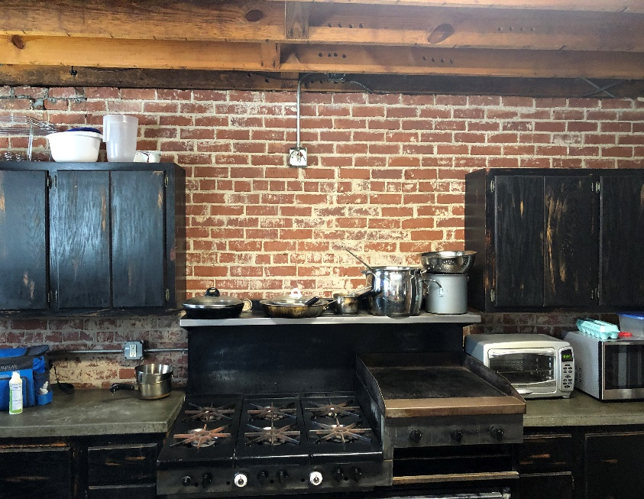
Fire Safety Hazards

Slide 28
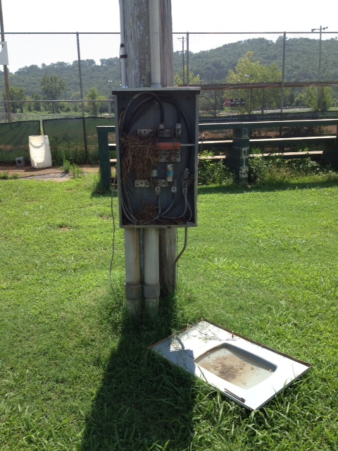
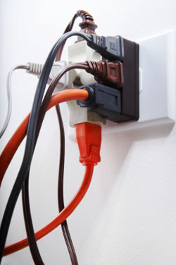
Electrical Safety Hazards

Slide 29
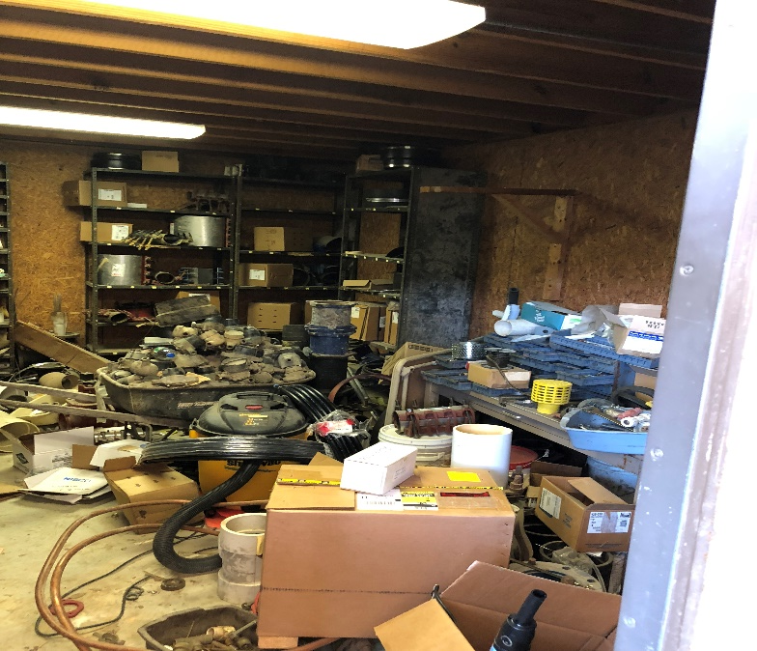
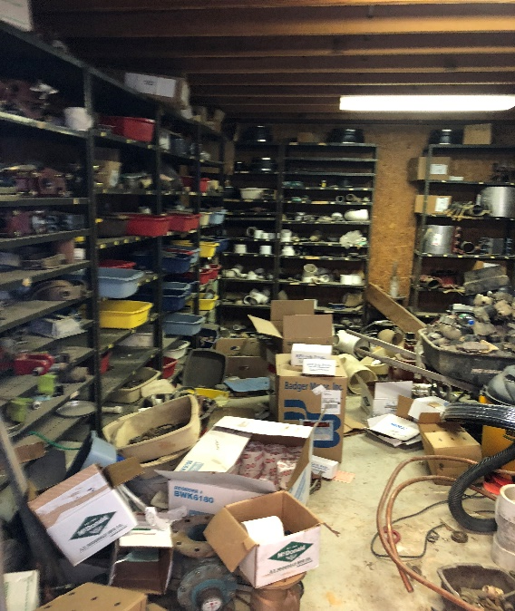
Storage Hazards

Slide 30
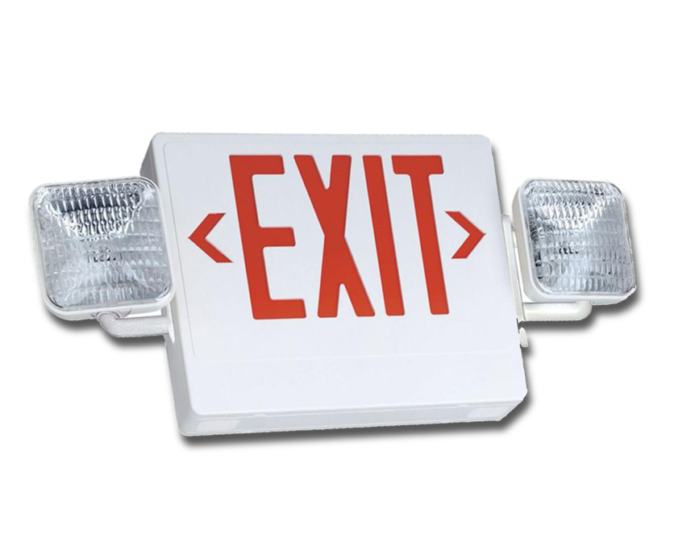
Emergency Safety Hazards

Slide 31
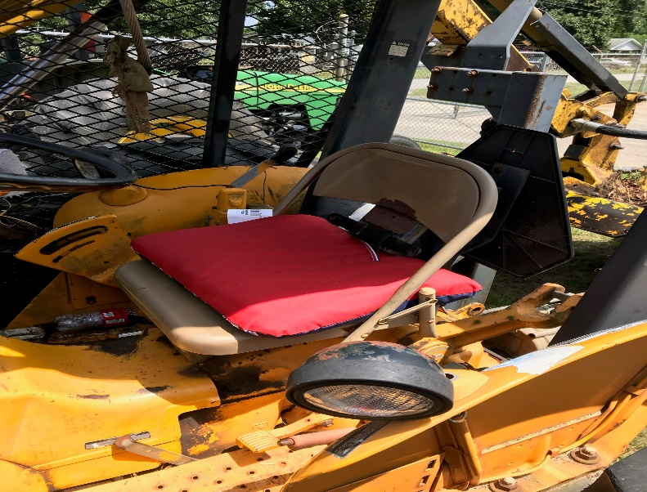
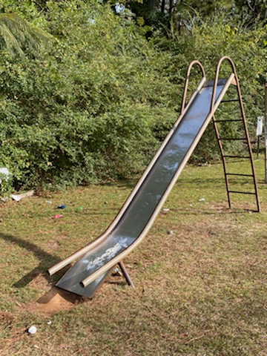
Equipment Hazards

Slide 32
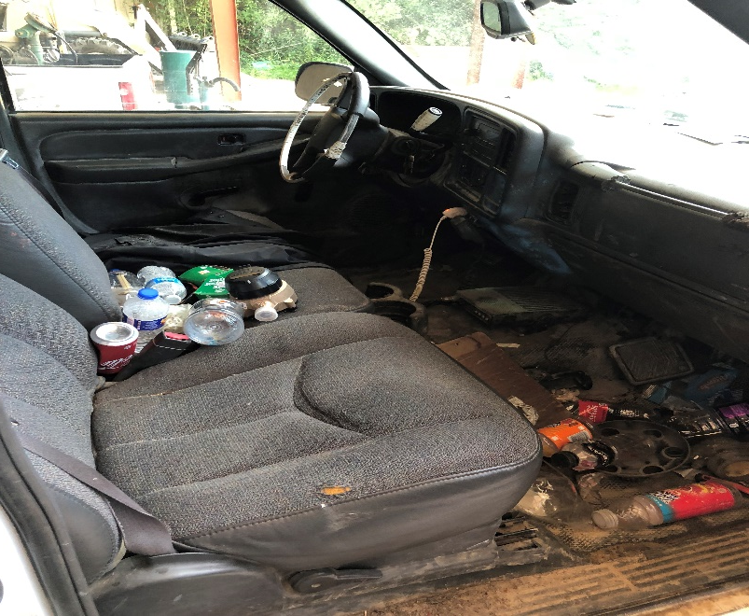
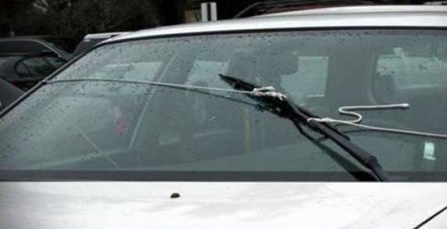
Vehicle Hazards

Slide 33

Self Inspections

Slide 34
Inspection guidelines
Focus is on Prevention
Team Concept
Follow up and Correct
Document
Notes:
Facility Safety Inspections — Monthly or periodic workplace safety inspections and documentation help monitor adherence to workplace safety programs. A member of the safety committee should lead the inspection. Department representatives should participate in the inspection of their departments. Focus inspections on physical hazards and unsafe acts or operations. Start with areas or operations that show up as causes of accidents/incidents in previous monthly safety inspections and in the quarterly loss analysis. Include fire hazards, security and other life-threatening areas. Correct any unsafe acts or conditions. Report the inspection results at the safety committee meeting. Create a to do list of the committee's recommendations and assign people to correct them.
(have as handout self inspection form) Possible group activity “inspect facility we are in”

Slide 35
Self inspections
Team Concept
Safety Committee
Department Self Inspections
Inspections Teams
Notes:
Create a to do list of the committee's recommendations and assign people to correct them. (SC I)

Slide 36
Types of inspections
Formal Inspections
Daily/Weekly Inspections
Special Function Inspections
Notes:
Formal Inspections are those that are scheduled in advance. They may include the Safety Officer and Safety Committee members.
Daily, all employees are required to conduct informal visual inspections of their work areas prior to beginning operations. Supervisors should continuously monitor work areas for developing hazards or unsafe practices.
Special function inspections are conducted after accidents and upon the introduction of new equipment or new procedures. They may be conducted by other regulatory agencies.
EX: When P&P added drug testing to it’s duties, did anyone check BBP procedures & requirements for exposure over carpeting & in cubicles? Did anybody conduct an assessment at each site to locate the best place for testing? Did anyone research types of kits with least “stick ratio”? Was a JSA developed to determine hazardous steps and what controls to use for elimination? (rubber gloves, retractable needles) Discuss with class

Slide 37
Inspection effect
Measures overall safety performance
Reinforces safety culture
Encourages accountability
Verifies employee’s participation
Notes:
Employees who observe supervisors and managers actively inspecting the work area will know it’s supported by management and that safety is important.
Everyone involved becomes safety conscious at work, home & in the community. Everybody Wins!

Slide 38
Inspection documentation
Written inspection report should include:
  Person & Date
  Building/Area Inspected
  Concerns Identified
  Corrective Action
Notes:
Written documentation should include these items:
Name of the person inspecting, identifying the hazards
Date the hazard was identified.
Areas/Buildings included in the inspection
Description and exact location of the hazard
Corrective action and the date hazard removed or repaired.

Slide 39
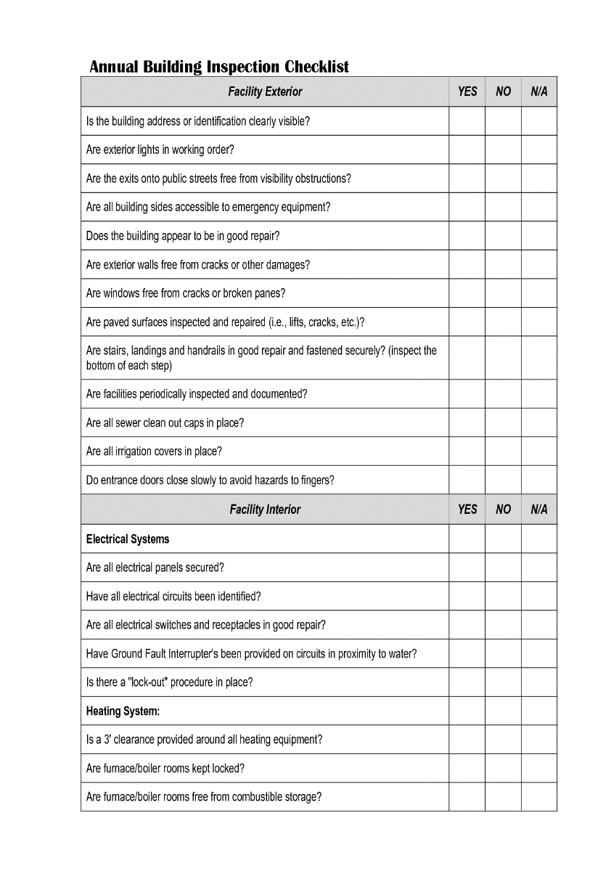
Inspection documentation
Checklist recommended
  Site-specific
    Revise as needed
Document your findings
Notes:
A checklist can be Departmental or Site specific. It’s best to take a basic form and tailor it to your site & needs. Site specific form is highly recommended over a departmental form. Specific form fits a specific building and would have no repetitive N/As.
All findings should be fully documented. It must also be documented when items recorded on the Hazard Control Log or Inspection Checklists have been corrected. The type of documentation that is used is not as important as ensuring it is done in a timely and thorough manner. Most common documentation: HCL, work orders, email to landlord, notebook

Slide 40
Other inspection items
Incident report logs that occurred after your last workplace safety inspection
Regulatory safety standards and laws relevant to the inspection
Previous inspection reports
Documented safety procedures
And other information you feel will benefit the inspection process

Slide 41

Self inspection

Slide 42

Vehicle inspection

Slide 43

Self Inspection Breakout

Slide 44
The next step
Correct unsafe conditions - An environmental or hazardous situation which caused the accident/incident independent of the employee(s)
Correct unsafe acts - An act by the injured person or another person (or both) which caused the accident/incident
Notes:
Unsafe conditions must be addressed within a reasonable time period. A follow-up inspection may be necessary.
Unsafe acts can normally be corrected immediately. Often, root-cause analyses reveal that unsafe acts are a result of incorrect training or lack of training. After a problem has been detected, management has the ultimate responsibility to take the necessary steps to correct it. Once a problem has been corrected, prudent steps should be taken to insure that it doesn’t return. Job safety observations may be used to ensure that proper job procedures are being used. These observations should be conducted immediately and intermittently.
When possible, line employees should be involved in the inspection process. In part because of their job/task knowledge, they are often able to develop safer, more efficient processes.
Always document corrective actions on the inspection form, HCL, work order….always document.

Slide 45
Follow up and correct
Send Recommendation from Safety Committee
Provide date for the department to respond
Have team members follow up to verify recommendations completed.

Slide 46
In review
Create a better understanding of operations.
Help us identify safety hazards.
Help us control unsafe acts and conditions.
Maintain a safe work environment.

Slide 47
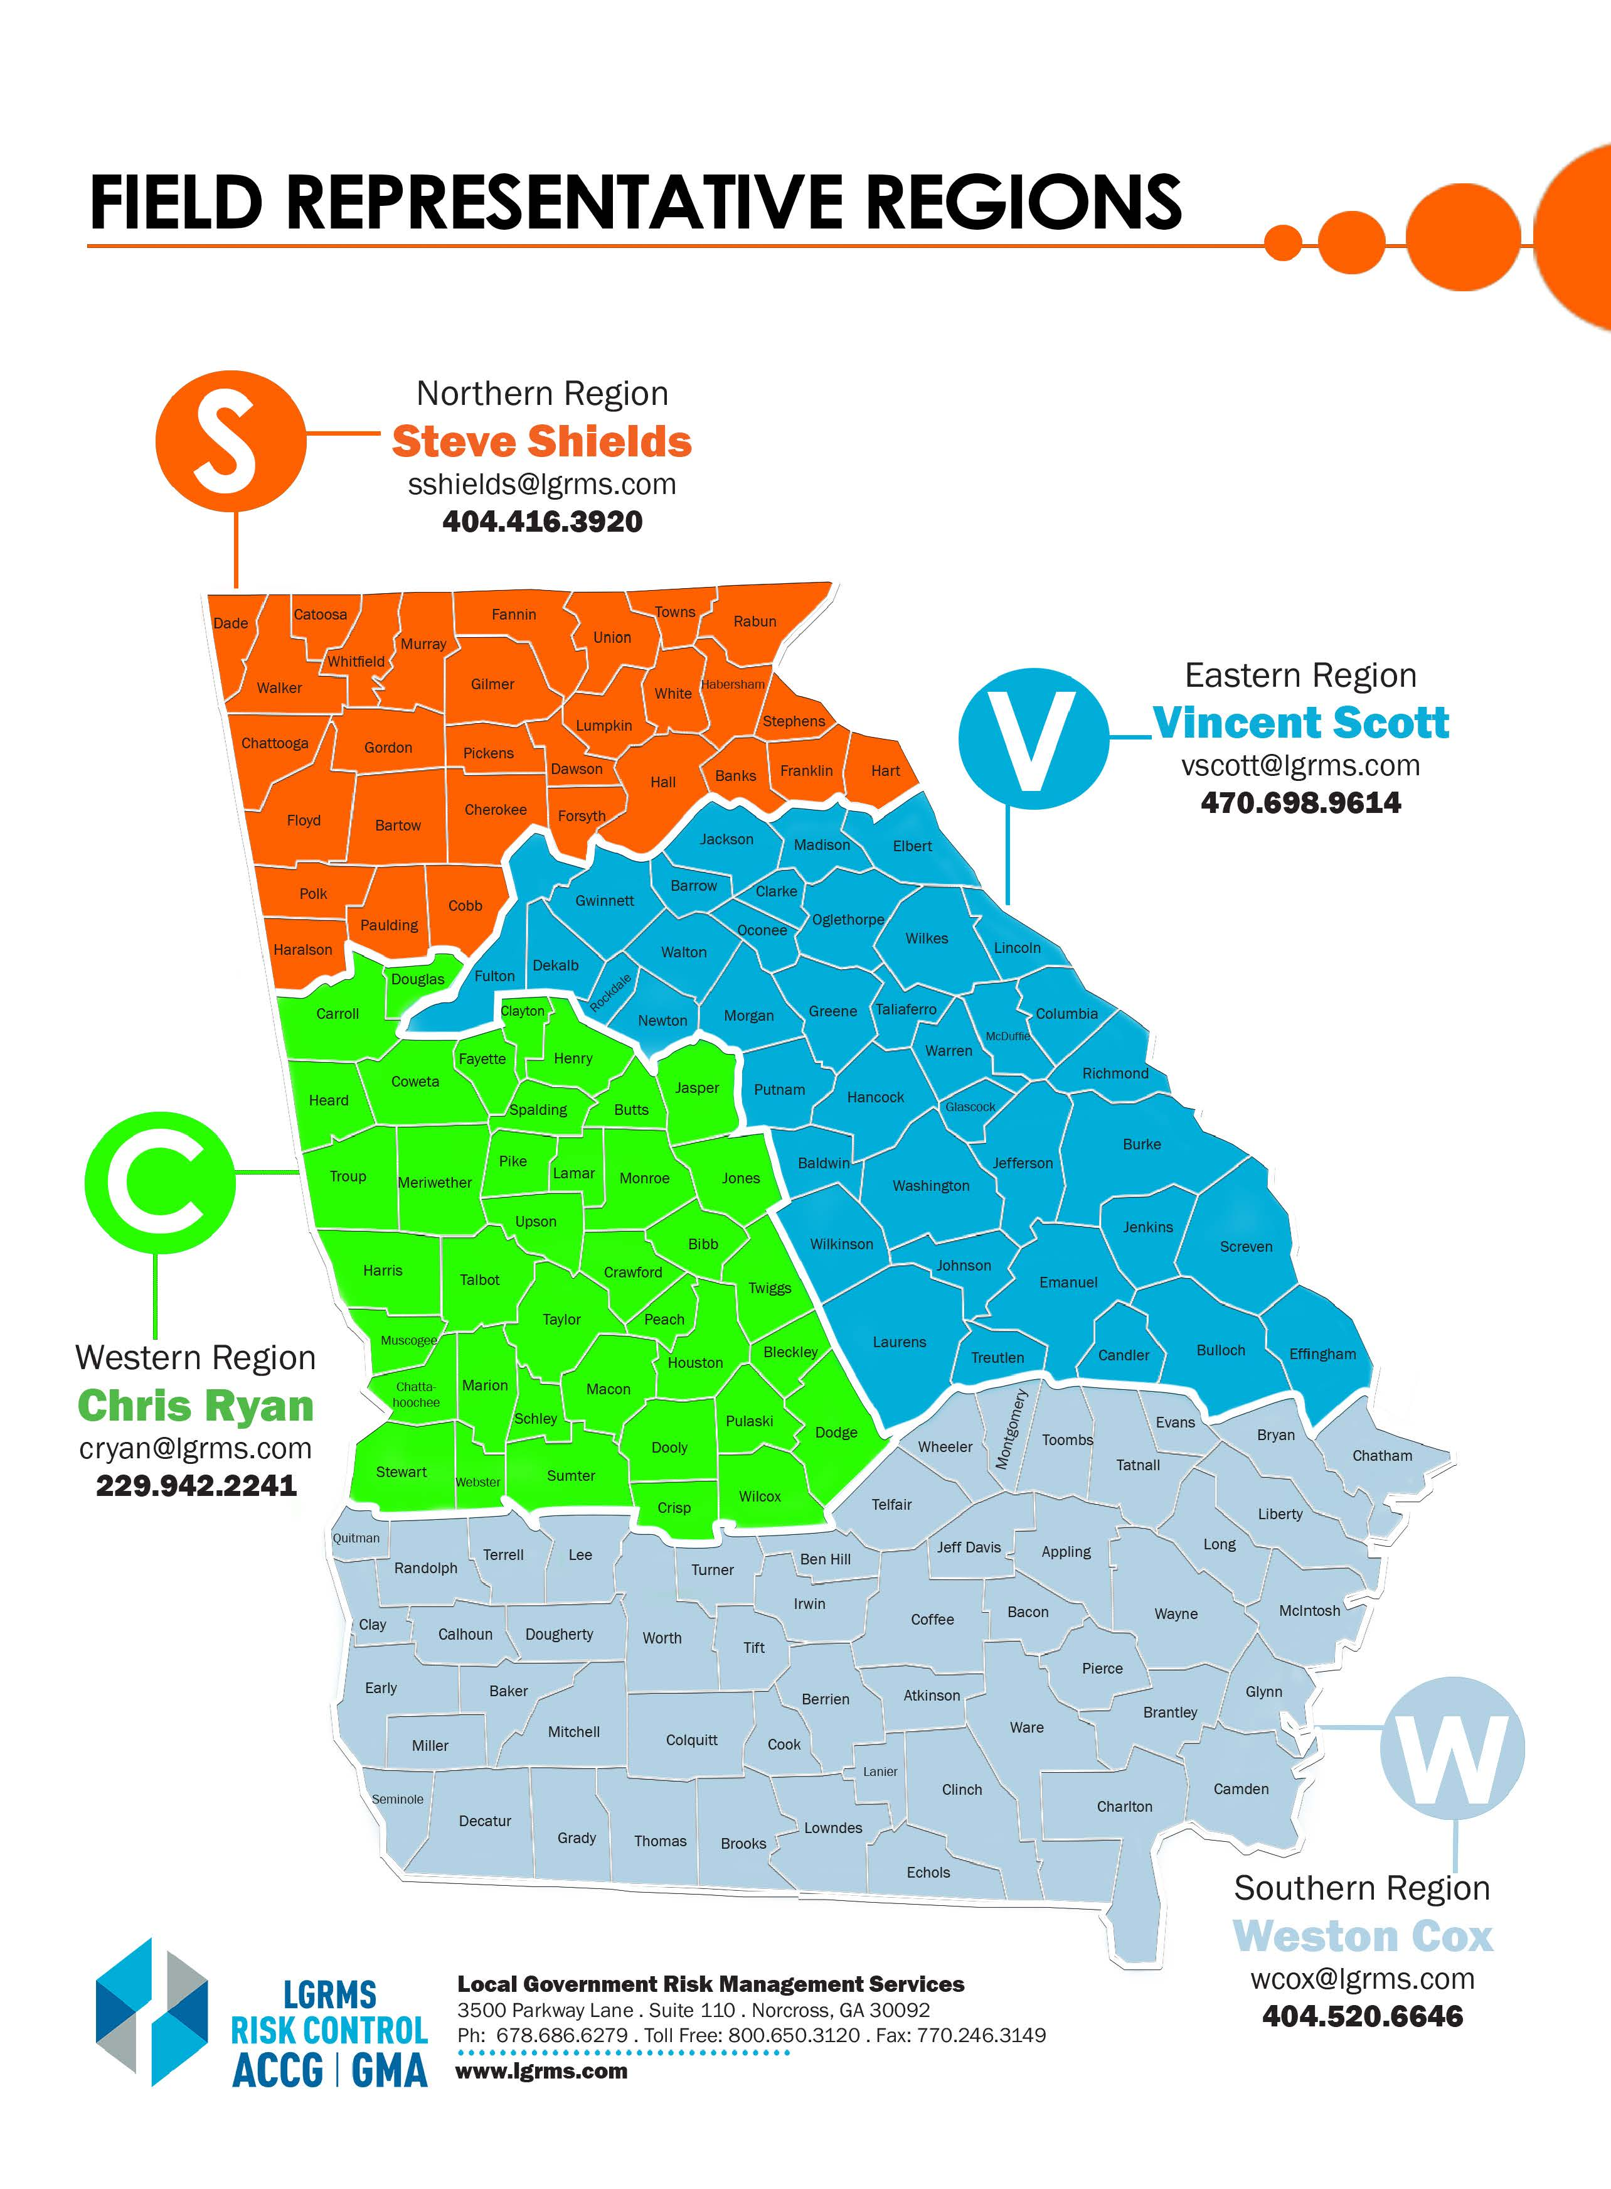
Risk Consultant Territory Map

Slide 48
What is to come?
Safety Coordinator III – Motor Vehicle Fleet Safety & Driver Safety

Slide 49
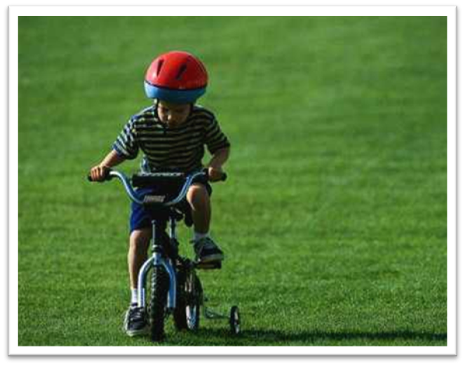
Contact us
Thank You for Your Attention
Please drive home safely…
Local Government Risk Management Services
800-650-3120
www.lgrms.com

Slide 50
Supplemental Documents
Safety Coordinator Inspection Program Form_050620.pdf
Department Safety Inspection.pdf
Vehicle Inspection Form.pdf

