Slide 1


Local government Safety Coordinator module iiI
Driver safety and fleet vehicle/Heavy Equipment safety
Notes:
Welcome Everyone, introduce GMA/ACCG employees, introduce LGRMS attendees, identify exits, restrooms, and discuss breaks, have each attendee introduce themselves, where they are from, and how long they have been with that entity.

Slide 2

Weston Cox
Risk Control consultant – southern region
Joined LGRMS as a Loss Control Consultant in August 2021.
BS in Business Administration and management
7 years experience in insurance/risk management industry
National Safety Council Instructor
wcox@lgrms.com
Notes:
Welcome Everyone, introduce GMA/ACCG employees, introduce LGRMS attendees, identify exits, restrooms, and discuss breaks, have each attendee introduce themselves, where they are from, and how long they have been with that entity.

Slide 3
Course Objectives
By the end of the session, participants will improve their knowledge and understanding of Driver Safety and Fleet Vehicles/Heavy Equipment Safety.

Slide 4
Local Government Safety Coordinator III
Section I- Driver Safety
Section II-Fleet Vehicles/Heavy Equipment Safety

Slide 5
Cost of Accidents
Vehicle accidents cost more than just the price of repairing the damaged vehicle:
Claims for damages to vehicles and property, injuries to motorists and passengers
Workers Compensation claims
General Liability claims
Damage to transported materials and equipment
Negligent Entrustment lawsuits and punitive damages
Notes:
Discuss an accident involves more than just repair invoice for the vehicle. Each motor vehicle accident will result in a minimum of 3 claims, one for the insured vehicle, one for the vehicle we struck, and one for the driver of the vehicle we struck. There will be additional claims for each passenger in the vehicle we struck. WC will be an additional claim for our employee, if injured. General Liability would be in the event we hit something before/after striking a vehicle (ie. Signs, buildings, pedestrians, etc.). Today’s legal environment is highly focused on suing insurance companies rather than individuals (ie. Who has the deepest pockets?)

Slide 6
THE LOSSES
Motor Vehicle Claims / Cost
ACCG & GMA Combined
2017 – 2356 Claims / $19,199,398
2018 – 2449 Claims / $25,052,408
2019 – 2295 Claims / $19,725,985
Notes:
Due to COVID 19 delay, claims are currently still open for the 2020, 2021 years.

Slide 7
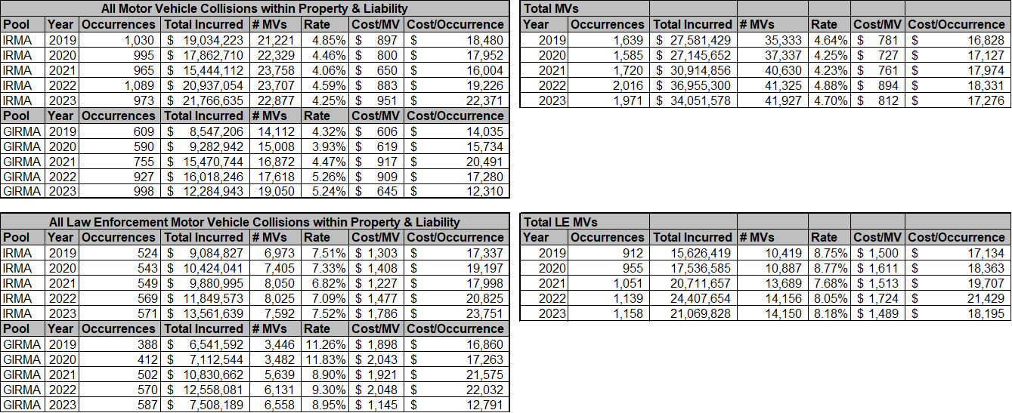
Notes:
One occurrence can result in multiple claims. Our vehicle, other insureds vehicles, proper damages to light poles, guard rails, median crossovers, buildings, liability damages to pedestrians, not to mention WC claims. LE is our main driver of MVA’s on the property/liability side.

Slide 8
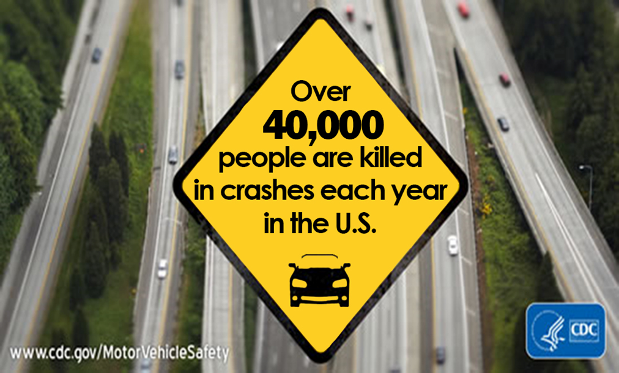
Nation-wide Statistics
Notes:
NSC states currently it is over 43,000 people. Population of Tift County, 40K+, as if everybody in Tift County died this year.
Something else to think about, 100 people die on the road each day. But its so common, we don’t discuss is as much. But think about it in a different perspective, if a plane crashed every day with 100 people on board, think about that impact. Now imagine those people are your loved ones, family, friends, children, spouses. It’s important to understand the severity of these statistics and the need for Driver safety.

Slide 9
National/State Statistics
https://www.cdc.gov/transportation-safety/about/index.html
file:///C:/Users/wcox/Downloads/cdc_118848_DS1%20(3).pdf
https://www.nhtsa.gov/press-releases/early-estimate-2021-traffic-fatalities
https://dph.georgia.gov/health-topics/injury-prevention-program/cdc-core/motor-vehicle-crashes

Slide 10
Group Discussion
Participants will discuss the scenarios and provide corrective action to help eliminate these accidents.
Notes:
The group discussion is for each table to discuss the scenarios. I will give you 5 minutes to discuss the corrective actions amongst yourselves.

Slide 11
Scenario 1
A 45-year-old employee was driving the service truck to a jobsite. He took a short cut through an old wood-yard where railcars were still parked. He was crossing a set of double tracks; a box car was parked by the crossing on the track closest to him. He apparently could not see around the parked box car and started to cross the tracks. A train was coming on the other side of the parked box car which hit the rear end of the service truck spinning it around. The employee was thrown from the cab (out the door window), who then struck the ground and was fatally injured. The service truck was repaired and placed back in service within a couple of weeks. The employee left behind a wife and three children.
Notes:
Corrective Action #1 – Employee was not buckled in, as he was thrown from the cab upon impact.
Corrective Action #2 – Why was the employee cutting across the yard? To take a short cut. They should not be taking a route that does not have clear visibility.
Corrective Action #3 – When crossing train tracks (or multiple tracks), you should always have a clear line of site in each direction, a train can be traveling from either side.
Results – He left a wife and three kids in a collision that resulted in limited damage to the vehicle (it was repaired and put back into service)

Slide 12
Scenario 2
A 21-year-old newly hired employee is driving a local government vehicle to a training class. It is 9am on a bright sunny fall morning. Evidence suggested that she drove off onto the shoulder, she overcompensated by jerking the wheel back to the left which had her going into oncoming traffic’s lane, and then she jerked back to the right and went into a skid. This resulted in her leaving the roadway hitting four fence posts, a boulder, and rolling up the side of a tree. She was ejected from the vehicle and was seriously injured.
Notes:
Discussion Point #1 – What is the Experience Level of the driver?
Discussion Point #2 - Type of Vehicle driven?
Corrective Action #1 – Know the experience level of the employee, including type of vehicles they have previously operated
Corrective Action #2 – Internal driver training, Overcorrection/Overcompensation of the wheel should be part of this discussion.
Discuss real life example – seat belt usage, etc.
Corrective Action #3 – Mandatory Use-Strictly enforced use of Seat belts

Slide 13
Scenario 3
A 53-year-old department head was driving west in a sedan on a Wednesday morning at 9:45am into the rising sun. There were no clouds in the sky, and it was a very bright day. Trees had grown over the roadway which projected shade, he was in and out of the shade continuously. He had gone through a heavily shaded area and entered the bright sun again. When his eyes focused, he saw a contractor’s truck pulling a backhoe enter his path from the right. He applied his brakes but hit the trailer and spun into the oncoming traffic's lane. He had his seat belt on and received minor injuries, however the vehicle was a total loss.
Notes:
Corrective Action #1 – Driver was driving too fast for conditions. Sunlight, shade, eye adjustment, etc.
Discuss potential hazards in the area of the class. Smoke, fog, etc.

Slide 14
Cause of Vehicle Accidents
Human Choices
Improper Speed
Following to close
Distracted Driving
Improper Turns
Driving Left of Center
Right of Way Violations
Notes:
DDC Top 6 Deadly Choices

Slide 15
Cause of Vehicle Accidents
Other Reasons
  Vehicle Maintenance
  Improper Vehicle Selection
  Other Drivers
  Road Conditions
  Weather Conditions
  Animals
  Pedestrians / Bikes / Golf Carts
Notes:
We should have Automotive Service Excellence (ASE) certified mechanics working on our vehicles. This is one of the first items a plaintiff’s attorney will look at.
This can be like pulling a skid steer with a ford ranger pickup. Need to use the appropriate vehicle to perform the job task.
We cannot control what other people do on the roadway.
Road conditions vary widely. From asphalt, concrete, tar and gravel, gravel, sand, and dirt. Shoulders/no shoulders. Ditches, ravines, and then discuss the condition of the types of roads. Potholes, washout areas, dips/scrapes etc.
Sunlight – sunglasses/visors, Nighttime- no sunglasses, snow/ice, rain, fog, high winds, flooding etc.
Domesticated and non-domesticated – dogs, cats, goats, cows etc.
Other road users

Slide 16
Break - 15 mins

Slide 17
Driver Evaluation and designation
The MVR’s (Motor Vehicle Record)
Pre-tests / special equipment
CDL Considerations
Notes:
We should be running an MVR on all prospective employees prior to allowing them to drive our vehicles, annual MVR’s on all employees who drive or have the potential to drive our vehicles, we have provided you with two documents - Guidelines for MVR Evaluation and MVR criteria for coverage.
When we are hiring an employee to operate special equipment/vehicles, we should require them to demonstrate working knowledge of the equipment.
Determine if CDL licenses or special credentials are required. 26001 lbs are required for CDL’s.

Slide 18
Employer actions
Conduct driver’s license background checks on prospective drivers before they are hired.
Establish a written policy requiring drivers and passengers to use seat belts .
Train drivers in safe driving practices and proper use of vehicles safety features.
Maintain all vehicle safety systems with written documentation.
Notes:
You received sample seatbelt policies in SC1. Make sure training is performance-based and periodically repeated.

Slide 19
Policies and procedures for drivers
Vehicle Polices and Procedures
Seat belt usage program – vehicles and equipment
Vehicle take home policy
Reporting of accidents
Training
Notes:
We have provided you with a sample Vehicle Use Policy. We also have provided you with Sample Seatbelt policies. Best practice for vehicle take home policy- have a set radius and established approved locations to park the take home vehicles.
You should establish a policy where accidents are reported immediately and the documentation that should be obtained at the scene of the accident. IE. Photos, other party information, witness statements.

Slide 20
implementation
Enforce – Policy And Discipline
Educate – Lead by example and training
Document – At fault accidents
Notes:
Ask tables: What type of policies do you have? Disciplinary policy? Is it followed? Is it progressive?
DDC training? Safety videos?
Are there repercussions for at fault accidents? Do you have a review committee that will assist in determining the at-fault accidents?

Slide 21
Driver Training resources
Emphasize Defensive Driving
Train on Defensive Driving
  LGRMS Training
  Safety National DDC
  PSRC Training (Emergency Services)

Slide 22
Safety National Demo
https://train.onqsafety.com/sn

Slide 23
Observe and report
Observe our employee’s driving habits and document findings
Implement corrective action
Provide Positive Recognition
Notes:
If we don’t document, it didn’t happen.
Positive recognition can come in different forms. IE. Certificates, awards, hats, jackets, monetary etc.

Slide 24
Always Remember…
There’s a lot of eyes watching
Choose drivers carefully
Give thorough direction and guidance
Practice and teach safe driving tactics
Notes:
Everyone has a cell phone and are willing to take photos/videos of us doing things we shouldn’t be.

Slide 25
Motor Vehicle Fleet Safety
Vehicle Inspections
Operations Policy
Equipment and Fleet Maintenance
Emergency Equipment
Load Securing
Vehicle Replacement Recommendation
Notes:
These are the items that we will be covering in this section.

Slide 26
Motor Vehicle & Equipment Inspections
Checklist
Documented
Operations Policy
Notes:
Recommended daily vehicle inspections. Documentation is key, without it no validity.

Slide 27
Operations Policy
Safe Operation Defects found
Reporting Procedures
Unsafe vehicles/equipment should not be driven
Documented repairs made by Fleet Services provider
Notes:
Do’s and Don’t on how to operate city/county vehicles. Seatbelts, blinkers, lights, how to report an accident, report immediately, repairs before vehicle is back in use.

Slide 28
Vehicle Replacement
Recommended Replacement
  Police Patrol Units – 100,000 miles
  Sheriff’s Office Road Patrol Units – 150,000 miles
  General Administration - 150,000 miles
  Ambulances – 150,000 miles
  Fire Trucks – years of service – (every 25 years) – parts become outdated or obsolete
Notes:
Tell story of county with fire truck purchased from Texas, travelling home, tires – 2000 model truck only 12,000 miles

Slide 29
Equipment and Fleet Maintenance
Certified Mechanics
Preventative maintenance
Pre-Shift Inspections
Record Keeping
Shop Operations
Notes:
ASE Certified Mechanic on staff, should sign off on all repairs to vehicles.
Documented preventative maintenance
Review checklist of items to review before each shift, job, or at minimum on a daily basis
Record keeping can be used to demonstrate/initiate the replacement of a vehicle or equipment.
Appearance does play a part, shop needs to be organized and free from hazards.

Slide 30
Review external vehicle photos

Slide 31
Break
Everybody take a 15-minute break!

Slide 32
Emergency Equipment
Fire Extinguishers
First Aid Kit (per supervisors / crew)
Breakdown triangles / cones (large trucks / equipment)
Placards / Signage
Notes:
Fire extinguishers serviced on an annual basis, readily accessible in the event of a fire.
First aid kits should be full stocked, not out of date.
Triangles/cones should be placed around equipment/vehicles in the event a breakdown occurs.
Placards/signs to tell vehicles how far to stay back, what is being transported etc.

Slide 33

Sample Placard
Notes:
Share story about Ware County

Slide 34
Load Securing
Properly secured loads
  Vehicle Structure – Floors / Walls / Decks tie point points
  Securing devices – Chains / Webbing / Ropes / Clamps etc.
  Blocking and Bracing Equipment – Chocks and Cradle Points
Notes:
4 points of securement when transporting equipment
Securing devices should be in good condition, no broken links, no rips/tears in straps/ropes, etc. Golden rule for DOT tiedown req. – the sum of all tiedowns must be at least 50% of the weight of the piece of equipment example: 5000 lbs on eq.
Bocking an bracing should be used to keep equipment/materials from shifting

Slide 35
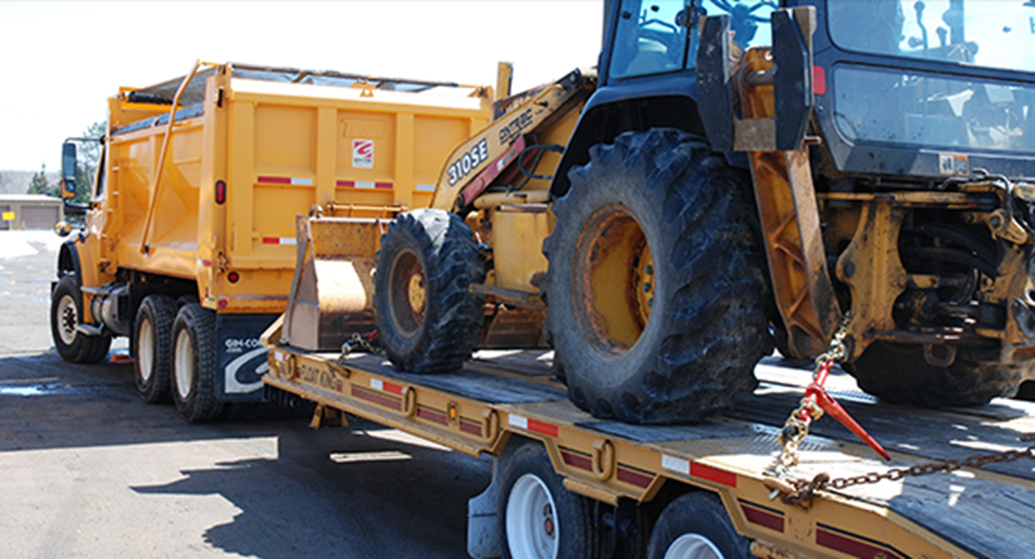
Load Securing

Slide 36
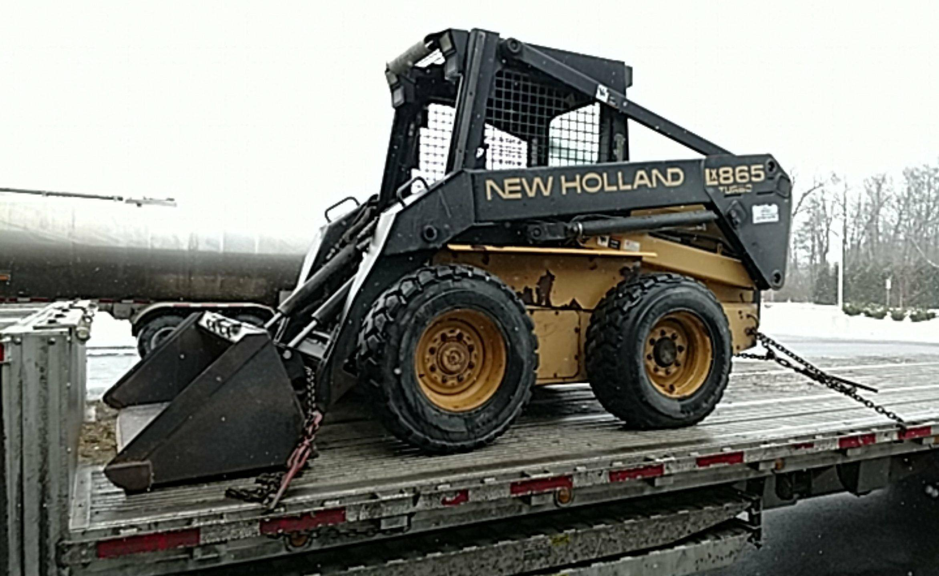
Load Securing

Slide 37
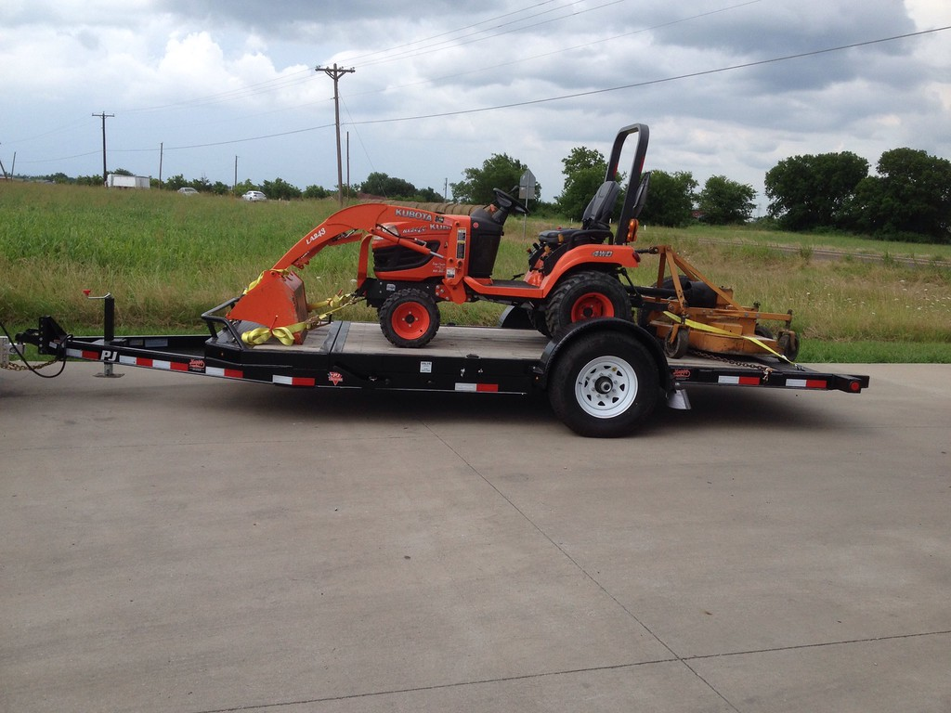
Load Securing

Slide 38
Common securement issues
Improper Weight Distribution
Exceeded Weight Limit
Improperly Secured Cargo
Notes:
Level pulling trailer
Exceeded weight limits – what the vehicle is rated to haul, or a full load on the vehicle? Strain on vehicles, trailers, tires, axles etc.
We have had claims where items have shifted, fell off, and/or fell on employees causing serious injuries/fatalities.

Slide 39
Mounting and dismounting equipment
Maintain three points of contact upon entrance
Do not carry multiple items up into cab
Do not jump off of equipment
For Sanitation employees, do not allow riding on steps
Do not stand directly in front of, behind, or between equipment
Notes:
Three points of contact minimum are a must when entering a machine. 2 hands and a foot, 2 feet and a hand.
Do not try to carry items in your hands or on your body, load them from ground level or ask for assistance
Do not jump, exit the machine the same way you entered with three points of contact. Emphasize ergonomics claims issues.
If possible, do not allow employees to ride on steps of sanitation trucks. If absolutely necessary, have speed limit policy in place.
Never stand in between implements of equipment. If directly in front of or behind equipment, confirm driver is aware by communicating via hand signals, vocally, by mobile devices or by radio

Slide 40
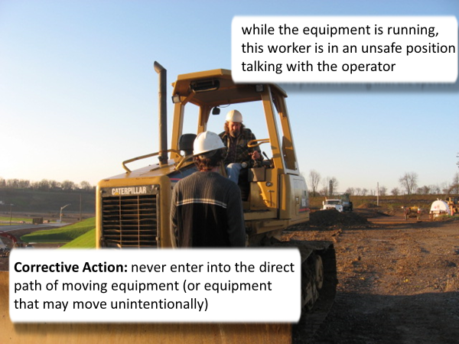
Notes:
This particular employee is standing between the implement and the equipment. Never stand in this area. Always communicate with the operator from a safe location several feet from the equipment.

Slide 41
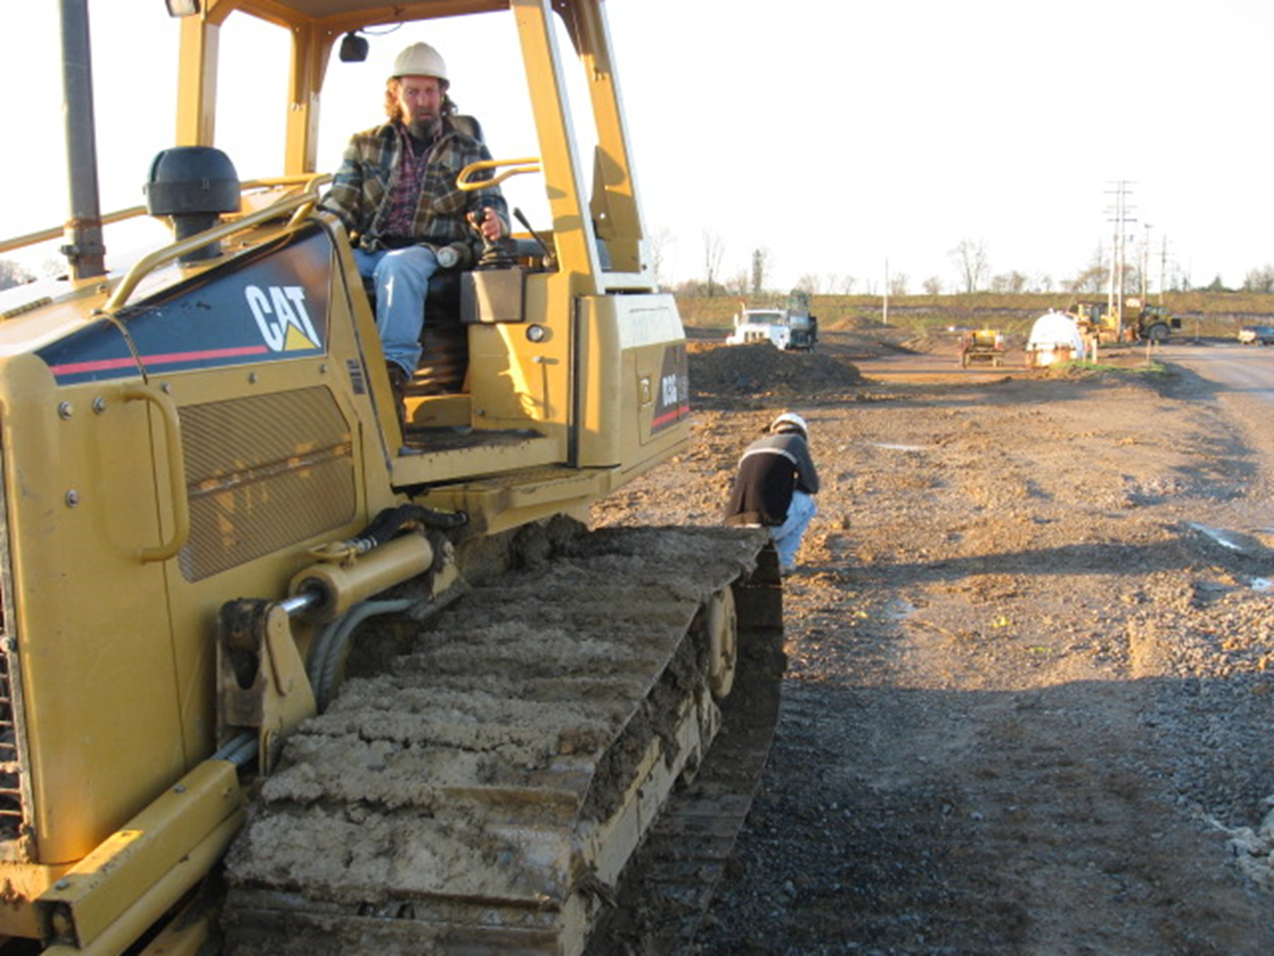
Notes:
This photo shows an employee bent down inspecting an area of land directly behind a piece of machinery. The operator of the equipment has his back towards him. This should never be an action taken by an employee, he should stay in clear view of the operator at all times.

Slide 42
Driver qualifications and training
Only drivers who are qualified physically, mentally, and by training and experience should operate it.
Management must determine the knowledge, experience, and abilities of a driver before he/she is allowed to work.
Supervisor or Senior Operator will demonstrate how to operate the equipment safely before first task/job is assigned.
Time required to become acquainted with the equipment, safety rules, driver reports, and emergency conditions will vary.

Slide 43
Ergonomics and posture
Inspect condition of seats regularly
Take frequent breaks when possible.
Adjust seat before work begins
Rotate employees at job site if the job requires extensive amount of time
Notes:
Make sure seat cushions and upholstery are in good shape. This goes for vehicles and equipment.
If it’s a one-man job, take frequent breaks every hour or two. Long term over-stimulation will create long-term issues. (Back problems, arthritis, carpel tunnel etc.)
Adjust the seat, torso, and headrest before work begins
If multiple workers are on one job that’s ongoing, rotate drivers out every couple of hours to keep from excessive wear on body

Slide 44
Where can you find help?
Risk Control Field Representative
Public Safety Risk Control Field Representative
Insurance Pools
LGRMS Webinars
Notes:
Review webinars externally, lots of information provided by GMA/ACCG attorneys

Slide 45
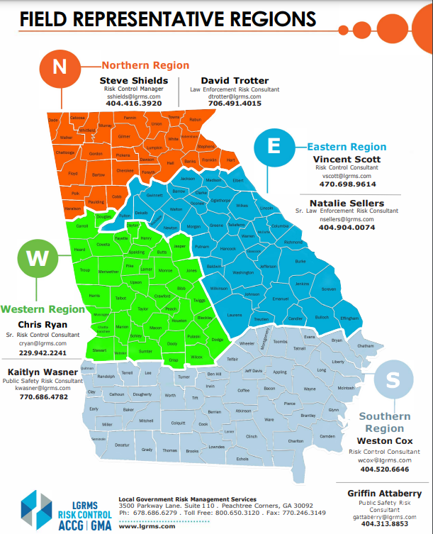
Risk consultant territory map
Notes:
Explain 2 reps for the simulators, 2 reps for the law enforcement risk training classes. Explain LE is heavily targeted audience for loss control efforts.

Slide 46
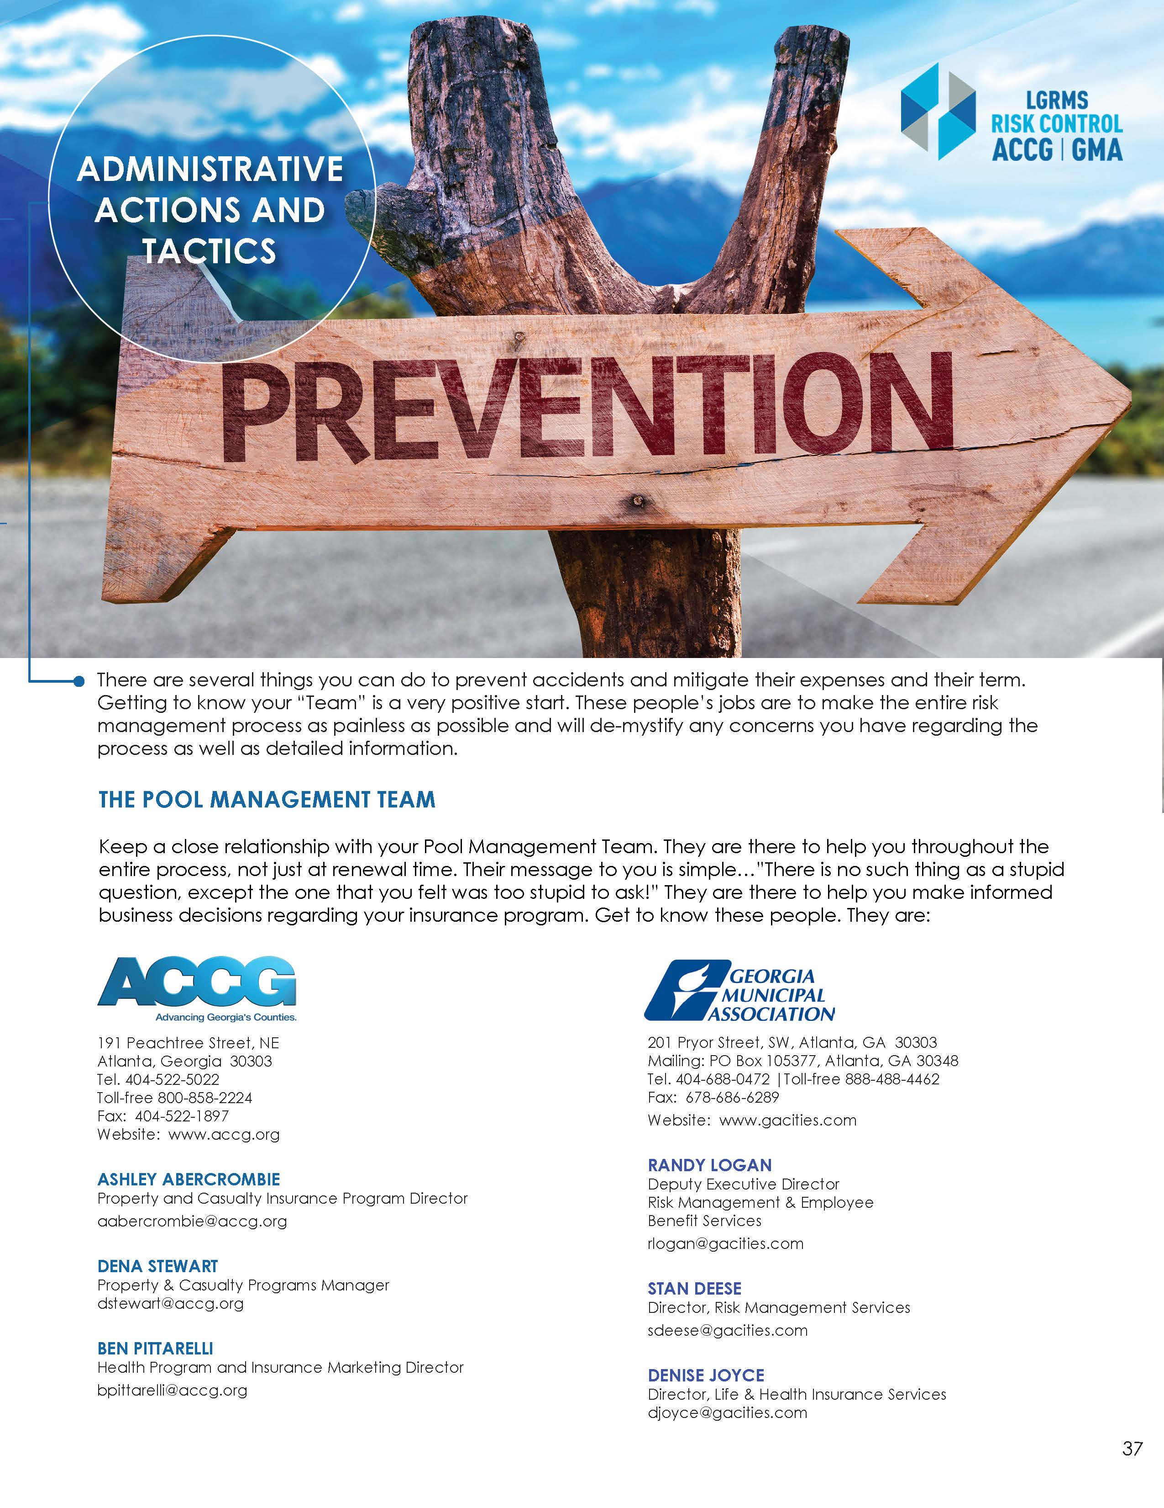
Pool management Contact Lists

Slide 47
Pool management claims Contact Lists
https://www.accg.org/insurance/gsiwcclaim.php
https://gacities.com/Service-Forms.aspx
GMA WC – Jan Hoard
GMA L&H –Denise Joyce
GMA GIRMA –Stan Deese
ACCG WC – Cheryl Hill
ACCG IRMA – Melanie Graham

Slide 48
What is to come?
Safety Coordinator 4 – Accident Investigations, Loss Analysis Reports, and Safety Action Plans

Slide 49


Thank you and drive back safely!
Thank You
Please drive home safely…
Local Government Risk Management Services
800-650-3120
www.lgrms.com
This Photo by Unknown Author is licensed under CC BY-NC
Notes:
Lunch will be served around 11:30-11:45am, next class will start at 1pm

