Slide 1

GAFC Executive Training Session:
Cancer Benefit Program Presentation
March 29, 2022

Slide 2
Discussion Topics
Overview of the Georgia law
Timeline for program administration
GFSTC Audit - Evidence of coverage
Build awareness of risk and coverage
Preventing cancer
How to file a claim
How to continue coverage

Slide 3
Overview of Law Requiring Cancer Coverage
Why?
  Help bridge the financial gaps firefighters encounter following a diagnosis of cancer
What?
  O.C.G.A. § 25-3-23 requires all legally organized fire departments to provide and maintain specific cancer coverage for anyone meeting the definition of “firefighter”
  Provides coverage for both Critical Illness (Lump Sum) and Disability (Income Replacement)
    Critical illness component requires payment of lump sum benefit of either $6,250 or $25,000 depending on the severity of the cancer
    Disability component requires a benefit equal to 60% of a firefighter’s total salary or $5,000 per month (whichever is less)
Who is eligible?
  All members of the fire department who meet the definition of “firefighter” as defined in O.C.G.A. § 25-4-2
  Diagnosis of an eligible cancer must be on or after January 1, 2018

Slide 4
Timeline for Program Administration
November 1st: Request for updated census sent
November 15th: Due date for updates
December 1st: Quote, Invoice (1st half of the year), Summary of Benefits sent
January 1st: New Policy Period commences
May 15th: Voluntary Request for census updates sent
June 1st: Due date for voluntary updates
June 15th: Invoice (2nd half of the year) sent

Slide 5
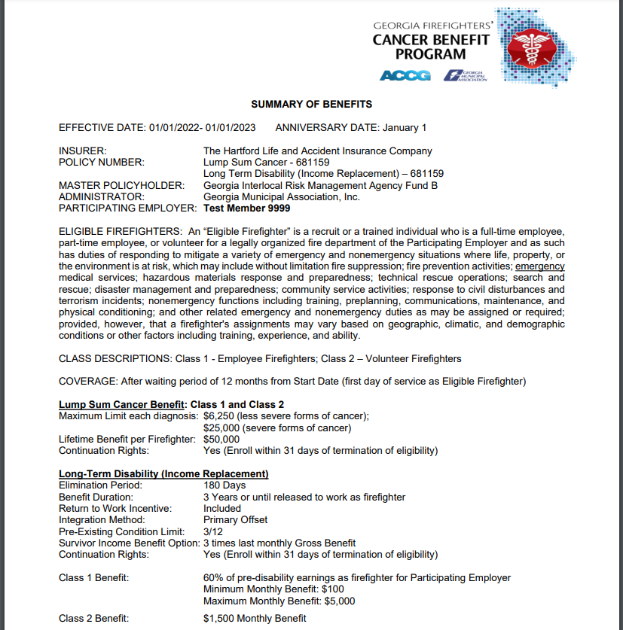
GFSTC Audit – Evidence of Coverage
Provide a copy of the Summary of Benefits for the GFSTC Audit
This is sent via email to the contacts in December each year.

Slide 6
Make Firefighters Aware of Risk & Coverage
Current and future firefighters
Lead department in efforts to prevent cancer
Share the city’s/county’s Statement of Benefits Form
Ask for a completed Firefighters Acknowledgments Form
  Example found on www.gfcpinsurance.com
Place posters and flyers in common areas
If firefighter contracts cancer, share available resources

Slide 7
Reduce the Risk of Cancer
Policy, practices and protective gear & equipment
Resources - see www.gfcpinsurance.com
  Firefighter Cancer Support Network (www.firefightercancersupport.org)
  Local Government Risk Management Services (www.lgrms.com)
    2022 Incentive Program: “Taking Action Against Firefighter Cancers”
    Regional Training:
    May 31 Tifton June 9 Gainesville
    June 2 Statesboro June 14 Macon
    June 7 Cartersville
  Cancer Treatment Centers of America
  40 Plus Fire and others!

Slide 8
How to file a Claim
Visit our website: www.gfcpinsurance.com
Click on “Claims Service”
Select ACCG (Counties) or GMA (Cities)
Choose applicable claim form

Slide 9
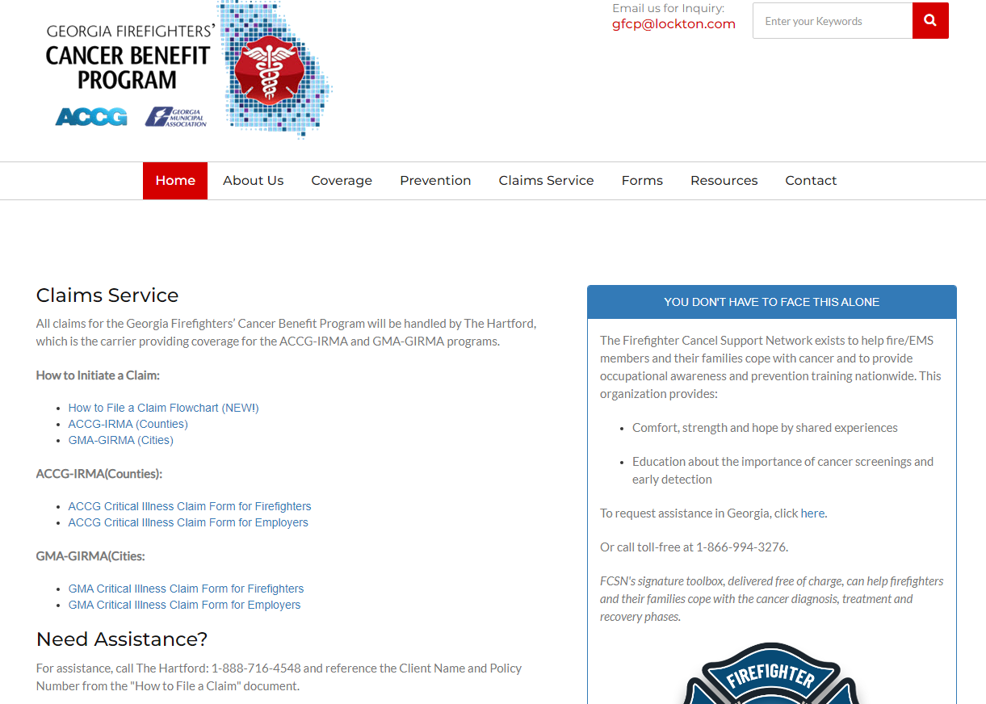
How to file a Claim

Slide 10
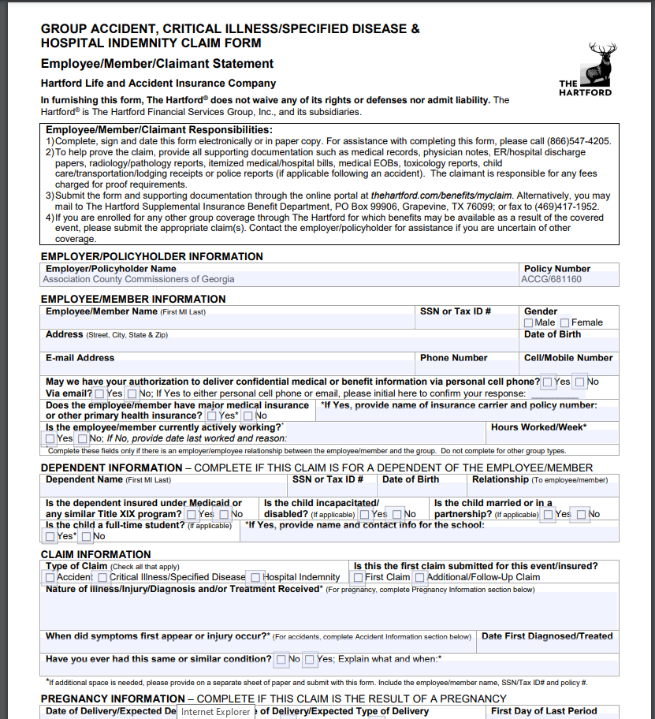
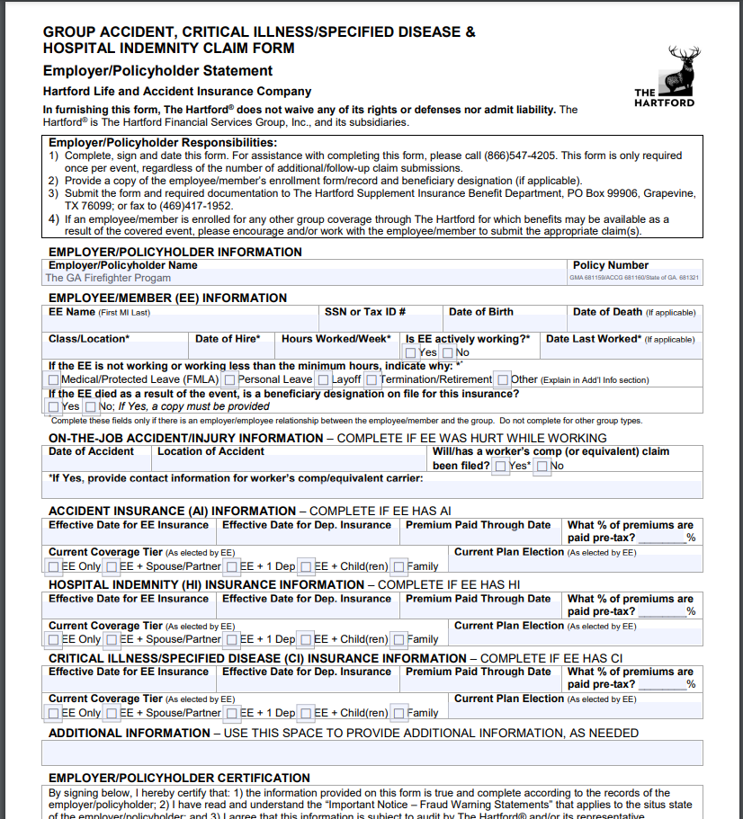
How to file a Claim
Option for Employee to complete the form
Option for Employer to complete the form

Slide 11
How to Continue Coverage
Visit our website: www.gfcpinsurance.com
Click on “Forms”
Select ACCG (Counties) or GMA (Cities)
Choose applicable claim form
Reminder: Please include the Continuation Form in the separation paperwork for your firefighters. They can continue the coverage at the same discounted rate the cities/counties are paying.

Slide 12
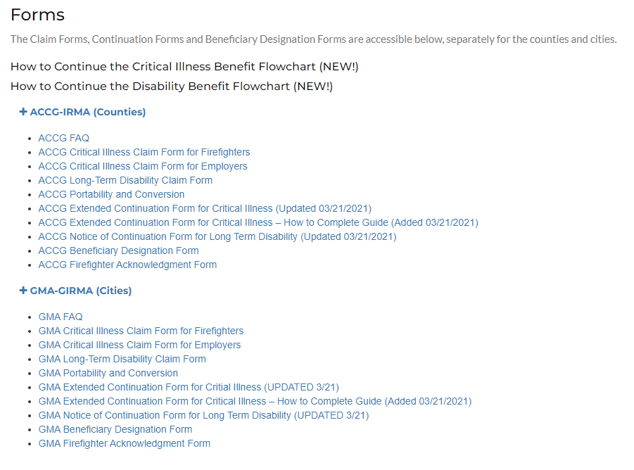
How to Continue Coverage

Slide 13
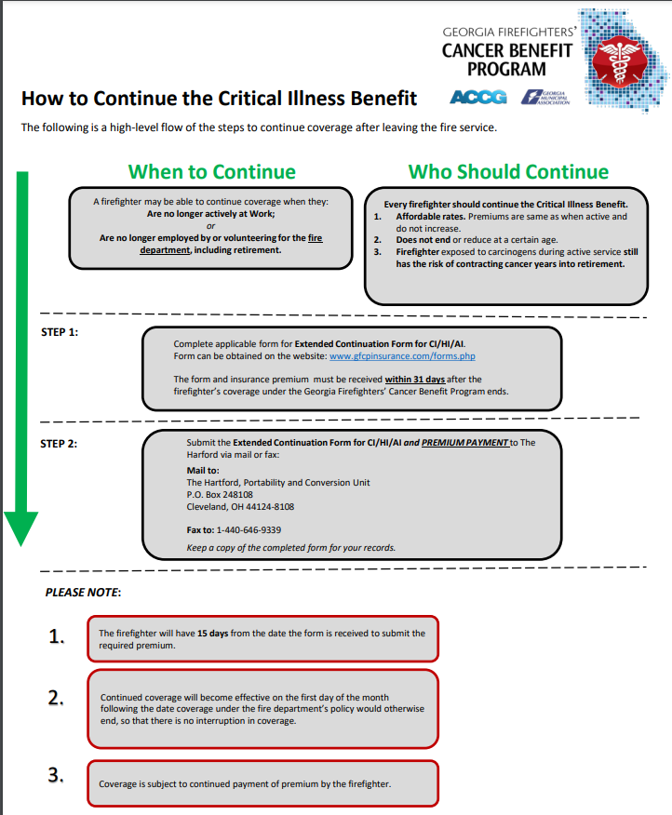
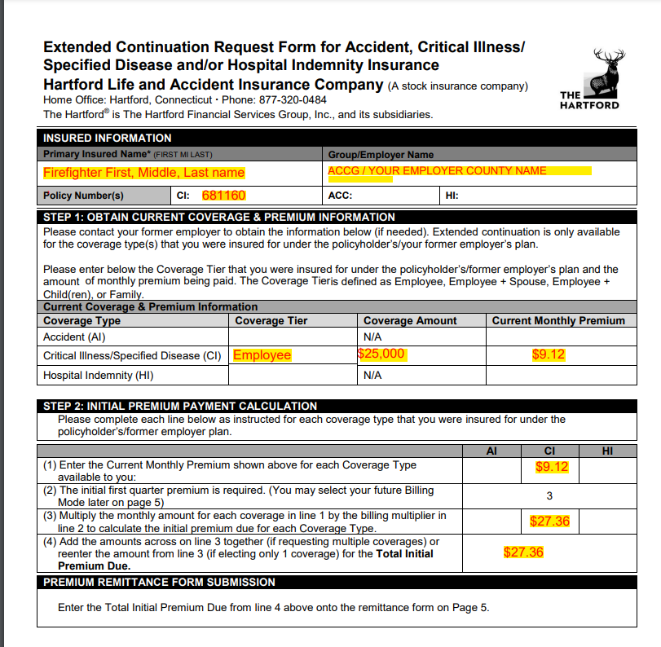
How to Continue Coverage

Slide 14
Questions?
Thank you for all you do to
protect our communities!

