Slide 1
DRAFTING 2021 INTO THE NEW YEAR!
2021 HEALTH PROMOTION
Workshop
OCTOBER 2021
9:00 AM-12:00 PM

Slide 2
Welcome Health Promotion Champions and Congratulations! The Grand Event Continues…
2021 HEALTH PROMOTION
Workshop
Notes:
Congratulations! The Grand Event (the Race for Resiliency) continues by drafting 2021 into the New Year!
Drafting: The practice of two or more cars, while racing, to run nose-to-tail, almost touching. The lead car, by displacing the air in front of it, creates a vacuum between its rear end and the nose of the following car, actually pulling the second car along with it. (NASCAR)
Drafting 2021 into the New Year = Pulling 2021 into the New Grant Year

Slide 3
CAR OF TOMORROW: Wellbeing Programs in Challenging Times
2021 HEALTH PROMOTION
2021 HEALTH PROMOTION
WORKSHOP
WORKSHOP
Drafting 2021 into the New Year starts with the “Car of Tomorrow”
Car of Tomorrow = Wellbeing programs designed to be effective in all kinds of times
Rethinking wellbeing to engage employees through challenging times
Adapting to today’s ever-changing environment
Renewing the focus on physical and emotional health
Reinforcing a culture of supporting employees in fulfilling their needs
Notes:
Pulling 2021 into the New Grant Year starts with the Car of Tomorrow
NASCAR's Car of Tomorrow -- a race car designed to be competitive on all NASCAR tracks
Health Promotion Champions Car of Tomorrow = Wellbeing Programs designed to be effective in all kinds of times
Rethinking wellbeing to engage employees through challenging times
As we continue to adapt to today’s ever-changing environment, it is important to consider the impact on workplace wellbeing. In these uncertain times, engaging employees in their health and wellbeing remains a high priority for organizations nationwide, but existing programs may need to be examined to ensure they meet changing needs.
Renew the focus on wellbeing As employees navigate this challenging time, it is an important opportunity to emphasize the value of wellbeing and self-care. Employees may be more receptive as they look for outlets to unwind and relieve stress, and as Health Promotion Champions, you are uniquely positioned to encourage employees to focus on their physical and emotional health right now. Reinforcing a culture of supporting employees in fulfilling their needs (wellbeing, self-care), even from a distance, can have a positive impact, in addition to offering valuable resources and tools to support this effort.

Slide 4
IN THE COCKPIT: Your Role as Local Government
2021 HEALTH PROMOTION
2021 HEALTH PROMOTION
WORKSHOP
WORKSHOP
As the Health Promotion Champion, you are responsible for driving forward your workplace wellbeing program
You are the primary link between your local government and LGRMS
Health Promotion Champion maneuvers for the race:
Leadership that provides for each employee’s diverse interests and needs
A workplace that encourages positive, healthy lifestyle choices
An environment where every employee can perform at their best level
Notes:
As the Health Promotion Champion of your workplace wellbeing program, there are certain maneuvers to help keep everyone in the race.

Slide 5
IN THE COCKPIT: Featuring Your Pit Crew and Manual
2021 HEALTH PROMOTION
WORKSHOP
Your Pit Crew: LGRMS Health Promotion Services (HPS)
Our Mission:
Proactively create opportunities for ACCG and GMA Life and Health Insurance Program members to enhance their health and productivity through leadership and the delivery of innovative health promotion services
We are committed to:
Helping you along every lap of this race
We’re here if you need to refuel, make planning adjustments, or just check on the program’s dynamics
2021 Health Promotion Champion Training Manual
Notes:
A partnership between local governments and LGRMS HPS is the foundation to building an effective workplace wellbeing program. We will provide valuable expert consultation to your local government and offer additional support to personnel.
This 2021 Health Promotion Champion Training Manual is a guide for Health Promotion Champions acting as points of contact with Local Government Risk Management Services, Inc. (LGRMS). Your Manual goes into detail about the dynamics of workplace wellbeing programs. It assists you in helping your local government support the health and productivity of its greatest asset: its employees.

Slide 6
START YOUR ENGINES: Revving Up Your Wellbeing Program
2021 HEALTH PROMOTION
WORKSHOP
Workplace wellbeing still in the time of COVID-19
How do you encourage change in an uncertain world where employees have to contend with the challenges of a pandemic? Resilience.
Physical, social, and mental health impact employee wellbeing
Mental wellness has the biggest impact
Notes:
COVID-19 has put the world on edge
Use your program to help employees during times like these.
Find ways to engage your employees and let them know we’re in this together.
Three fundamental dimensions of wellness (physical, social, and emotional/mental) actually impact overall employee wellbeing. But surprisingly, the research uncovers a wellness paradox showing that mental/emotional wellness has a higher impact on overall employee wellbeing than either social or physical wellness. This reveals one of the reasons that current wellness programs often fail to meet their goals, since most companies focus mostly on employee physical wellness. Instead, companies would do better to focus on creating an environment that improves emotional/mental wellness as well and empowers employees to be well at work.
How do you encourage change in an uncertain world where employees have to contend with the challenges of a pandemic? Resilience.

Slide 7
START YOUR ENGINES: Why Draft 2021 Into the New Year?
2021 HEALTH PROMOTION
WORKSHOP
Drafting's importance as one of the techniques and strategies in a race, has as much to with the driver as the car
As the driver of your Wellbeing Program, you’re still building a resilient workforce
Resilience: the capacity to recover quickly from difficulties
Protects against stress and anxiety
Increases productivity, employee engagement, and job satisfaction
Instead of anxious feelings getting in the way, we can take productive steps to be in problem-solving mode rather than worry and stress mode
Notes:
Drafting's importance as one of the techniques and strategies to win a race, has as much to with the driver as the car.
As the driver of your Wellbeing Program, you’re still racing for resiliency and building a resilient workforce.
Drafting Strategy
Drafting strategy involves more than simply knowing where to place your car on the track.
It often has less to do with aerodynamics and more to do with driver's knowledge of wellbeing and your employees’ mind.
Drafting strategy is where a race becomes a mental challenge as well as a battle of speed and guts.
Those with good resilience are less vulnerable to getting knocked down by obstacles. They see unfavorable situations as an inevitable part of life, rather than an undeserved hindrance. They may even gain a sense of fulfilment from being able to work through them and grow..
major factor in emotional health and job satisfaction. A wellness program that helps develop emotional resilience will equip employees to deal with disappointment, failure, or crisis, learn from it, and continue to move forward.
instead of anxious feelings getting in the way, we can take productive steps to be in problem-solving mode rather than worry and stress mode.

Slide 8
Building a Resilient Workforce
2021 HEALTH PROMOTION
WORKSHOP
“According to psychological research, there are four elements that are essential to building the resilience needed to stay healthy under pressure. Known as the 4Cs, these are our need for positive interaction with others (community), wanting to feel part of something important (commitment), the chance to stretch ourselves without feeling overwhelmed (challenge), and the need to have a sense of control over our daily lives (control).” Wolfgang Seidl (2020)

Slide 9
Building a Resilient Workforce
2021 HEALTH PROMOTION
WORKSHOP
Foster community, commitment, challenge, and control through your workplace wellbeing programs
Lead by example and build your own personal resilience
Encourage social support among employees
Help your employees find meaning in what they do
View the changes due to COVID as a challenge
Help employees develop a sense of control and self-confidence
Be optimistic and use positive messaging
Encourage healthy habits across all dimensions

Slide 10
ON THE SPEEDWAY: Taking Off With Your Wellbeing Program
2021 HEALTH PROMOTION
WORKSHOP
Successful workplace wellness initiatives require supporting employees in fulfilling their needs in seven areas.
Lane 1. Health
Lane 2. Meaning
Lane 3. Safety
Lane 4. Connection
Lane 5. Achievement
Lane 6. Growth
Lane 7. Resiliency
Notes:
Push the petal to the medal! The speedway ahead consists of many lanes, but don’t let that deter you. We’re going to check each one out!
Wellbeing is the active pursuit to understand and fulfill your individual human needs—which allows you to reach a state where you are flourishing and able to realize your full potential in all aspects of life. Every person has wellness aspirations. Successful workplace wellness initiatives require supporting employees in fulfilling their needs in seven areas.

Slide 11
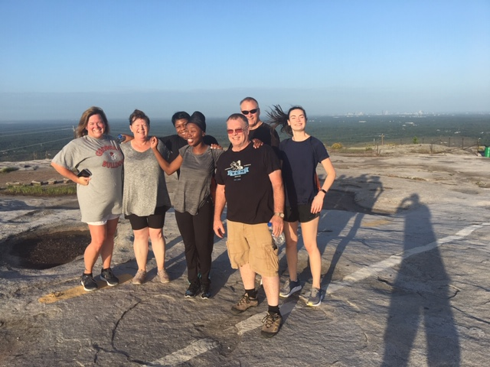
ON THE SPEEDWAY: Lane 1. Health
2021 HEALTH PROMOTION
WORKSHOP
Beyond the absence of mental and physical illness, health is a feeling of strength and energy from your body and mind
Notes:
Stone Mountain Park/Top of Stone Mountain
LGRMS
LEAN Conference 2019

Slide 12
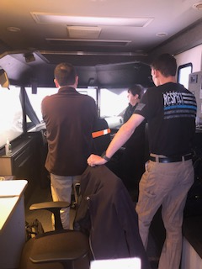
ON THE SPEEDWAY: Lane 2. Meaning
2021 HEALTH PROMOTION
WORKSHOP
Feeling part of something bigger than yourself
Knowing that your work matters
Having purpose in your life
Notes:
Laurens County
Simulator Training
Sheriff’s Department

Slide 13
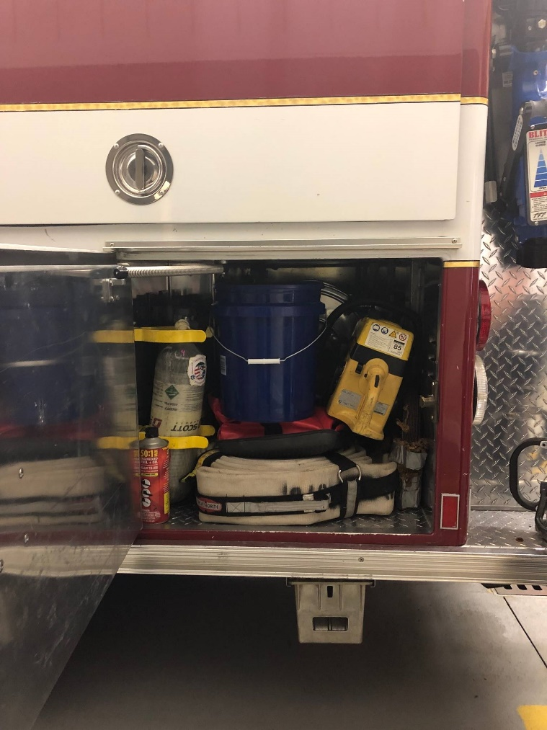
ON THE SPEEDWAY: Lane 3. Safety
2021 HEALTH PROMOTION
WORKSHOP
Knowing that you are safe from physical and psychological harm at work
Feeling secure enough to take calculated risks and show vulnerability
Free of concern about meeting basic life needs
Notes:
City of Centerville
Fire Department
Bucket Program

Slide 14
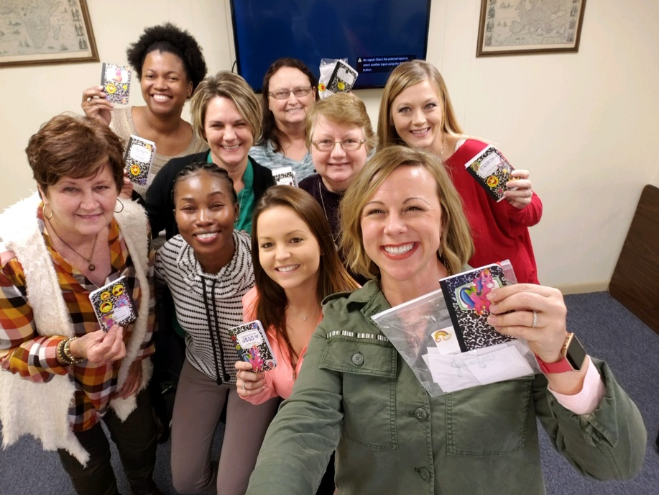
ON THE SPEEDWAY: Lane 4. Connection
2021 HEALTH PROMOTION
WORKSHOP
Experiencing positive, trusting relationships with others
Feeling a sense of belonging, acceptance, and support
Notes:
Heart of Georgia Altamaha Regional Commission
Team Building

Slide 15
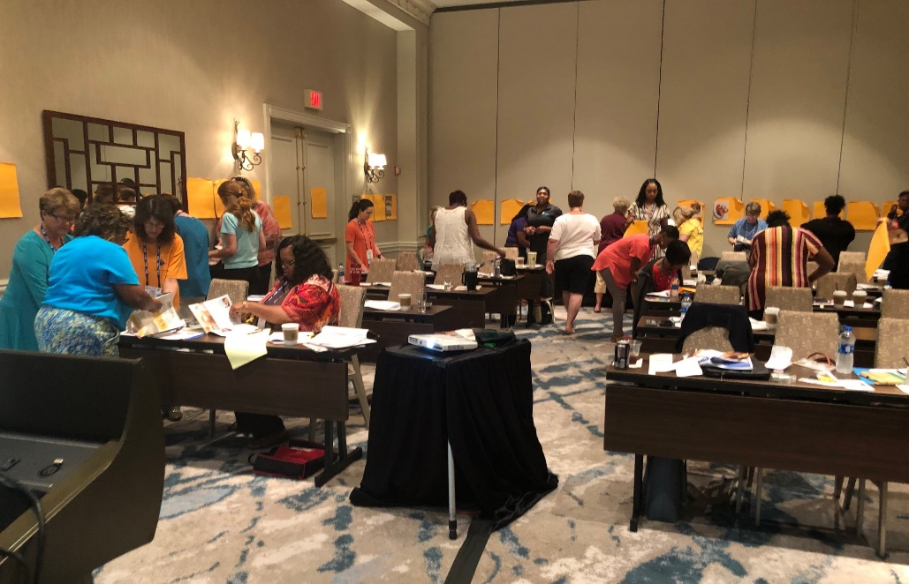
ON THE SPEEDWAY: Lane 5. Achievement
2021 HEALTH PROMOTION
WORKSHOP
Feeling you have the support, resources and autonomy to achieve your goals
Succeeding at meeting your individual goals and work aspirations
Notes:
2019 GMA Annual Convention
Work-Life Balance

Slide 16
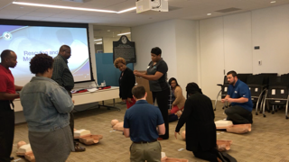
ON THE SPEEDWAY: Lane 6. Growth
2021 HEALTH PROMOTION
WORKSHOP
Feeling like you are progressing in your career
Learning and being challenged to use and expand on your strengths
Notes:
ACCG CPR and AED Training

Slide 17
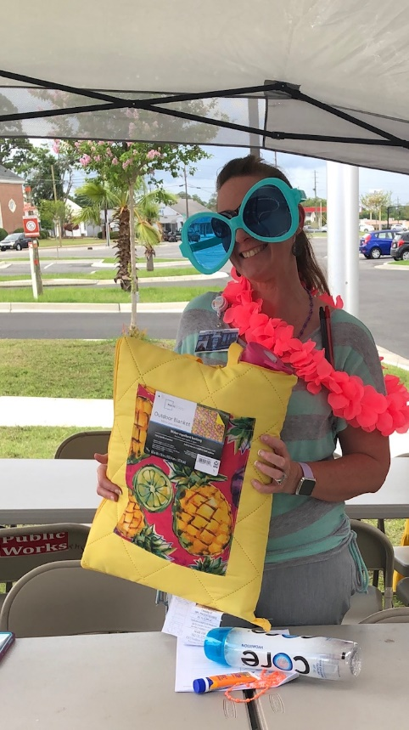
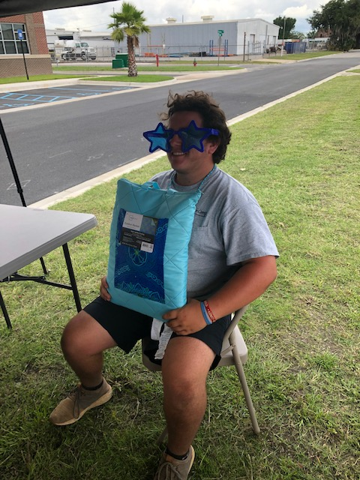
ON THE SPEEDWAY: Lane 7. Resiliency
2021 HEALTH PROMOTION
WORKSHOP
Viewing life with optimism
Feeling grateful and expressing appreciation
Feeling validated and encouraged
Notes:
Ware County
Sun Safety Program

Slide 18
ON THE SPEEDWAY: Building Your Workplace Wellbeing Program
2021 HEALTH PROMOTION
WORKSHOP
Wellbeing Committee
Program Goals
Action Planning
With your Committee and your LGRMS HPS Rep
Allow employee input and ideas
Health Promotion Interest Survey
Health Risk Assessments (HRAs)
Notes:
Program goals: Your program’s goals should reflect your organizational culture and resonate with your government. The program should tie in your mission and vision. This will help create the foundation of the program.
Action Planning: Your action plan should list events and activities to help you reach your program’s goals.

Slide 19
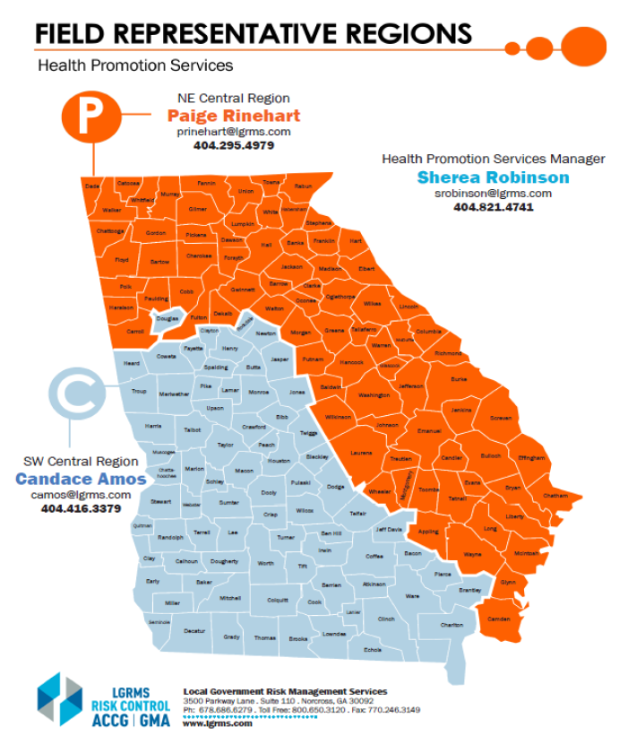
Pit Crew Support: LGRMS HPS
2021 HEALTH PROMOTION
WORKSHOP
Sherea Robinson
Health Promotion Services Manager
srobinson@lgrms.com
404.821.4741
Candace Amos
Southwest Central Region
camos@lgrms.com
404.416.3379
Paige Rinehart
Northeast Central Region
prinehart@lgrms.com
404.295.4979
Notes:
LGRMS HPS is here to support you on every straightaway and curve. Regardless of the lap you’re on, we’re only a pit stop away. We’re working to help you achieve a world-class workplace wellbeing program.

Slide 20
Pit Crew Support: Services and Resources
2021 HEALTH PROMOTION
WORKSHOP
Awareness Resources and Health Communication Campaigns
Our website: www.LGRMS.com offers access to a wide array of wellbeing resources
2021 Health Promotion Champion Training Manual
Appendix contains planning templates, flyers, community resources, and more!
Health Promotion Interest Survey
Weekly Health Scoop
Health and Wellbeing Poster Campaign
Living Well Georgia in the SHARE Newsletter
Monthly Forum Call
Notes:
There are many ways you can protect yourself, as well as your employees’ health. You can start by participating in the LGRMS HPS Forum Call, in which we’ll go over a Health Toolkit that provides “tools” to promote health in your organization.
The Health Toolkit will be placed in the next issue of the SHARE newsletter, following the Forum Call, but it will be for the upcoming month. You’ll receive all the tools you’ll need beforehand to start planning.
The Forum Call is for Health Promotion Champions and individuals responsible as health promotion leaders, administrators, HR and personnel directors, clerks, health/safety coordinators, and wellness/health benefit coordinators. All are welcome to participate. You’ll receive an invite each month. Please stay on the lookout!

Slide 21
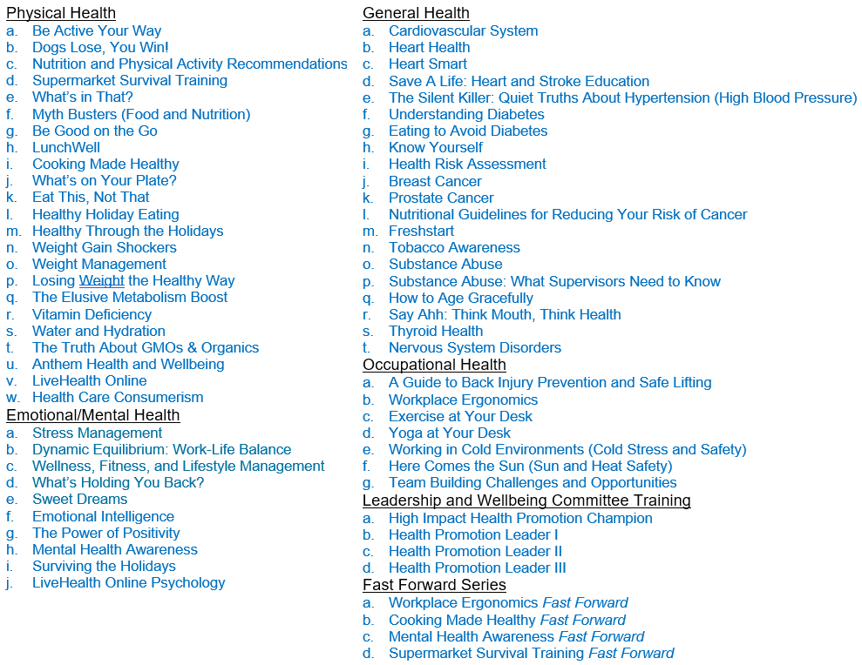
Pit Crew Support: Services and Resources
2021 HEALTH PROMOTION
WORKSHOP
Prevention and Health Education Trainings
LGRMS Training
Physical Health
Emotional/Mental Health
General Health
Occupational Health
Leadership and Wellbeing Committee Training
Fast Forward Series
Notes:
Trainings are offered onsite and virtually.
Trainings focus on learning and screening activities that impact knowledge, skills, beliefs, and health habits.
•LocalGovU – They offer online training courses with topics in: Health Promotion & Wellness, Employee Safety, Corrections, Law Enforcement, and Management. Classes are provided at no cost to ACCG & GMA Risk Management Fund Members.
•If you have an account already set up, you can go through the Workers’ Comp side to find a training most relevant to what you are looking for. If you do not have an account set up, go to this link: https://www.lgrms.com/Online-Training.aspx, and there’s a number you can call to get started.
•Safety National – They offer training and education, including classes and seminars on safety and risk control topics geared toward managers, supervisors, and employees. Safety National Website (training and other resources) are all free to ACCG & GMA Members.
•LGRMS sponsored a webinar on Safety National. Here is the link to the webinar recording: https://attendee.gotowebinar.com/recording/6460624077807545857.

Slide 22
Pit Crew Support: Services and Resources
2021 HEALTH PROMOTION
WORKSHOP
Prevention and Health Education Trainings
LGRMS Training
Anthem Resources, Toolkits, and LiveHealth Online
Health Risk Assessments (HRAs)
LGRMS HRA
Electronic and Paper
Anthem BCBS HRA
Online through Anthem Portal
LocalGovU E-Learning
Online training courses with topics in: Health Promotion & Wellness, Employee Safety, Corrections, Law Enforcement, and Management
Safety National
Training and education, including classes and seminars on safety and risk control topics geared toward managers, supervisors, and employees
Notes:
Trainings are offered onsite and virtually.
Trainings focus on learning and screening activities that impact knowledge, skills, beliefs, and health habits.
•LocalGovU – They offer online training courses with topics in: Health Promotion & Wellness, Employee Safety, Corrections, Law Enforcement, and Management. Classes are provided at no cost to ACCG & GMA Risk Management Fund Members.
•If you have an account already set up, you can go through the Workers’ Comp side to find a training most relevant to what you are looking for. If you do not have an account set up, go to this link: https://www.lgrms.com/Online-Training.aspx, and there’s a number you can call to get started.
•Safety National – They offer training and education, including classes and seminars on safety and risk control topics geared toward managers, supervisors, and employees. Safety National Website (training and other resources) are all free to ACCG & GMA Members.
•LGRMS sponsored a webinar on Safety National. Here is the link to the webinar recording: https://attendee.gotowebinar.com/recording/6460624077807545857.

Slide 23
Pit Crew Support: Services and Resources
2021 HEALTH PROMOTION
WORKSHOP
Behavior Change and Disease Management Programs
Team Building
Heart Health 6-Week Program
Freshstart Tobacco Cessation
Healthy Workplace Consultations and Honors
Wellbeing Program Action Planning
Workplace Health Audit
HRA Group Summary Report Analysis
Eudaemonia Award Program*
Notes:
Add notes about Eudaemonia Award… and Email to Sherea too DONE
*It’s coming
•Walk Georgia
The WalkGeorgia.org website was decommissioned on December 31, 2020. This difficult decision was made due to an aging website infrastructure and resource limitations. Walk Georgia appreciates all program participants over the years and their commitment to leading a healthy life! Please visit related UGA Extension resources at:
•https://extension.uga.edu/topic-areas/food-health/nutrition-health.html
•https://www.fcs.uga.edu/extension/health
•https://www.fcs.uga.edu/extension/food (Update with Maria information)

Slide 24
HIGH-PERFORMANCE LAPS: The Grant
2021 HEALTH PROMOTION
WORKSHOP
Health Promotion and Wellbeing Grant Requirements
Lap 1: Designate a Health Promotion Champion
Lap 2: Attend the Health Promotion Champion Training workshop
Lap 3:
Distribute an initial Grant Press Release to local media and all employees announcing support of the program
Implement at least two communications to employees promoting the Anthem Blue Cross Blue Shield 24/7 NurseLine and four other Anthem health communications during the year
Lap 4: Employees Complete Health Risk Assessment (HRA)
Lap 5:
Implement a Workplace Wellness Policy
Participate in Wellbeing Committee Meetings
Notes:
Complete these 9 laps to satisfy the Health Promotion and Wellbeing Grant requirements

Slide 25
HIGH-PERFORMANCE LAPS: The Grant
2021 HEALTH PROMOTION
WORKSHOP
Lap 6: Offer at least two health promotion programs to all employees
Examples: immunization program (flu shots), cancer screenings, CPR/First-Aid training, tobacco use reduction program, nutrition-weight programs, stress management programs, etc.
Lap 7: Create a 12-month Action Plan for the workplace wellbeing program; including awareness, communications, prevention and behavior change programs
Lap 8:
Mid-Point Check (Due January 1)
Year-End Report (Due June 1)
Receipts (Due June 1)
Grant Requirements Checklist (Due June 1)
Lap 9: Attend at least one other LGRMS HPS Regional Training class during the current Grant year
Notes:
Complete these 9 laps to satisfy the Health Promotion and Wellbeing Grant requirements

Slide 26
HIGH-PERFORMANCE LAPS: The Grant
ACCG
Award recipients will receive 50% of their initial Grant amount via mail after the Health Promotion Champion Training
The remaining 50% will be received after the Mid-Point Check has been submitted
GMA
Oversight in the Award Letters
Letters went out in September and were sent with the full Grant amount
Thus, this will be the only funds received for this Grant year
There will not be a second installment after the Mid-Point Check has been submitted
Notes:
There was an oversight on the GMA Grant - You do not need to return the check to us, and may continue to process it. However, you will not receive a second installment check in 2022, and we will follow-up throughout the grant period to ensure completion of the mid-point report. A formal letter with this information has also been mailed to the Mayor or Executive Director.
Letters sent on Friday, September 24

Slide 27
HIGH-PERFORMANCE LAPS: The Grant
Grant Year Timeline
Start of Current Grant Year……………………………………………………….July 1, 2021
Health Promotion Champion Training Workshop……………………October 2021
12-Month Action Planning……………..Schedule with Your HPS Representative
Monthly Forum Call………………………Starting January 2022 (Exact Dates TBD)
Mid-Point Check Due………………………………………………………….January 1, 2022
HPS Regional Training…………………………………..Spring 2022 (Exact Dates TBD)
Year-End Report Due (Report, Checklist, Receipts)…………………..June 1, 2022
End of Current Grant Year………………………………………………………June 30, 2022

Slide 28
HIGH-PERFORMANCE LAPS: Grant Funds Usage
PPE
Exercise equipment (Commercial Grade)
Healthy food for Training
Door prizes
Sunscreen
Ergonomic chairs (only if have the Ergonomics training offered through LGRMS)
Reusable lunch totes
Pedometers
Tobacco cessation aids (only if have the Tobacco Cessation training offered through LGRMS)
Keyboard wrist support (only if have the Ergonomics training offered through LGRMS)
Water
Blood pressure cuffs
AED
Computer desk (only if have the Ergonomics training offered through LGRMS)
Hand sanitizer
Notes:
List (not all-inclusive) of acceptable items that you may purchase using the Grant funds.
If you have any questions about something that is not on the list, please don’t hesitate to contact us.
*Health screenings and immunizations can usually go through the insurance.

Slide 29
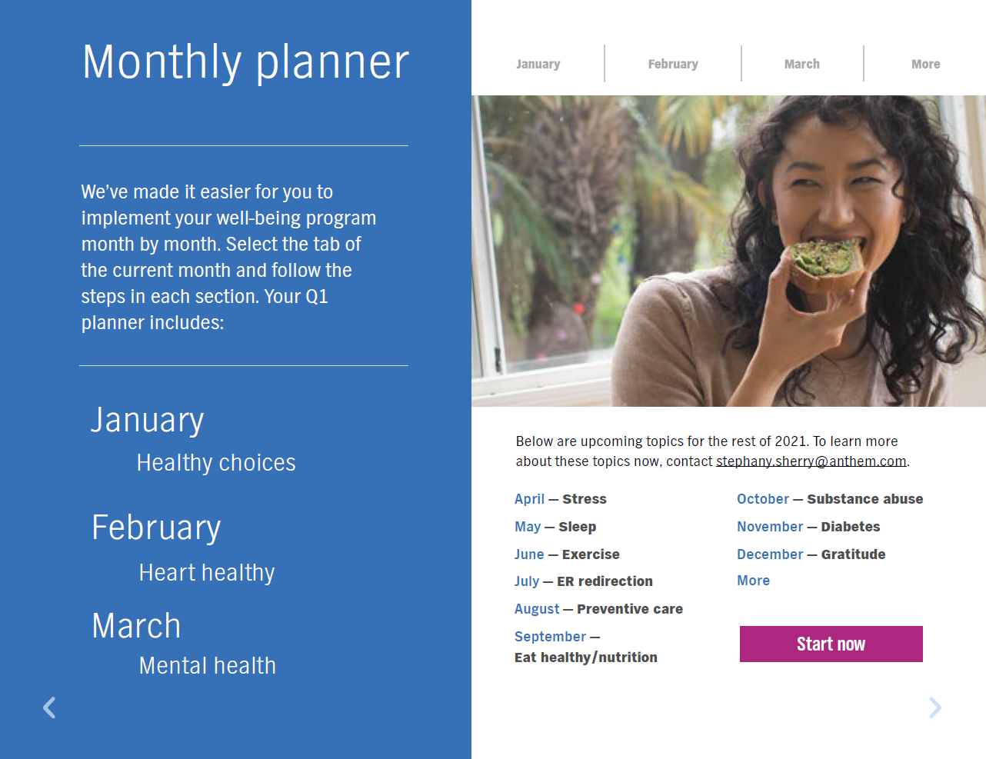
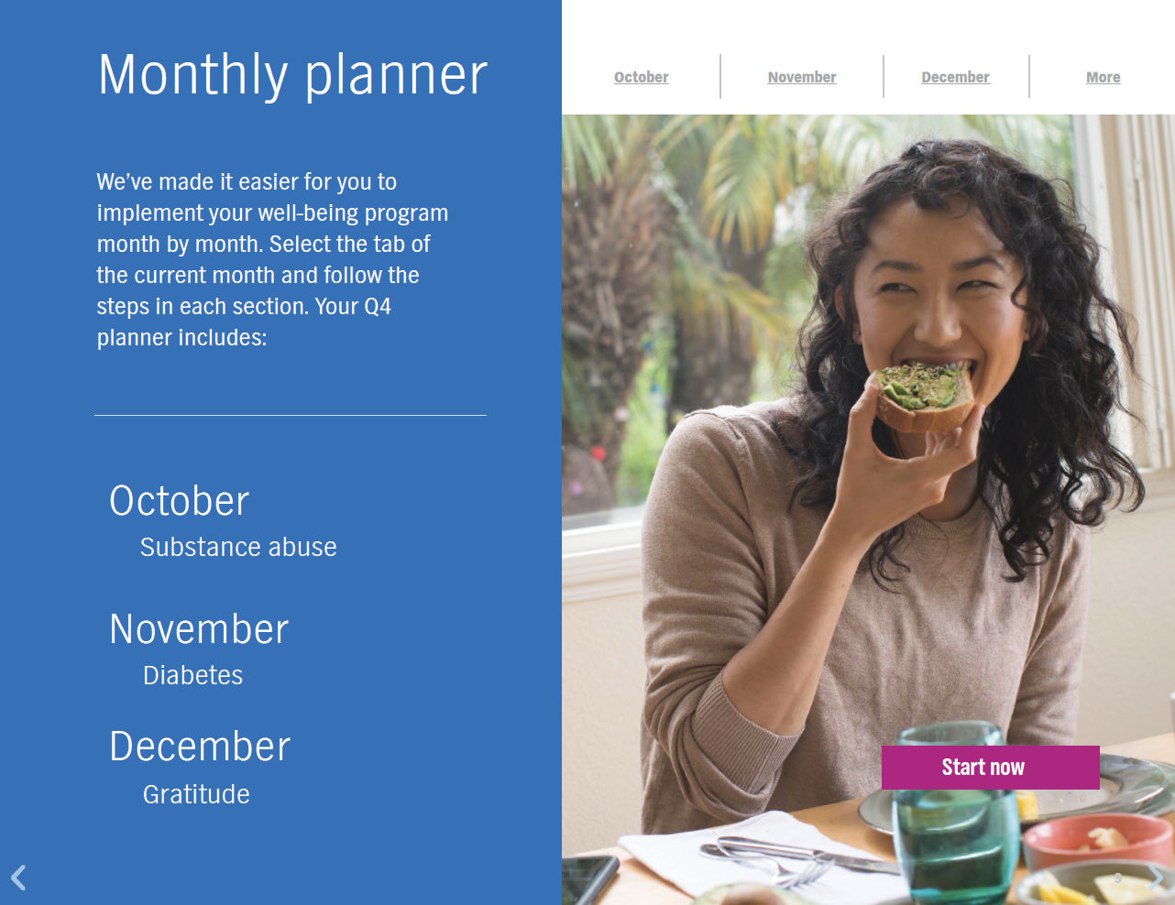
HIGH-PERFORMANCE LAPS: Activity – Action Planning
Each group will receive a “Monthly Planner” packet that includes:
One month to focus on
One health topic
One toolkit
Well-being strategies
HPS Training List
Additional wellness ideas
Every member in the group will receive:
12-Month Action Planning Form
One-Month Calendar
In your groups, use the tools/resources/services within the packet to help create your Action Plan for one month
Group 1 – February: Heart Healthy
Group 2 – March: Mental Health
Group 3 – October: Substance Abuse
Group 4 – November: Diabetes
Notes:
Action planning is one of the most important aspects of a successful wellbeing program. Your action plan should list events and activities to help you reach your program’s goals. Include the date, time, and location (if applicable). Also, determine if any cost will be associated with it (food, incentives, etc.).
The Action Planning form is broken down by month, starting with July and ending with June. Each month, you want to have some type of wellness initiative, whether it is in the Awareness Resources, Health Communication Campaigns, Prevention & Health Education, and/or Behavior Change/Disease Management category. The idea is to constantly keep wellbeing all around.
***
Wellbeing is the active pursuit to understand and fulfill your individual human needs—which allows you to reach a state where you are flourishing and able to realize your full potential in all aspects of life. Every person has wellness aspirations. Successful workplace wellness initiatives require supporting employees in fulfilling their needs in seven areas.
Develop an action plan for your wellbeing program that touches on each of these areas:
HEALTH-Beyond the absence of mental and physical illness, health is a feeling of strength and energy from your body and mind.
MEANING-Feeling part of something bigger than yourself. Knowing that your work matters. Having purpose in your life.
SAFETY-Knowing that you are safe from physical and psychological harm at work. Feeling secure enough to take calculated risks and show vulnerability. Free of concern about meeting basic life needs.
CONNECTION-Experiencing positive, trusting relationships with others. Feeling a sense of belonging, acceptance, and support.
ACHIEVEMENT-Feeling you have the support, resources, and autonomy to achieve your goals. Succeeding at meeting your individual goals and work aspirations.
GROWTH-Feeling like you are progressing in your career. Learning and being challenged to use and expand on your strengths.
RESILIENCY-Viewing life with optimism. Feeling grateful and expressing appreciation. Feeling validated and encouraged.
***
Monthly Forum Call
There are many ways you can protect yourself, as well as your employees’ health. You can start by participating in the LGRMS HPS Forum Call, in which we’ll go over a Health Toolkit that provides “tools” to promote health in your organization.
The Health Toolkit will be placed in the next issue of the SHARE newsletter, following the Forum Call, but it will be for the upcoming month. You’ll receive all the tools you’ll need beforehand to start planning.
The Forum Call is for Health Promotion Champions and individuals responsible as health promotion leaders, administrators, HR and personnel directors, clerks, health/safety coordinators, and wellness/health benefit coordinators. All are welcome to participate. You’ll receive an invite each month. Please stay on the lookout!

Slide 30
GRANDSTAND FANS
Ben Pittarelli
Health Program and Insurance Marketing Director
(404) 589-7840
bpittarelli@accg.org
ACCG
www.accg.org
Joe Dan Thompson
Marketing and Field Services Representative
(404) 589-7862
jthompson@accg.org
Randy Logan
Deputy Executive Director
(678) 686-6253
rlogan@gacities.com
GMA
www.gacities.com
Denise Joyce
Director, Life and Health Services
(678) 686-6231
djoyce@gacities.com
Notes:
They are waving and cheering you on!
Your Grandstand Fans are enthusiastic and devoted to helping you triumph in this race.
Utilize them as you put your plan into action

Slide 31
GRANDSTAND FANS
Paige Kirk
Clinical Account Executive
(404) 606-2903
paige.kirk@anthem.com
Anthem Blue Cross Blue Shield
www.anthem.com
Stephany Sherry
Health Promotion Manager
(404) 323-1985
stephany.sherry@anthem.com
Community Resources and Groups
UGA Extension
Community Health Promotion Resources
Community Support Groups
Notes:
They are waving and cheering you on!
Your Grandstand Fans are enthusiastic and devoted to helping you triumph in this race.
Utilize them as you put your plan into action
Crowds of additional Community Health Promotion Resources and Community Support Groups

Slide 32
THE CHECKERED FLAG STILL WAVES
“Employers who can connect their people to a sense of purpose and invite them to rise to the challenge will not only give them a sense of direction that will protect their mental health, but also will allow them to emerge stronger from the crisis as a result” (Seidl, 2020).
Wellbeing is unending... Draft 2021 into the New Year!
Be on the lookout for the Monthly Forum Calls and 12-Month Action Planning!
Notes:
Workplace wellbeing programs make healthy living, stress-less living that much easier by empowering employees.
“Employers who can connect their people to a sense of purpose and invite them to rise to the challenge will not only give them a sense of direction that will protect their mental health, but also will allow them to emerge stronger from the crisis as a result” (Seidl, 2020). Although we’ve arrived at the checkered flag, it doesn’t mean that our race is over.
Wellbeing is unending. Racing for Resiliency continues… Draft 2021 into the New Year…Renew the focus on physical and emotional health…Meet employees where they are

Slide 33
THE CHECKERED FLAG STILL WAVES
Questions?
Thank you!

