Slide 1
SEPTEMBER 2022
TACKLING OUR WAY INTO 2023

Slide 2
Welcome Health Promotion Champions and Congratulations!
Notes:
You are on your way to enhancing your employees’ health! As the Health Promotion Champion, you are over your organization’s commitment to creating a culture that promotes and affirms the importance of employee wellbeing. Organizational procedures, policies, cultures, and behaviors
strongly impact the health and wellbeing of employees.

Slide 3
TACKLING OUR WAY INTO 2023
HUT, HUT, HIKE!
Pre-Snap Calls
Notes:
In a football game, the teams line up to snap the ball to start every non-kicking play. Before the ball is snapped, the quarterback can be heard yelling a series of words, usually ending in one or more “Hut”s.
It could be something like: “White 80! Set! Hut!” These are different forms of pre-snap calls.
Pre-snap calls are yelled before the ball is snapped back by the center to the quarterback. This is the quarterback communicating information and plays to his team.
You are the quarterback of your team (your team is your employees). You are uniquely positioned to make plays that have a profound impact through your program.

Slide 4
LINE ASSIGNMENT: SUBDUE THE OPPONENT
Use your wellbeing program to tackle challenges coming out of COVID-19
These are stressful times for many
Hardships
Unending cycle of issue after issue
Prepare your employees to:
Stand firm
Adjust to the defenses of challenges
Change the game play
Notes:
With your program, you want to subdue the enemy
Offensive and Defensive Lines
Using Wellbeing Programs to Tackle All Challenges Coming Out of COVID-19
Employees are navigating the aftereffects of coming out of COVID-19. These times may be stressful for some. There may be hardships. Others may feel like they are in an unending cycle of one issue after another. Now is the time to tackle them. Prepare your employees with the tools they'll need to stand
firm. Aid them in adjusting to the defenses of challenges. Change the game play. Employees may be more receptive as they look for ways to ease their minds and relieve stress.
You are in an excellent position to call and run plays that will be effective in reshaping the way employees think about, and handle, health and hardships. Pay particular attention to financial, mental, and social health; especially concerning the challenges facing most of the world today. This is a key opportunity to boost your employees’ confidence and determination.

Slide 5
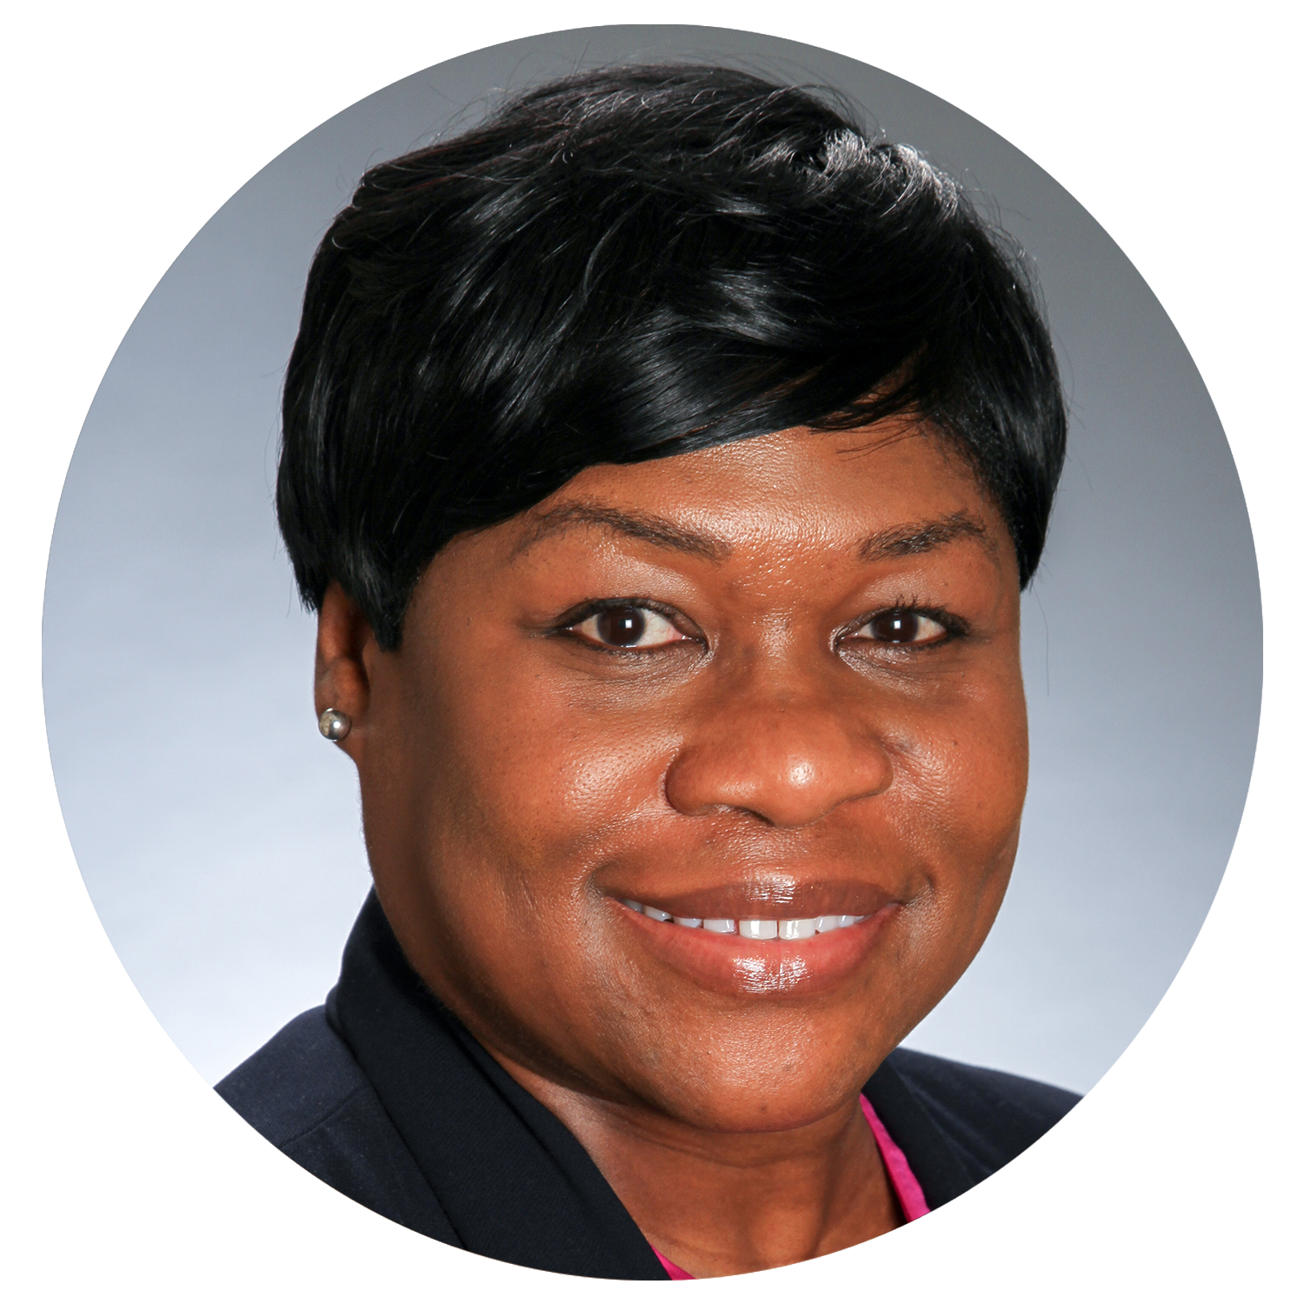
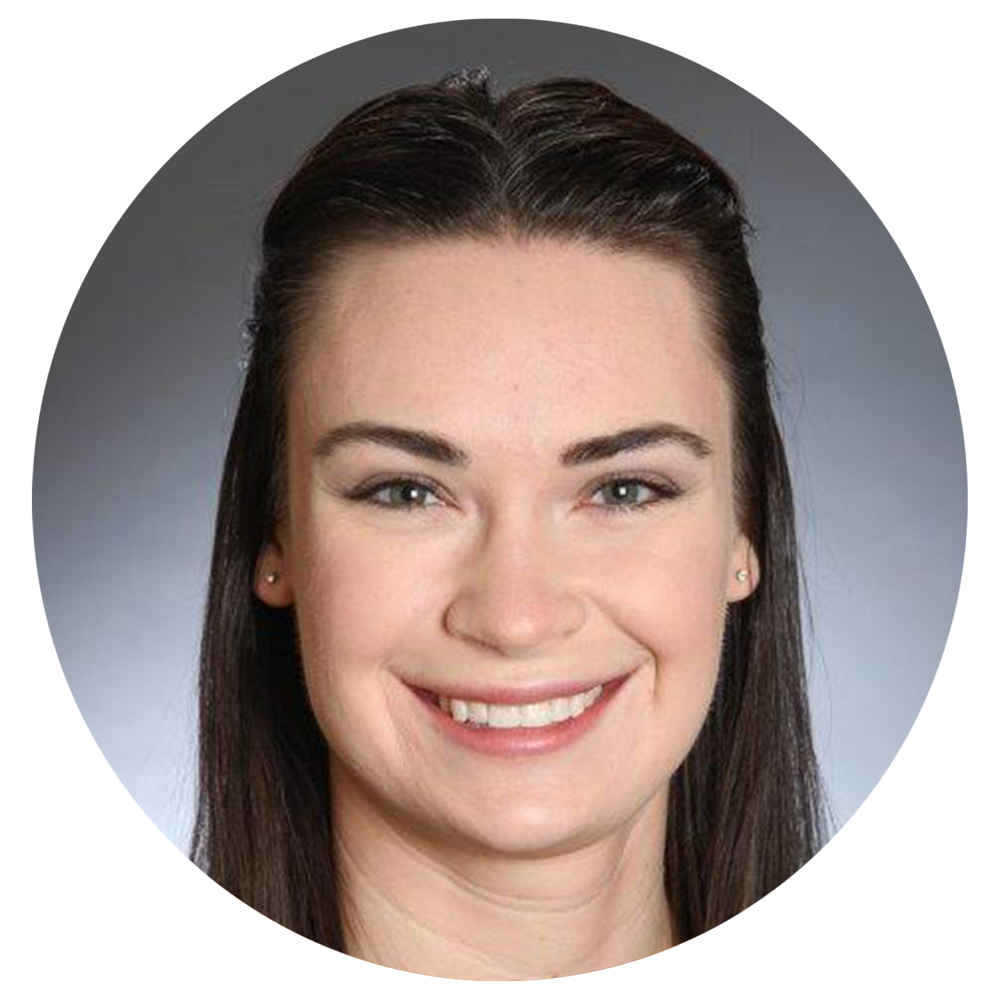
ON THE SIDELINES: Your Coaching Staff & Playbook
Place the contents of your presentation here!
Add bullet points etc.
Second point here
Third point here
Your Coaching Staff: LGRMS Health Promotion Services (HPS)
Our Mission:
Proactively create opportunities for ACCG and GMA Life and Health Insurance Program members to enhance their health and productivity through leadership and the delivery of innovative health promotion services
We are committed to:
Helping you make plays and gain yards
We’re here if you need to move into the pocket, run a Hail Mary, or just check on information in the program’s playbook
2022 Health Promotion Champion Training Manual

Slide 6
ON THE SIDELINES: Local Government Partnership
Place the contents of your presentation here!
Add bullet points etc.
Second point here
Third point here
You are the primary link between your local government and LGRMS HPS
As the Health Promotion Champion, you are responsible for calling and running plays to move your workplace wellbeing program forward
Health Promotion Champion maneuvers on the field:
Leadership that provides for each employee’s diverse interests and needs
A workplace that encourages positive, healthy lifestyle choices
An environment where every employee can perform at their best level
Notes:
As the Health Promotion Champion of your workplace wellbeing program, there are certain maneuvers to help keep everyone on the field.

Slide 7
TIME TO TAKE THE FIELD! Importance of Your Wellbeing Program
Why begin or resume your workplace wellbeing program?
It’s designed to enhance the health of an organization and its most important asset: its employees
However, COVID-19:
Has changed the way organizations across the world function
Aftereffects has impacted employees in ways beyond imaginable
Now, it's time to take the field!
Develop your program
Address employee concerns
Encourage positive change
Notes:
Importance of Beginning or Resuming Your Wellbeing Program
The workplace wellbeing program is designed to enhance the health of an organization and its most important asset: its employees. The average adult spends almost two-thirds of their waking hours at work, thus the workplace offers an ideal setting and infrastructure. However, COVID-19 has changed the way organizations across the world function. Some organizations have employees working virtually. Other organizations have employees coming in on alternate days. Many organizations have employees back in-person working as before. And the aftereffects of the pandemic has impacted employees in ways beyond imaginable. Thus, it's time to take the field. Develop your workplace wellbeing program. Address employee concerns. Encourage positive change. Build a resilient workforce.

Slide 8
TIME TO TAKE THE FIELD! Why Tackle Our Way Into 2023?
Tackling an issue head-on stops it in its progress
Being resilient allows you to manage both mind and emotion in high stress situations
Wellbeing and resilience are vital to developing efficient problem-solving skills
As well as:
Building and maintaining interpersonal relationships
Setting realistic goals
Notes:
Why Tackle Our Way Into 2023?
Tackling an issue head-on stops it in its progress and helps employees figure out how to best approach it in a very determined and/or efficient way.
It can be difficult, but being resilient allows you to manage both mind and emotion in high stress situations and quickly switch gears from worry and stress mode to problem-solving mode.
Wellbeing and resilience are vital to developing efficient problem-solving skills, building and maintaining interpersonal relationships, and setting realistic goals. All of which greatly enhance an individual’s ability to perform and contribute meaningfully in daily life.

Slide 9
HUDDLE UP: Strategize Your Wellbeing Program
Place the contents of your presentation here!
Add bullet points etc.
Second point here
Third point here
Successful workplace wellbeing initiatives require supporting employees in fulfilling their needs in seven areas
Play 1. Health
Play 2. Meaning
Play 3. Safety
Play 4. Connection
Play 5. Achievement
Play 6. Growth
Play 7. Resiliency
Notes:
Wellbeing is the active pursuit to understand and fulfill your individual human needs—which allows you to reach a state where you are flourishing and able to realize your full potential in all aspects of life. Every person has wellness aspirations. Successful workplace wellness initiatives require supporting employees in fulfilling their needs in seven areas.
So, strategize your program. Show your employees a level of execution that meets the demands of the pro wellbeing game.

Slide 10
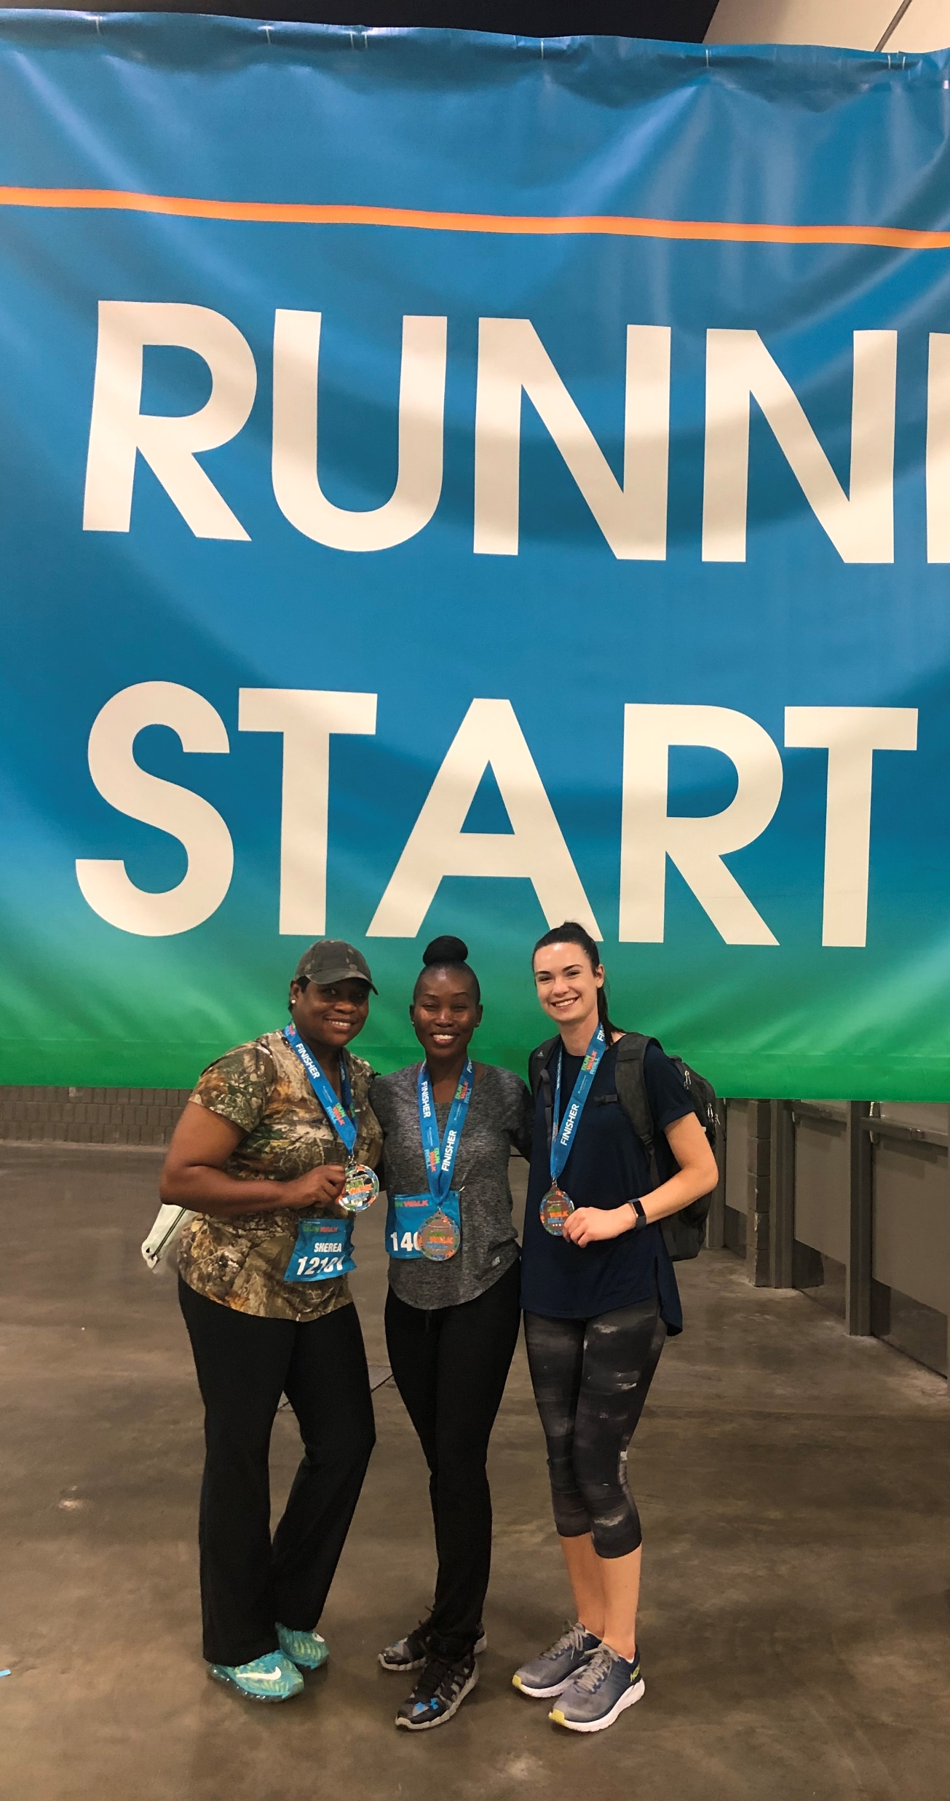
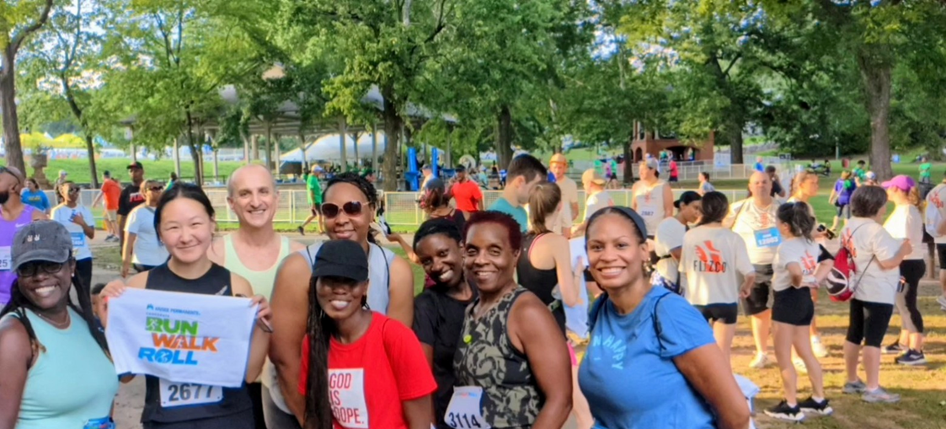
HUDDLE UP: Decide Upcoming Plays
Play 1. Health
Beyond the absence of mental and physical illness, health is a feeling of strength and energy from your body and mind
Notes:
ACCG and GMA Kaiser Permanente 5K Run, Walk, & Roll

Slide 11
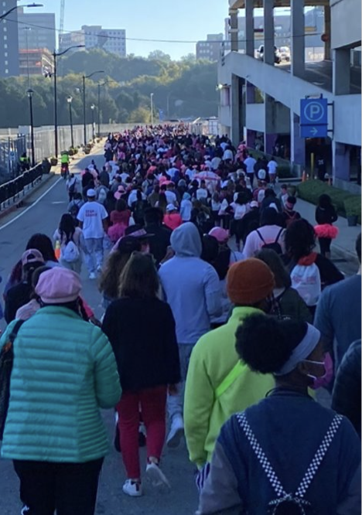
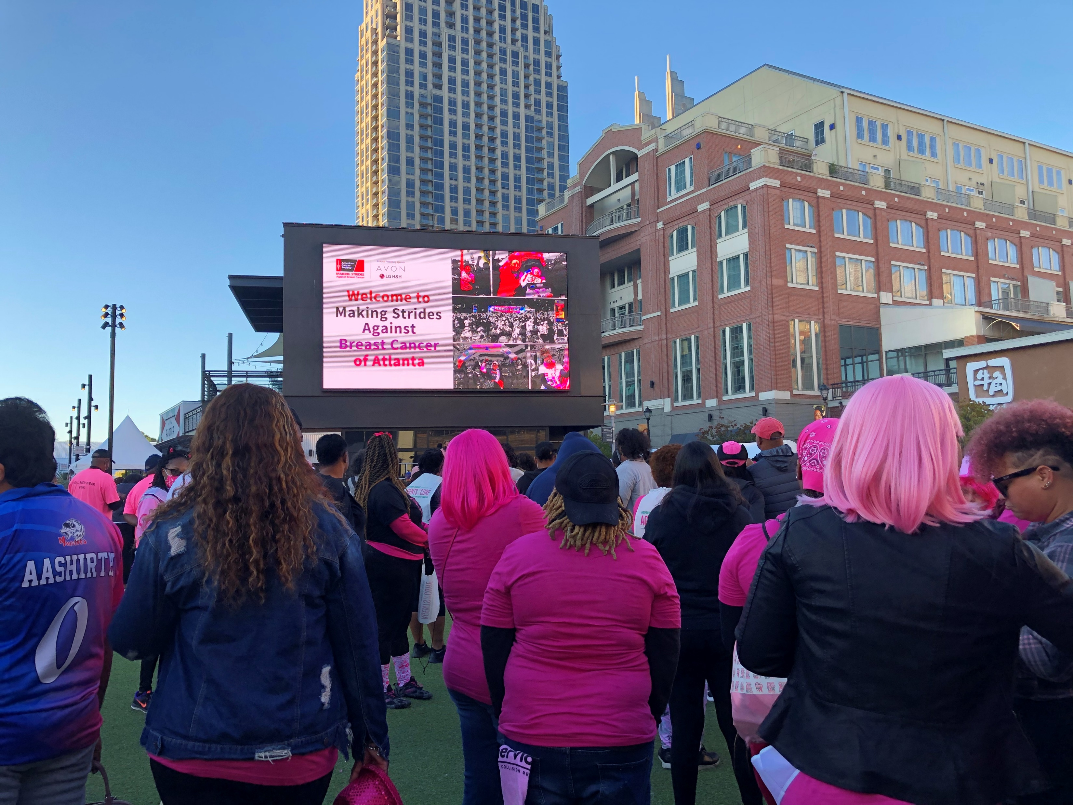
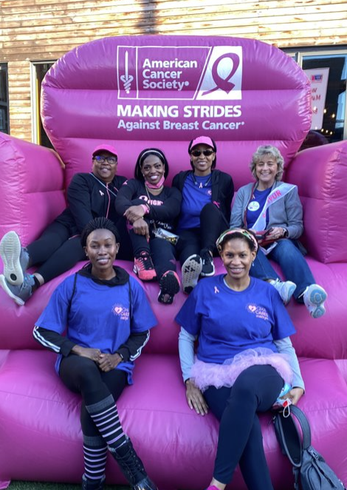
HUDDLE UP: Decide Upcoming Plays
Place the contents of your presentation here!
Add bullet points etc.
Second point here
Third point here
Play 2. Meaning
Feeling part of something bigger than yourself
Knowing that your work matters
Having purpose in your life
Notes:
GMA MSABC 5K Walk

Slide 12
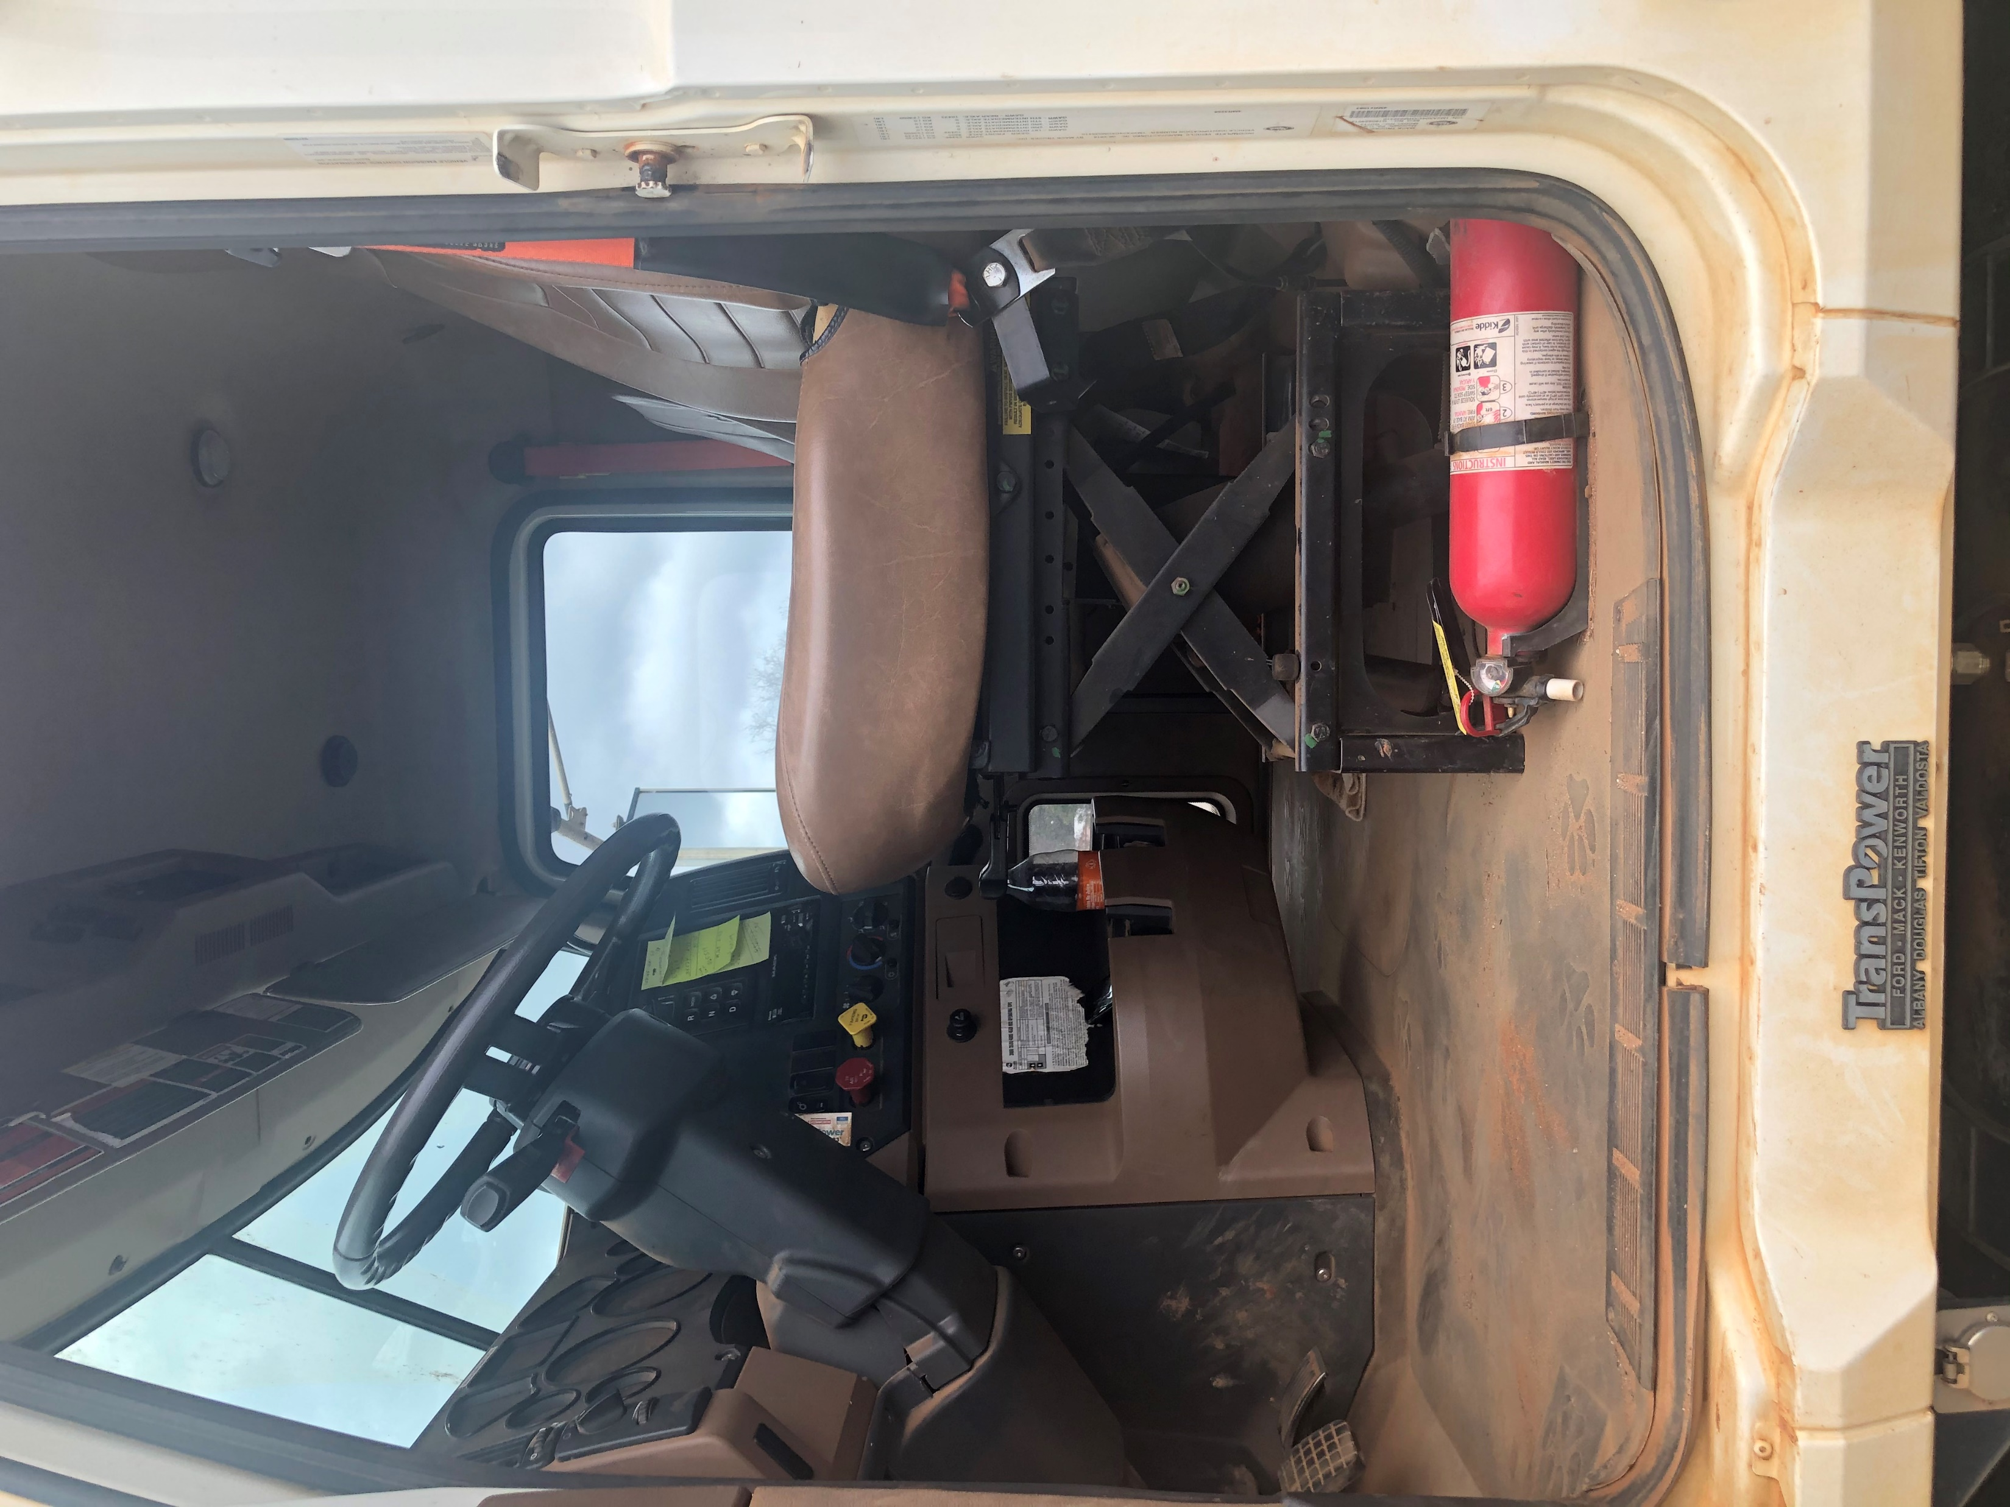
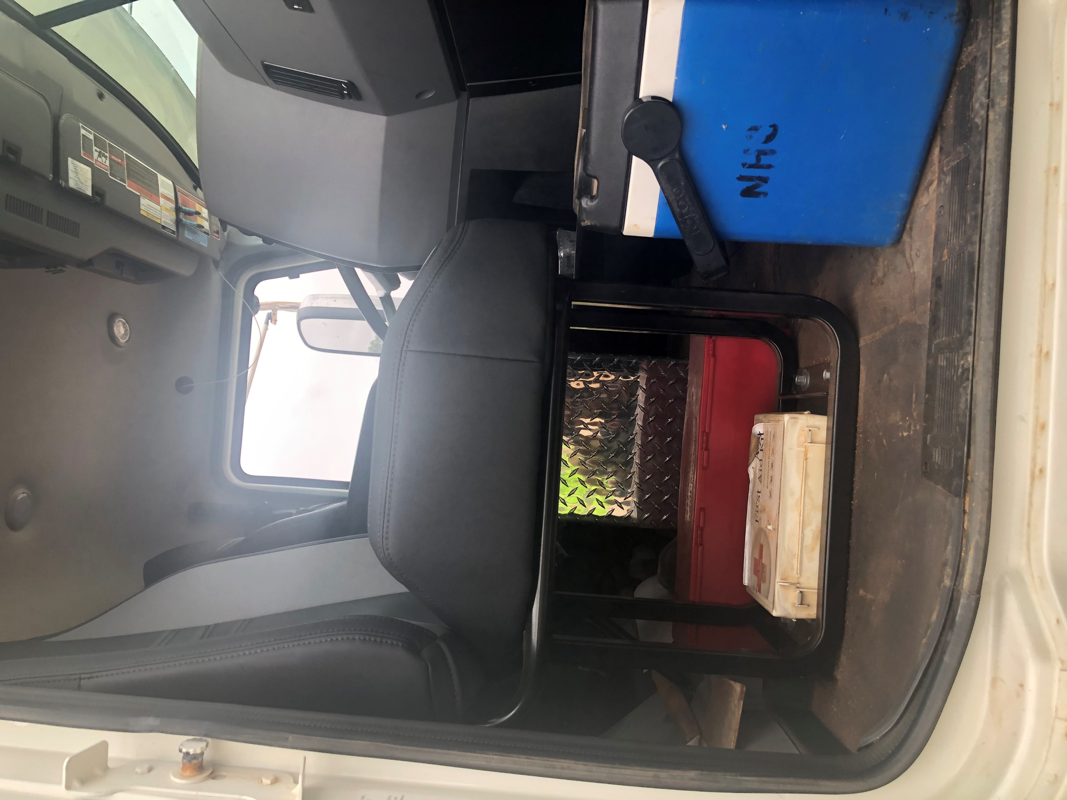
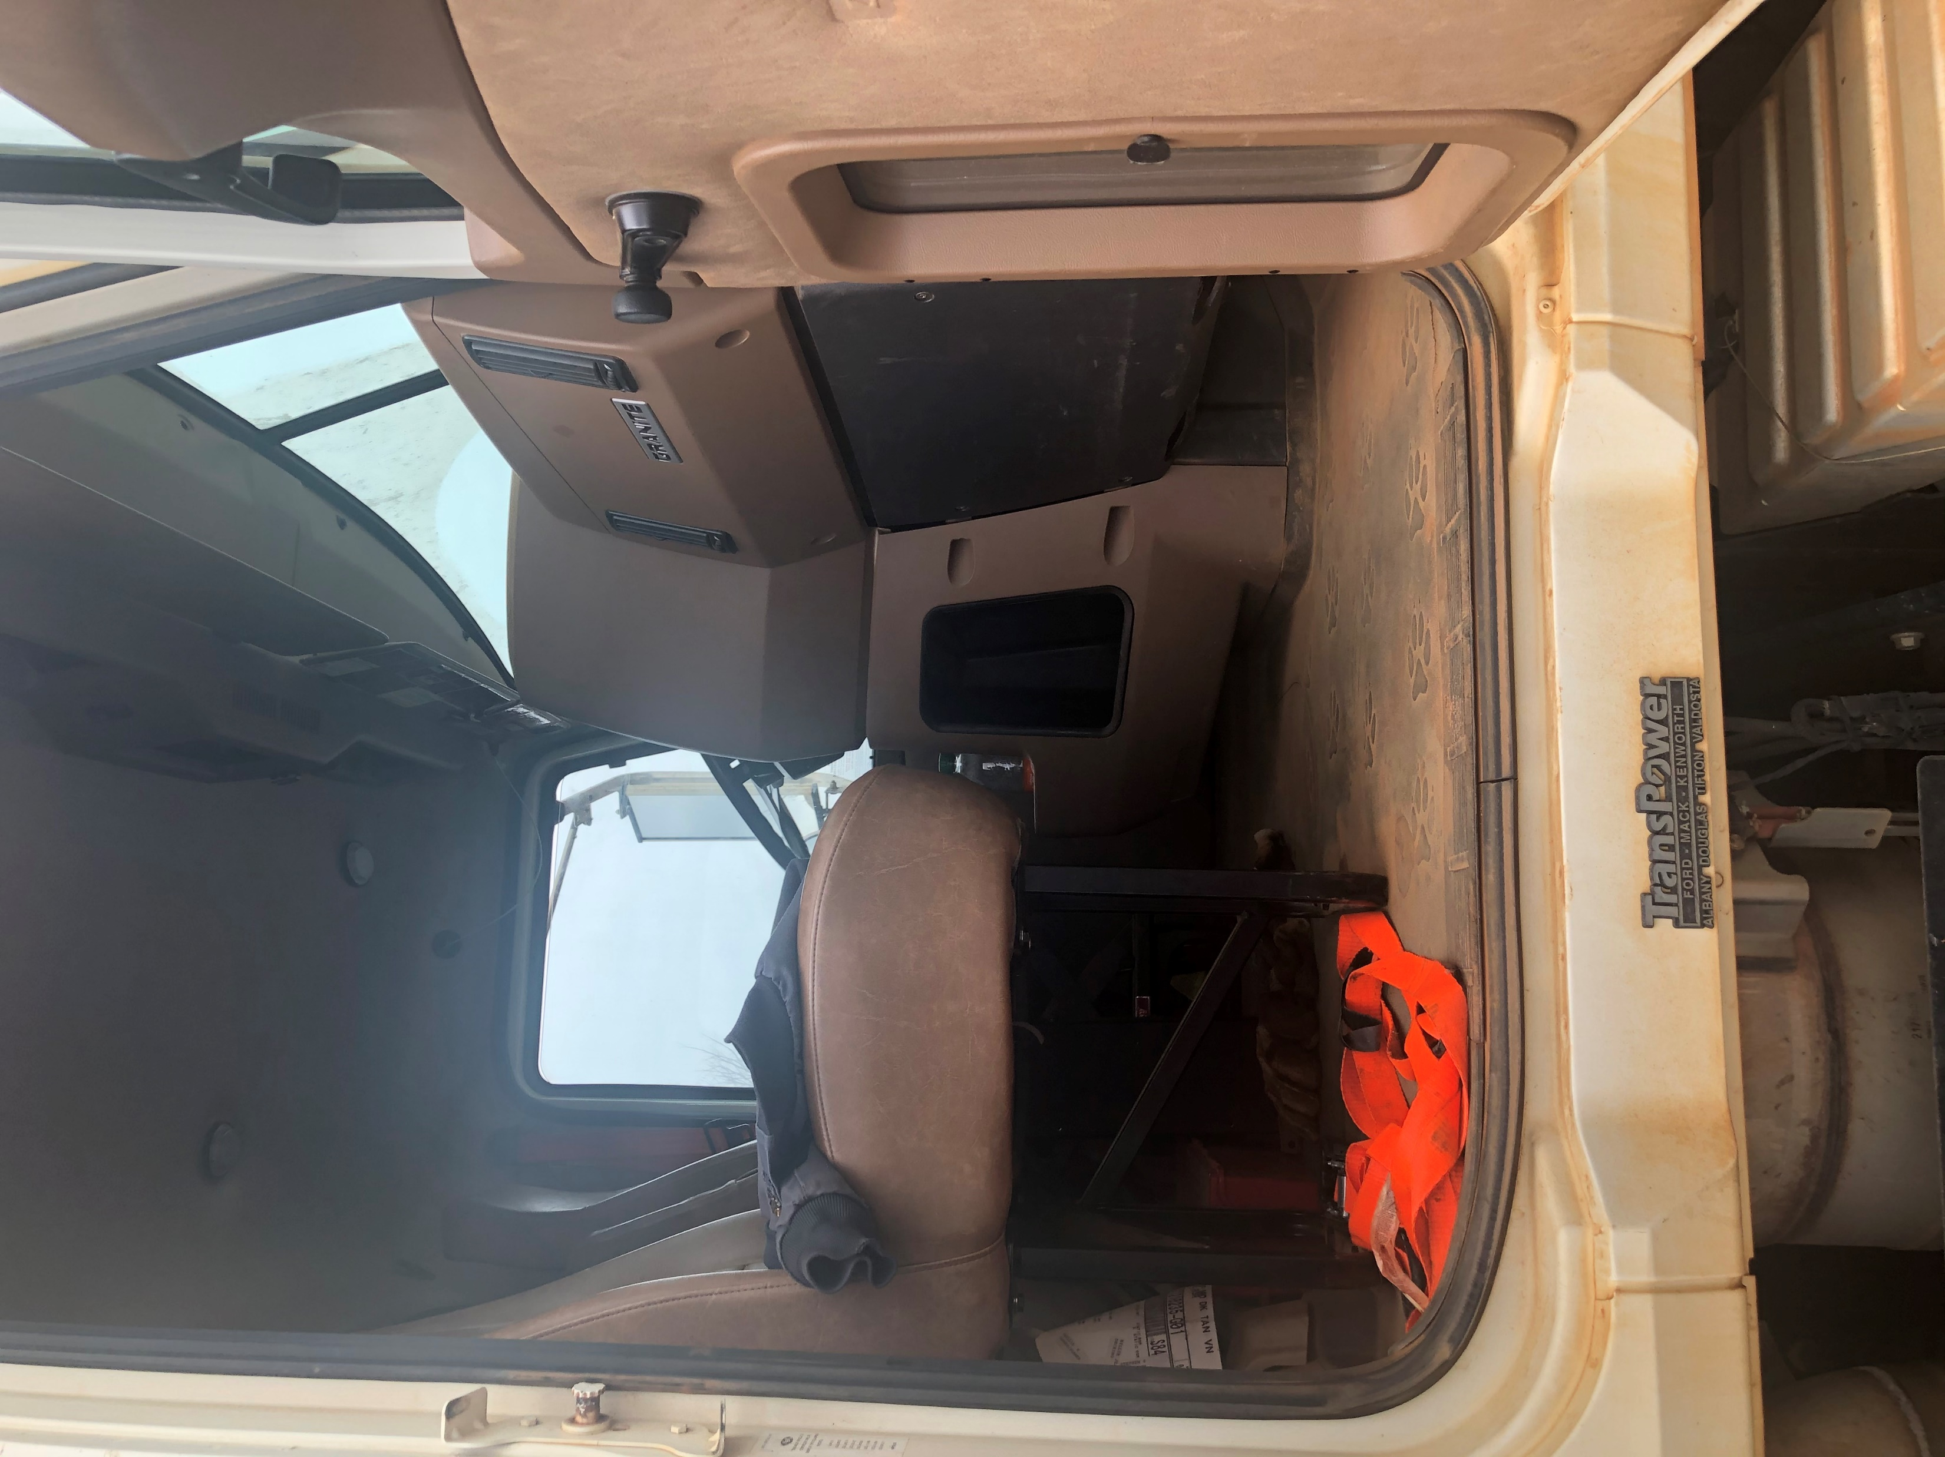
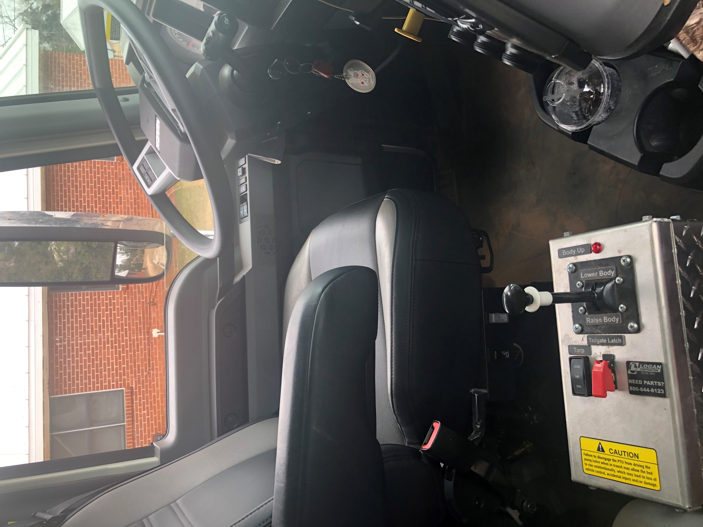
HUDDLE UP: Decide Upcoming Plays
Place the contents of your presentation here!
Add bullet points etc.
Second point here
Third point here
Play 3. Safety
Knowing that you are safe from physical and psychological harm at work
Feeling secure enough to take calculated risks and show vulnerability
Free of concern about meeting basic life needs
Notes:
Stewart County Ergonomics (Public Works)

Slide 13
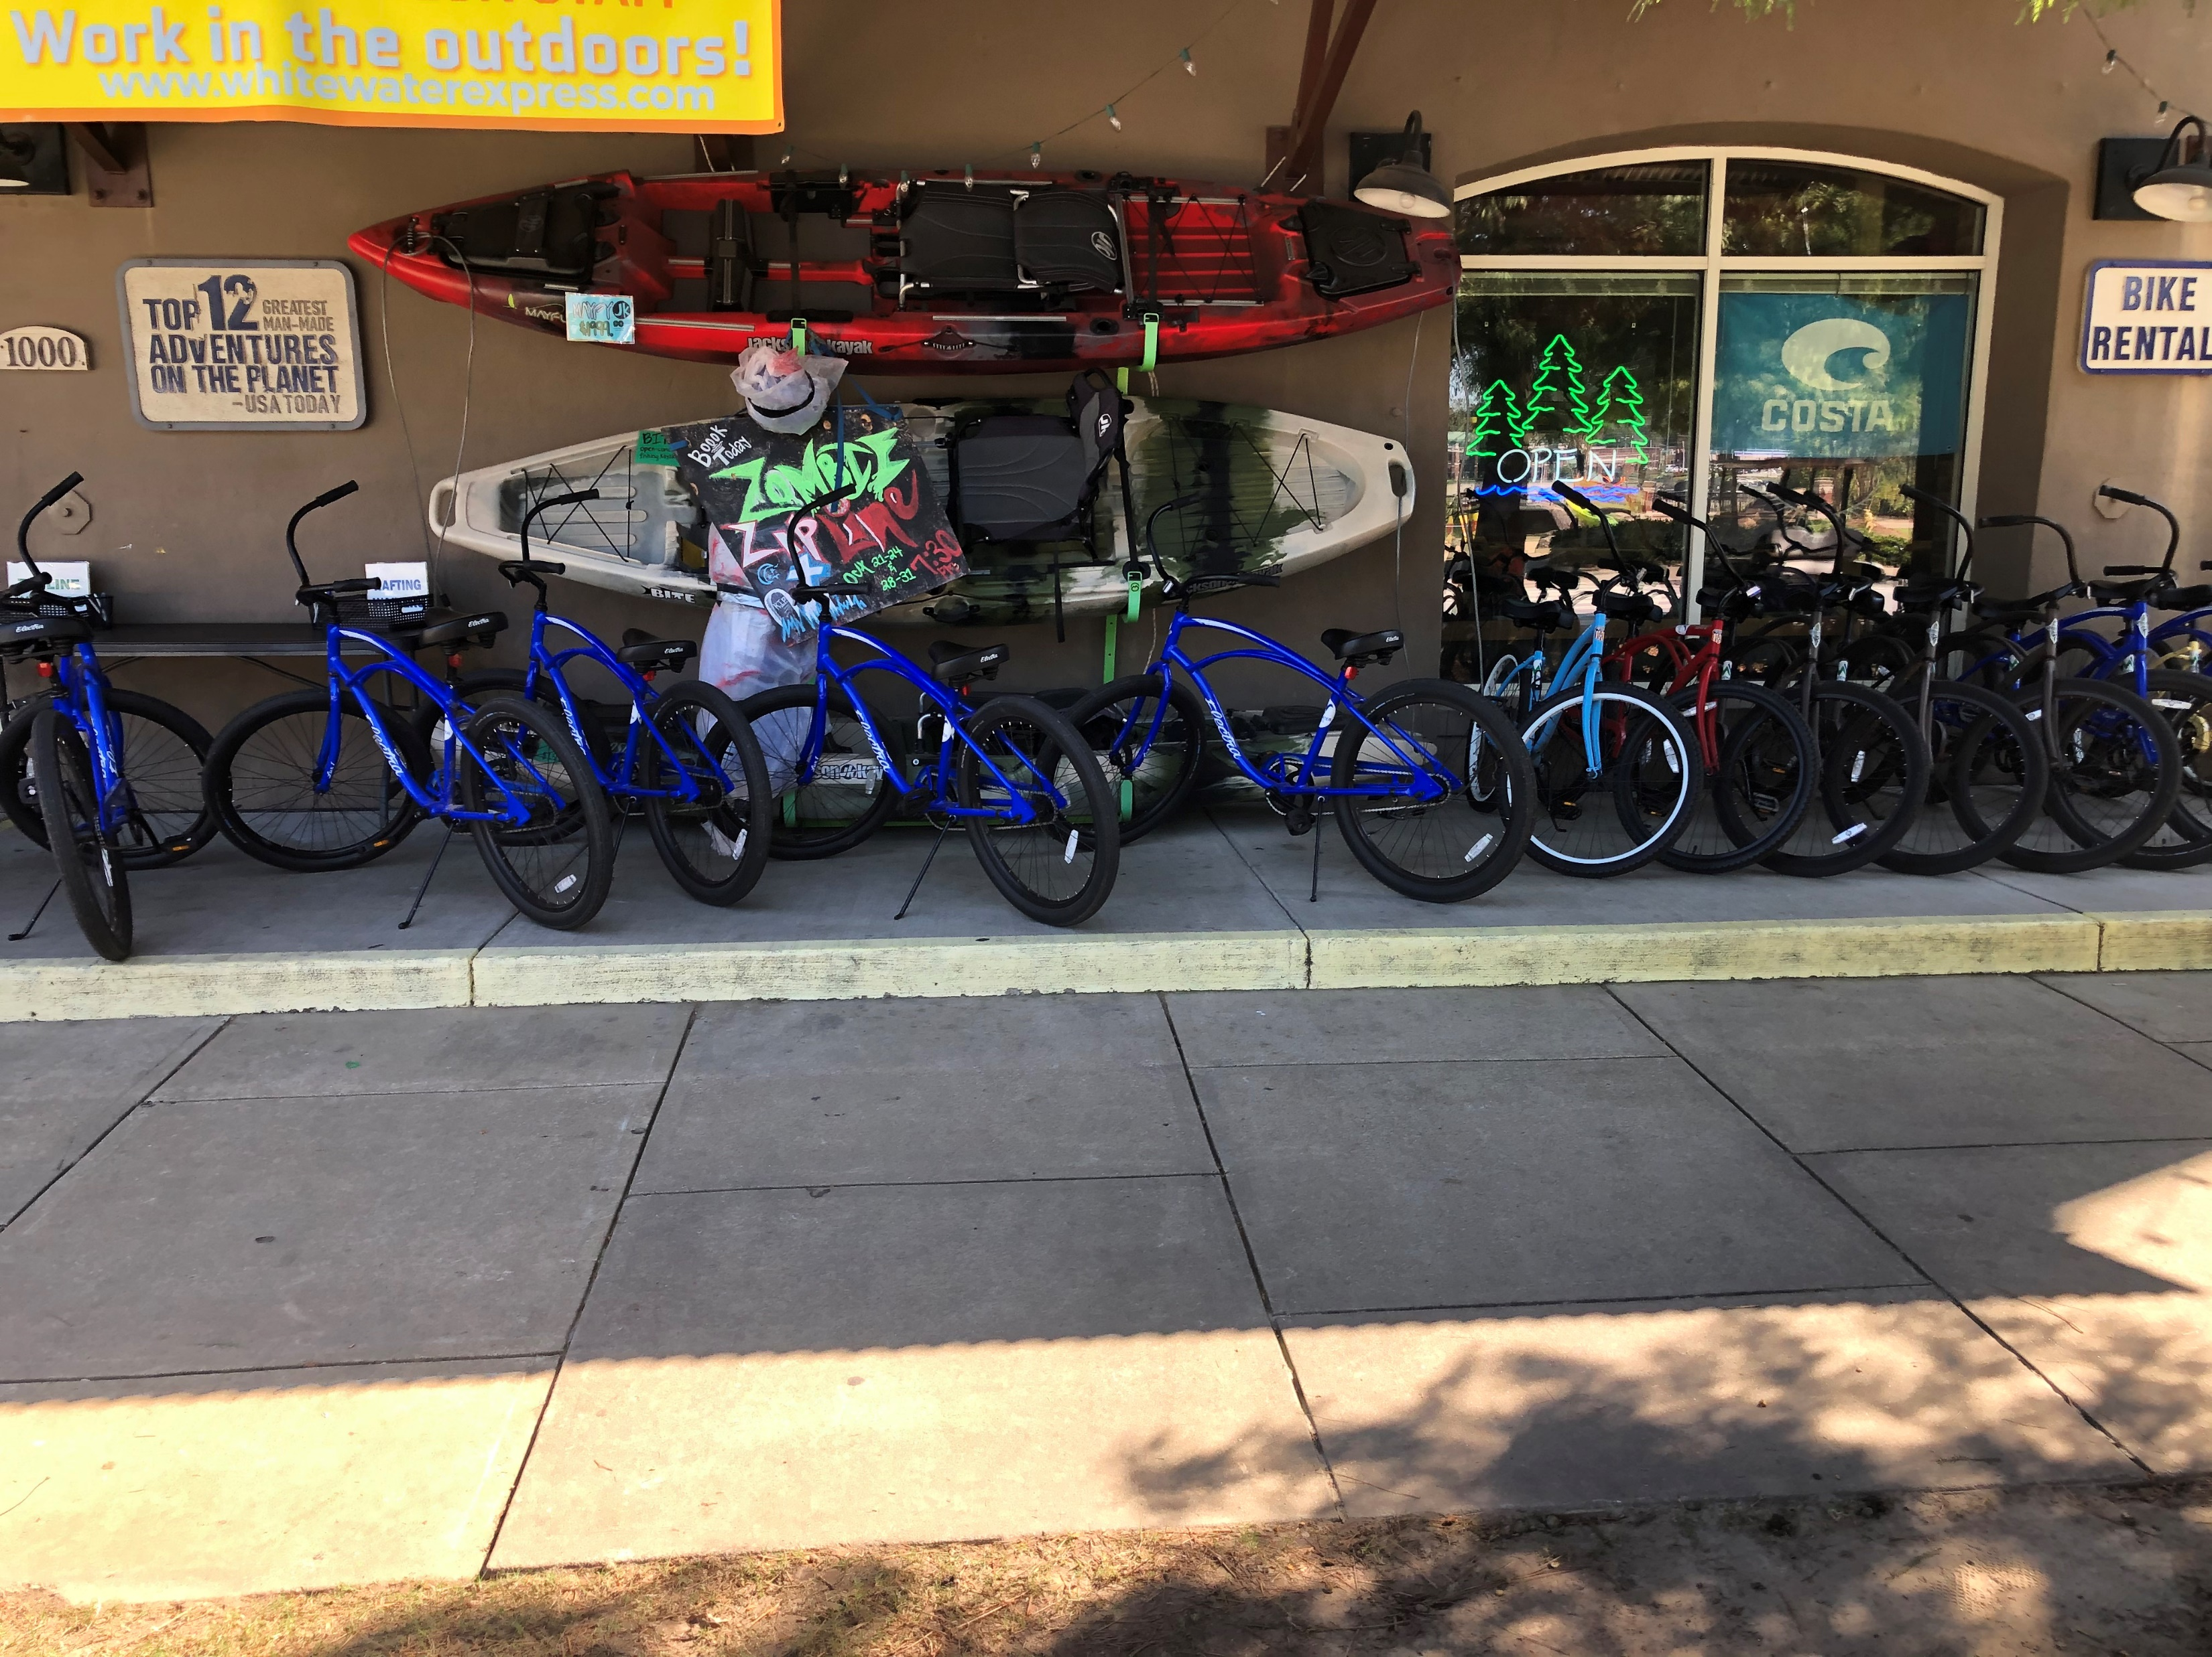
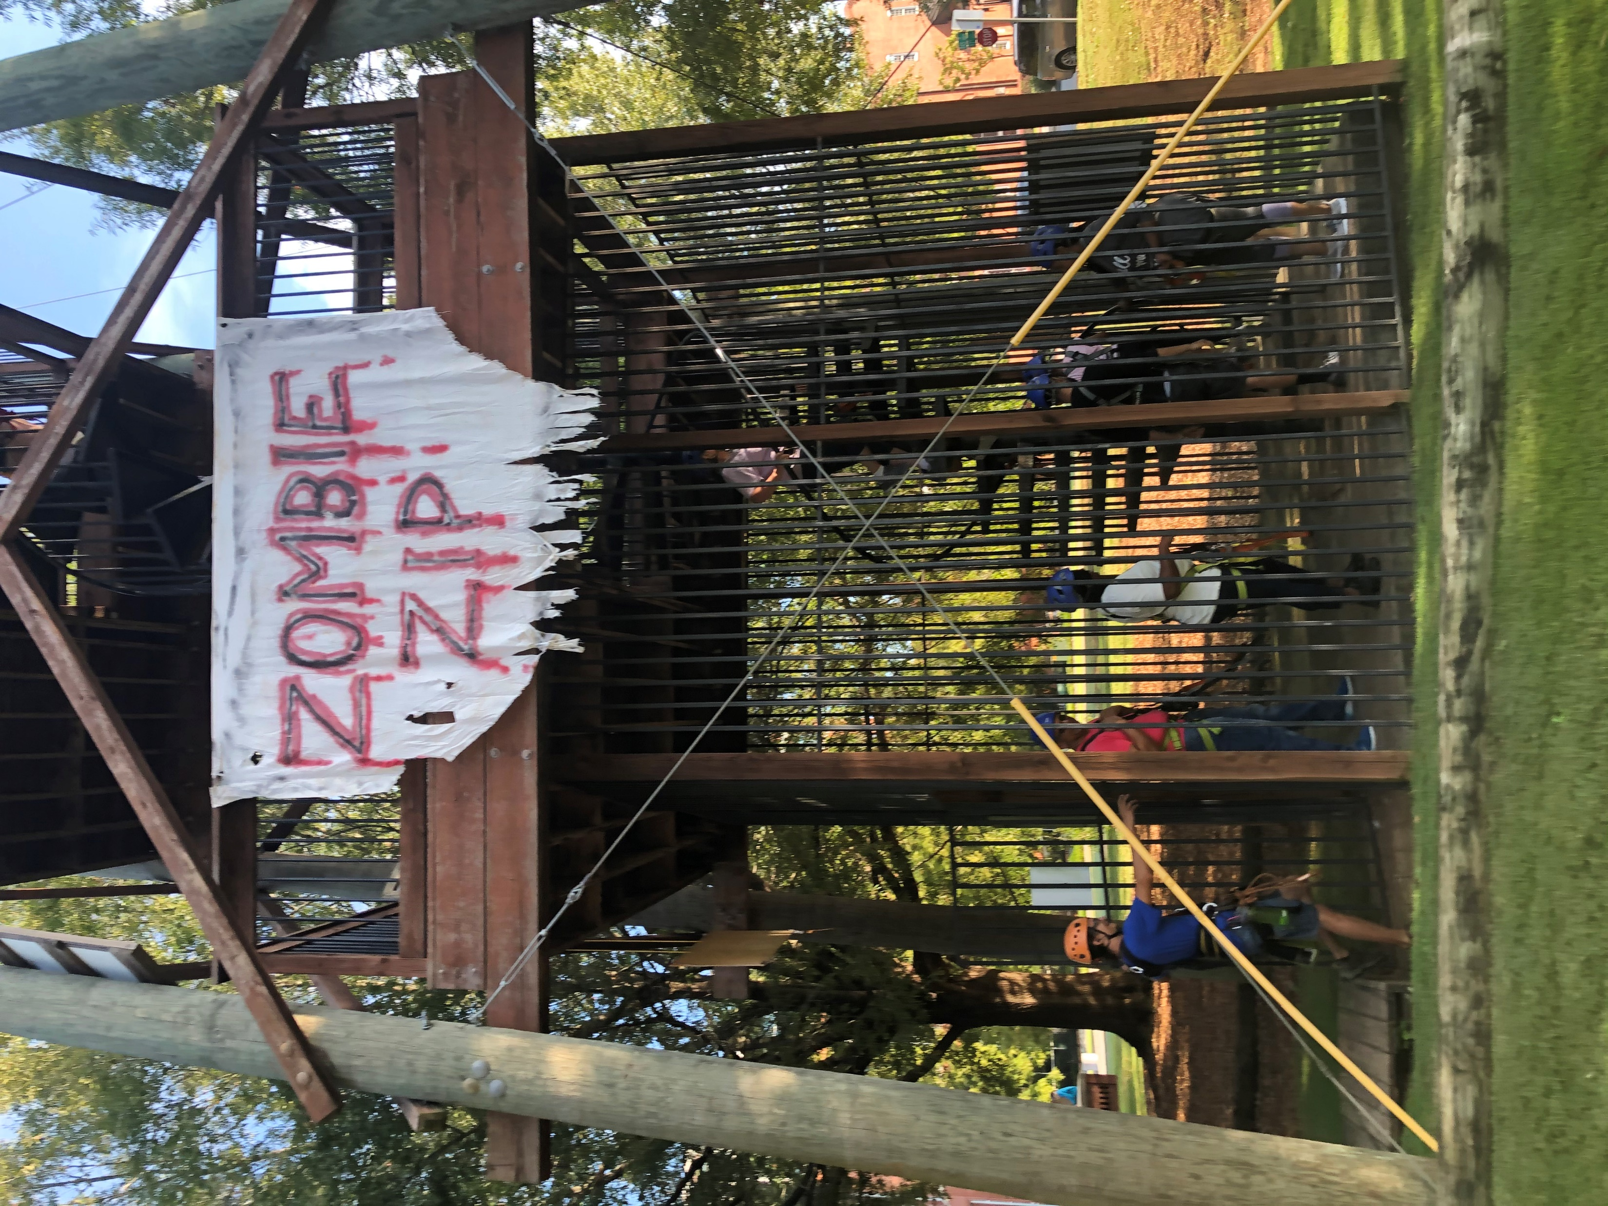
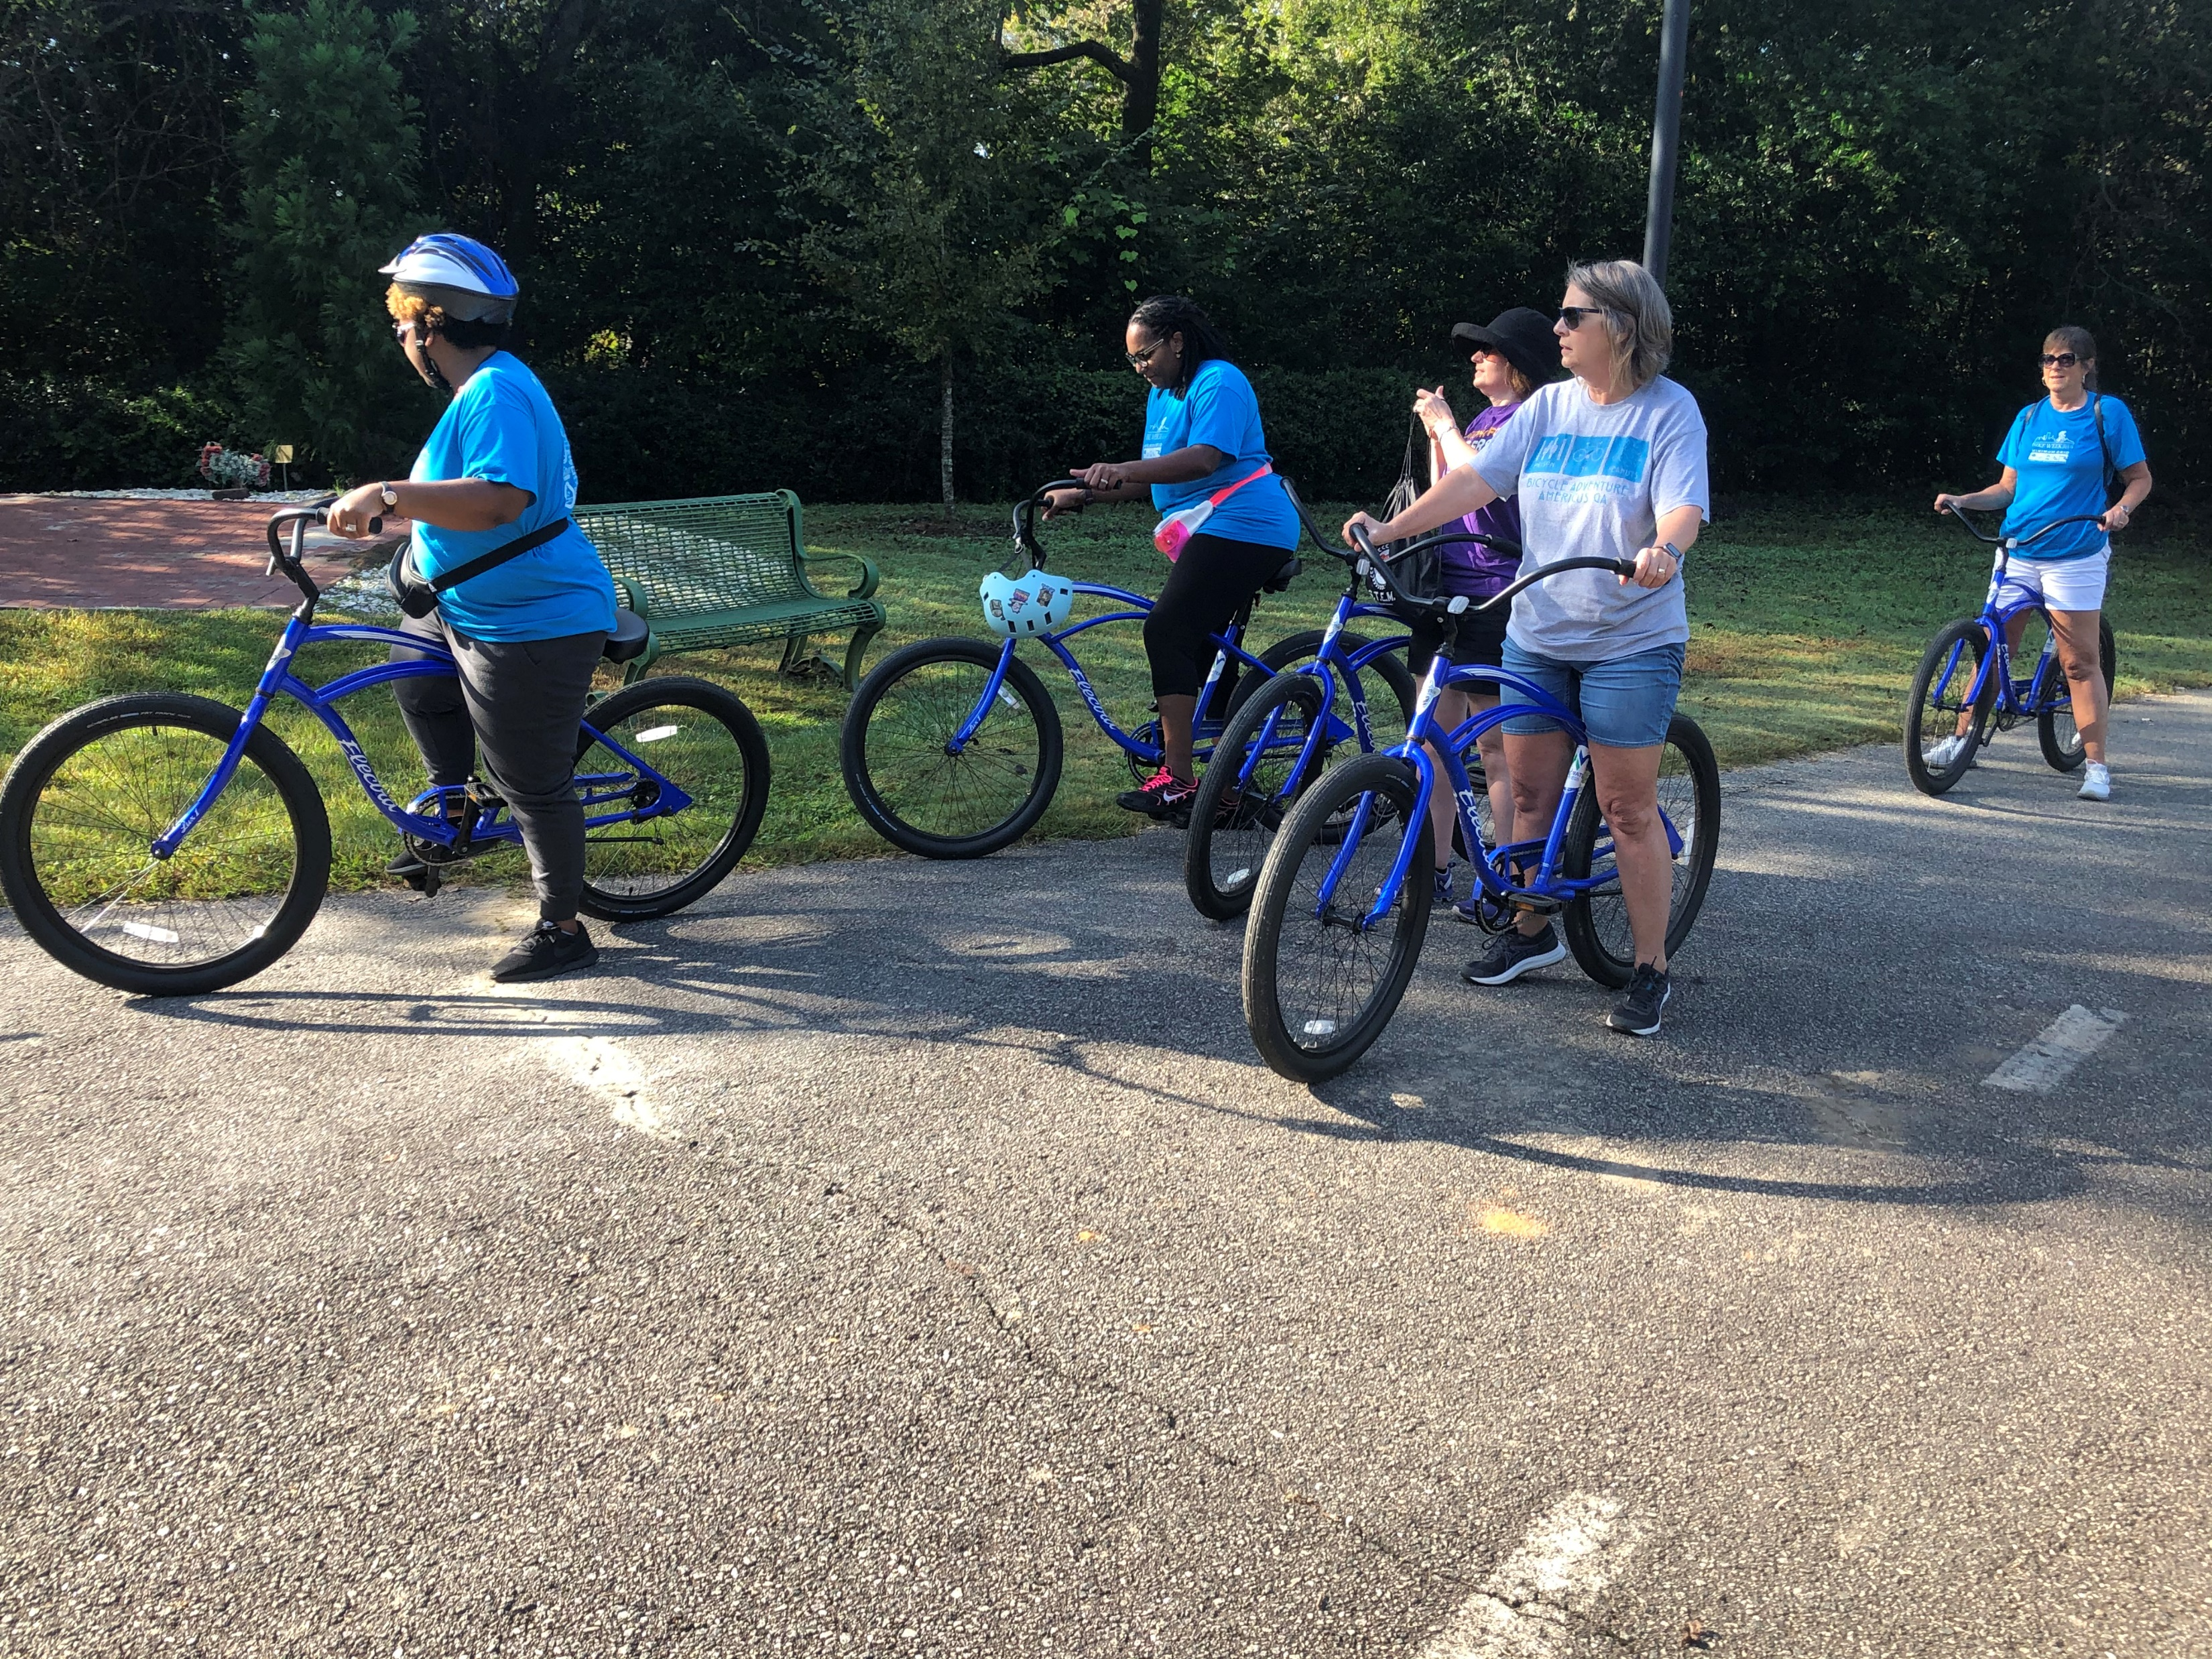
HUDDLE UP: Decide Upcoming Plays
Place the contents of your presentation here!
Add bullet points etc.
Second point here
Third point here
Play 4. Connection
Experiencing positive, trusting relationships with others
Feeling a sense of belonging, acceptance, and support
Notes:
RVRC employee’s health and wellness outing
Video - Ziplining

Slide 14
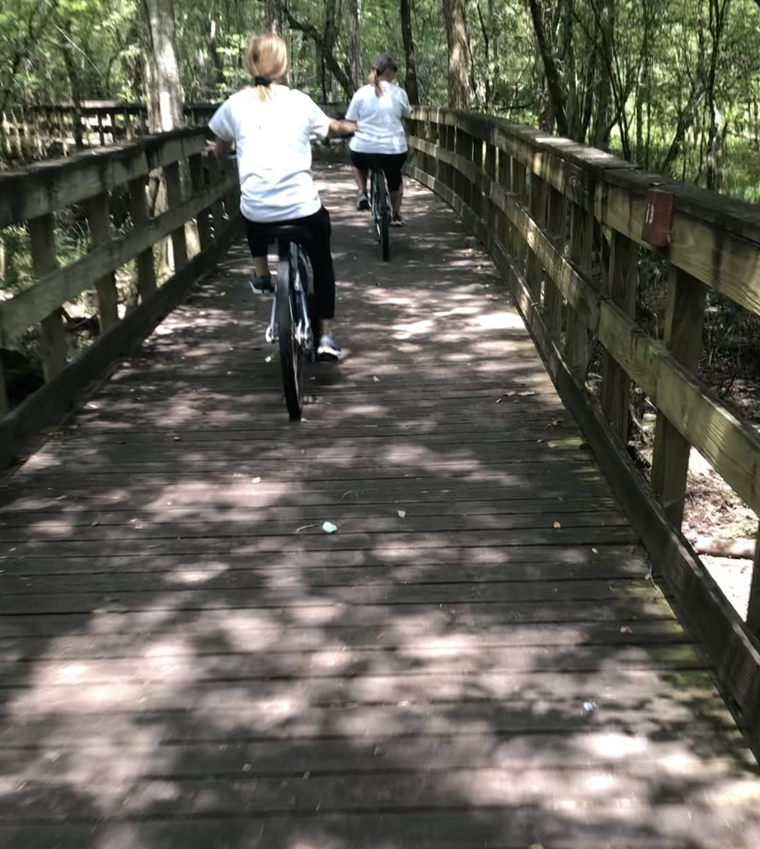
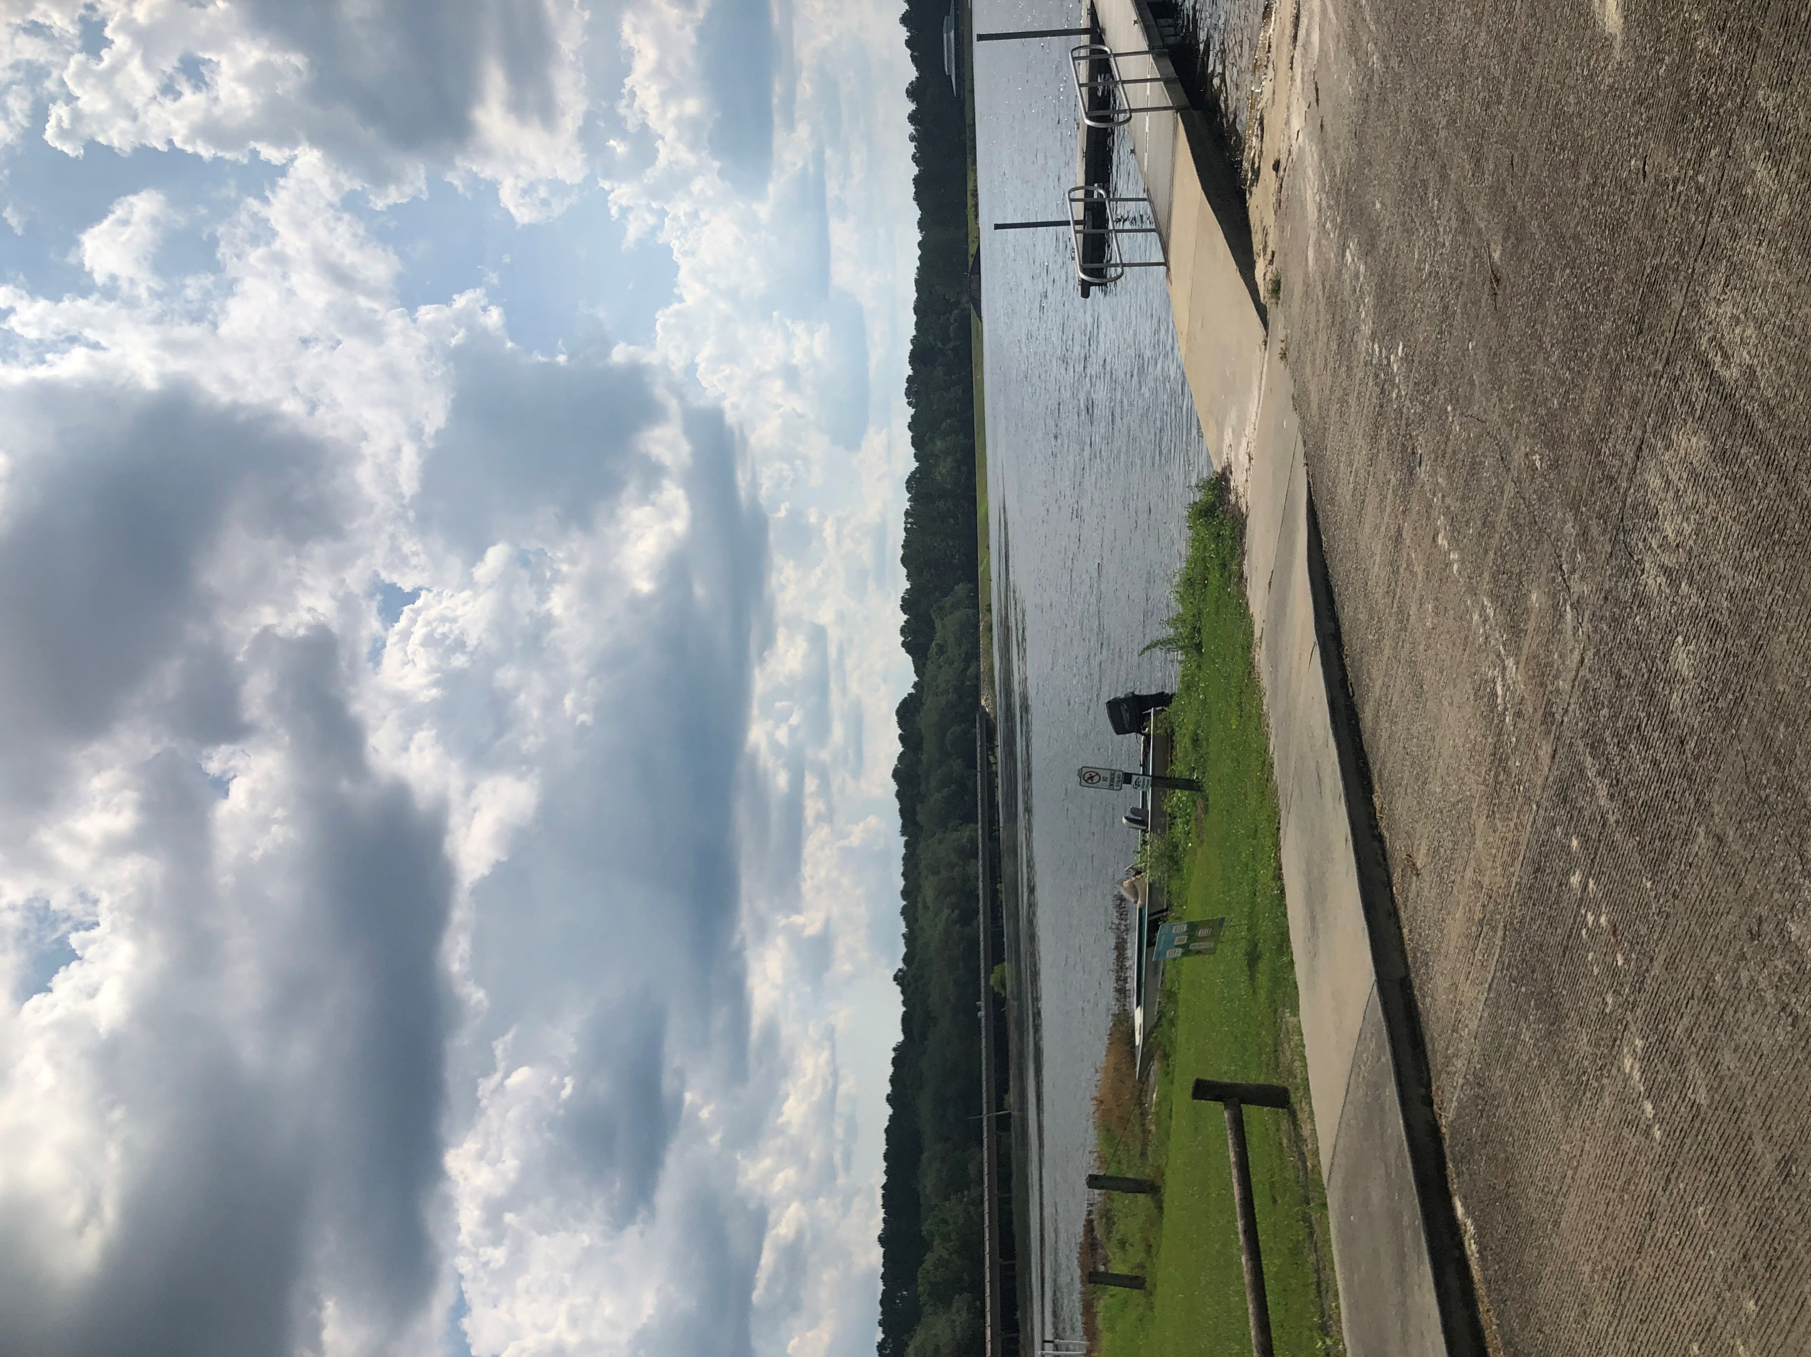
HUDDLE UP: Decide Upcoming Plays
Place the contents of your presentation here!
Add bullet points etc.
Second point here
Third point here
Play 5. Achievement
Feeling you have the support, resources, and autonomy to achieve your goals
Succeeding at meeting your individual goals and work aspirations
Notes:
SGRC Wellbeing retreat at Reed Bingham State park
Video – Bike Riding

Slide 15
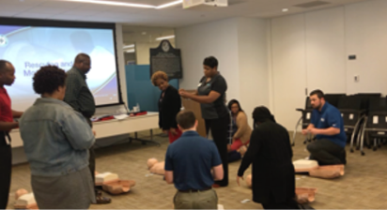
HUDDLE UP: Decide Upcoming Plays
Place the contents of your presentation here!
Add bullet points etc.
Second point here
Third point here
Play 6. Growth
Feeling like you are progressing in your career
Learning and being challenged to use and expand on your strengths
Notes:
ACCG CPR and AED Training

Slide 16
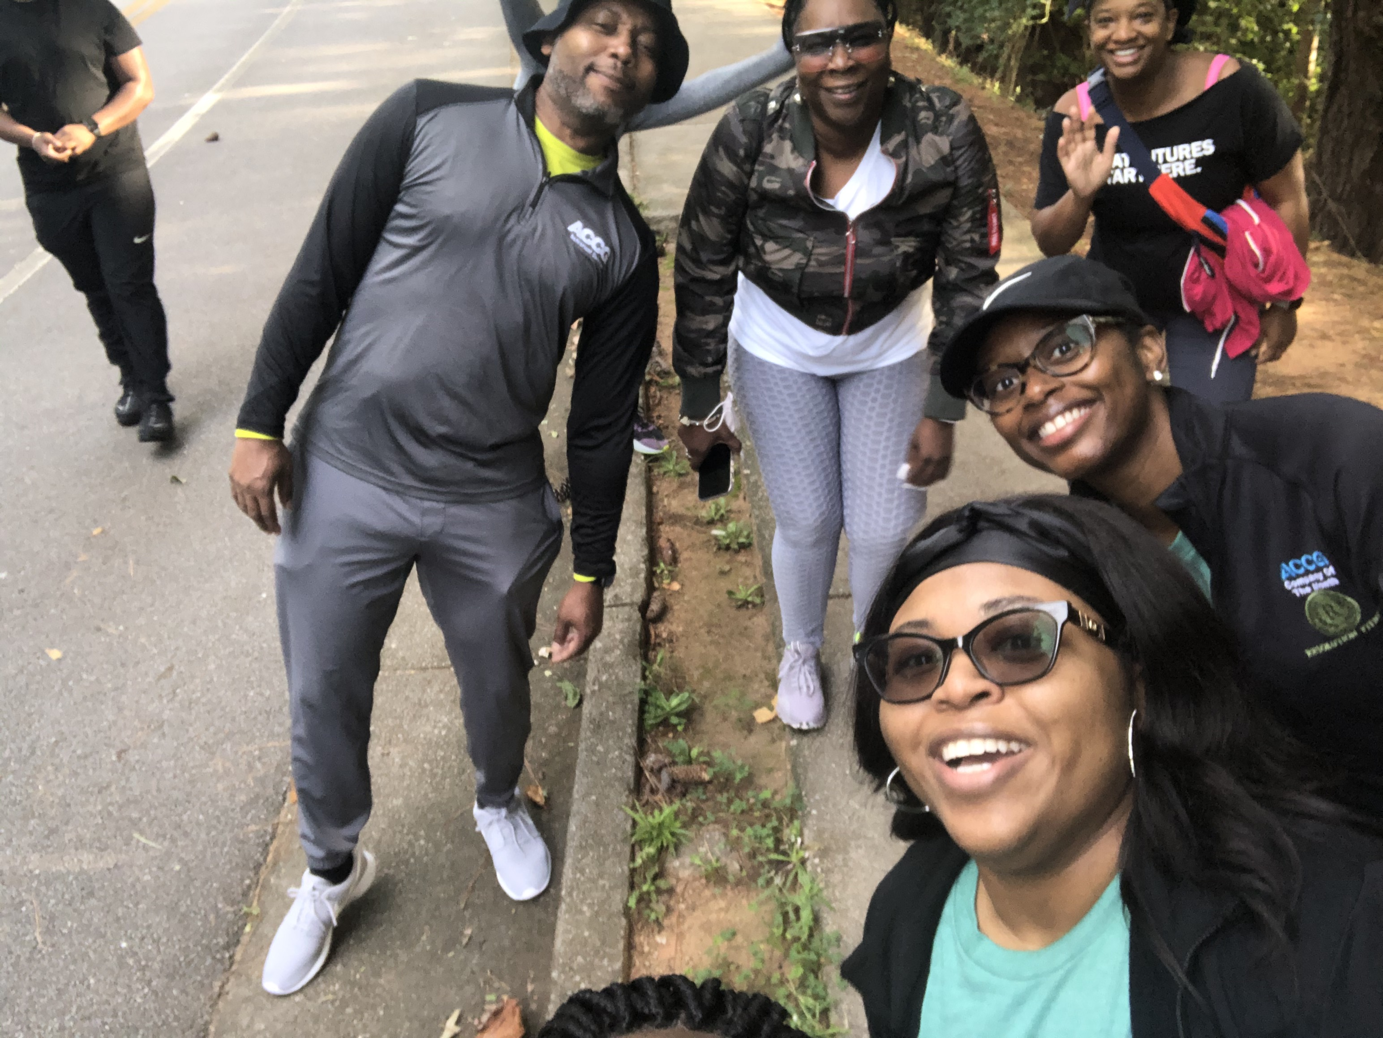
HUDDLE UP: Decide Upcoming Plays
Place the contents of your presentation here!
Add bullet points etc.
Second point here
Third point here
Play 7. Resiliency
Viewing life with optimism
Feeling grateful and expressing appreciation
Feeling validated and encouraged
Notes:
Video - GMA Employee Event: Karaoke
ACCG Wellness Day at Stone Mountain

Slide 17
HUDDLE UP: Create a Culture of Wellbeing
Wellbeing Committee
Program Goals & Action Planning
With your Committee and your HPS Representative
Use aggregate data
Allow employee input and ideas
Health Promotion Interest Survey
Notes:
Now that you have received the Health Promotion & Wellbeing Grant and sent out your Grant Press Release (Appendix A and B), what happens next? Form a Wellbeing Committee! It is a lot of work implementing a workplace wellbeing program. However, it is much easier to do if a group of people are involved.
Next, set goals for your program. Goals should be based on your employees’ biggest health concerns. Use aggregate data to help understand what those concerns are.
Then it is time to plan, plan, plan! Action planning is one of the most important aspects of a successful workplace wellbeing program. Your action plan should list events and activities to help you reach your program’s goals (Appendix C). Your program’s goals should reflect your organizational culture and resonate with your government. The program should tie in your mission and vision. This will help create the foundation of the program.
Allow employee input and ideas. Let them fill out the Health Promotion Interest Surveys (Appendix H). It promotes a sense of ownership. Learn what your employees are most concerned about and what they need. You can enlist the help of other organizations too. Look at National Health Observances to get ideas (Appendix I) and check out Community Health Promotion Resources (Appendix J).

Slide 18
IN THE FIELD OF PLAY: Build A Resilient Workforce
“According to psychological research, there are four elements that are essential to building the resilience needed to stay healthy under pressure. Known as the 4Cs, these are our need for positive interaction with others (community), wanting to feel part of something important (commitment), the chance to stretch ourselves without feeling overwhelmed (challenge), and the need to have a sense of control over our daily lives (control).” Wolfgang Seidl (2020
Notes:
Build a resilient workforce.

Slide 19
IN THE FIELD OF PLAY: Build A Resilient Workforce
Foster community, commitment, challenge, and control through your workplace wellbeing programs
Lead by example and build your own personal resilience
Encourage social support among employees
Help your employees find meaning in what they do
View the changes due to COVID as a challenge
Help employees develop a sense of control and self-confidence
Be optimistic and use positive messaging
Encourage healthy habits across all dimensions
Notes:
Build a resilient workforce.

Slide 20
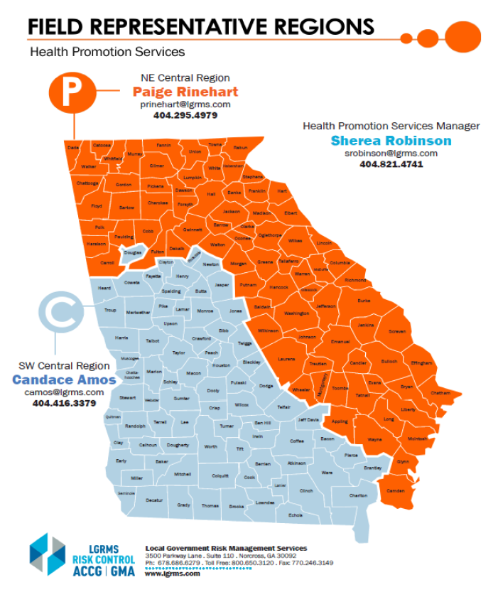
IN THE FIELD OF PLAY: HPS Field Representatives
Sherea Robinson, Health Promotion Services Manager
srobinson@lgrms.com; 404.821.4741
Candace Amos, Southwest Central Region
camos@lgrms.com; 404.416.3379
Paige Rinehart, Northeast Central Region
prinehart@lgrms.com; 404.295.4979
Notes:
Communicate with your coaches.
LGRMS HPS is here to support you during every play. Regardless of the yard you’re on, your coaching staff is right on the sidelines. Helping you coordinate, motivate, and organize your workplace wellbeing program.

Slide 21
IN THE FIELD OF PLAY: Services and Resources
Workplace Offerings
Awareness Resources and Health Communication Campaigns
Our website: www.LGRMS.com offers access to a wide array of wellbeing resources
2022 Health Promotion Champion Training Manual
Appendix contains planning templates, flyers, community resources, and more!
Health Promotion Interest Survey
Weekly Health Scoop
Health and Wellbeing Poster Campaign
Living Well Georgia in the SHARE Newsletter
Monthly Forum Call
Notes:
Utilize the services available to you.
We offer many services and resources through our workplace health promotion offerings
Our mission is to: “Proactively create opportunities for ACCG and GMA Life and Health Insurance Program members to enhance their health and productivity through leadership and the delivery of innovative health promotion services.”
There are many ways you can protect yourself, as well as your employees’ health. You can start by participating in the LGRMS HPS Forum Call, in which we’ll go over a Health Toolkit that provides “tools” to promote health in your organization.
The Health Toolkit will be placed in the next issue of the SHARE newsletter, following the Forum Call, but it will be for the upcoming month. You’ll receive all the tools you’ll need beforehand to start planning.
The Forum Call is for Health Promotion Champions and individuals responsible as health promotion leaders, administrators, HR and personnel directors, clerks, health/safety coordinators, and wellness/health benefit coordinators. All are welcome to participate. You’ll receive an invite each month. Please stay on the lookout!

Slide 22
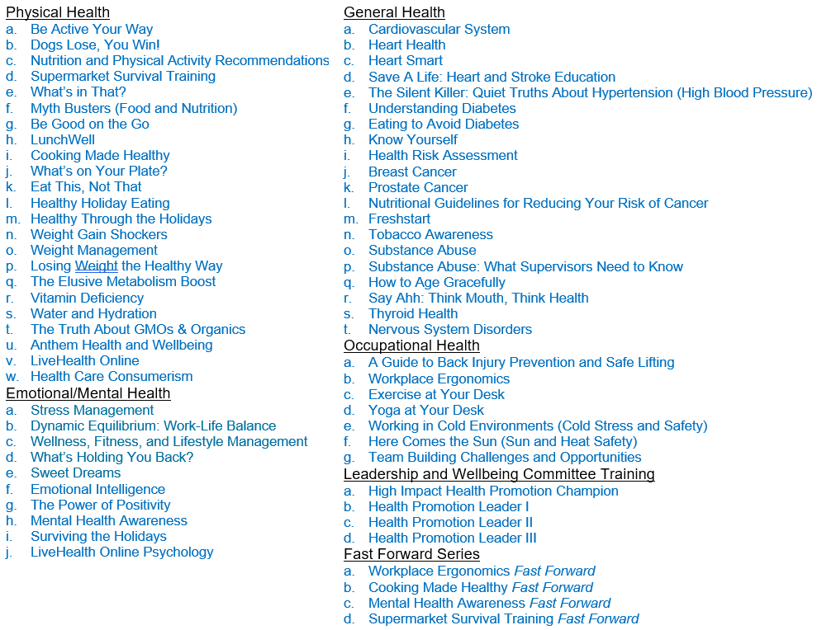
IN THE FIELD OF PLAY: Services and Resources
Workplace Offerings
Prevention and Health Education Trainings
LGRMS Training
Physical Health
Emotional/Mental Health
General Health
Occupational Health
Leadership and Wellbeing Committee Training
Fast Forward Series
Notes:
Utilize the services available to you.
Trainings are offered onsite and virtually.
Trainings focus on learning and screening activities that impact knowledge, skills, beliefs, and health habits.

Slide 23
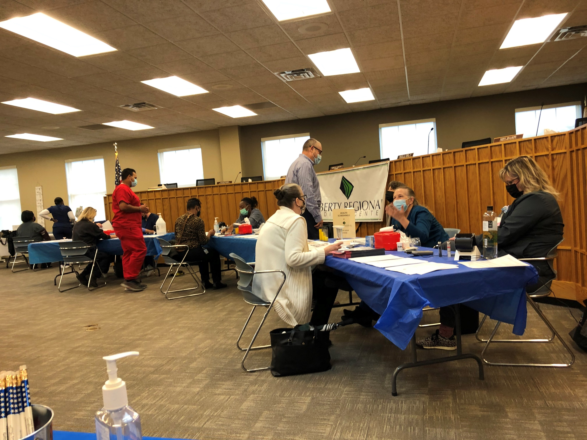
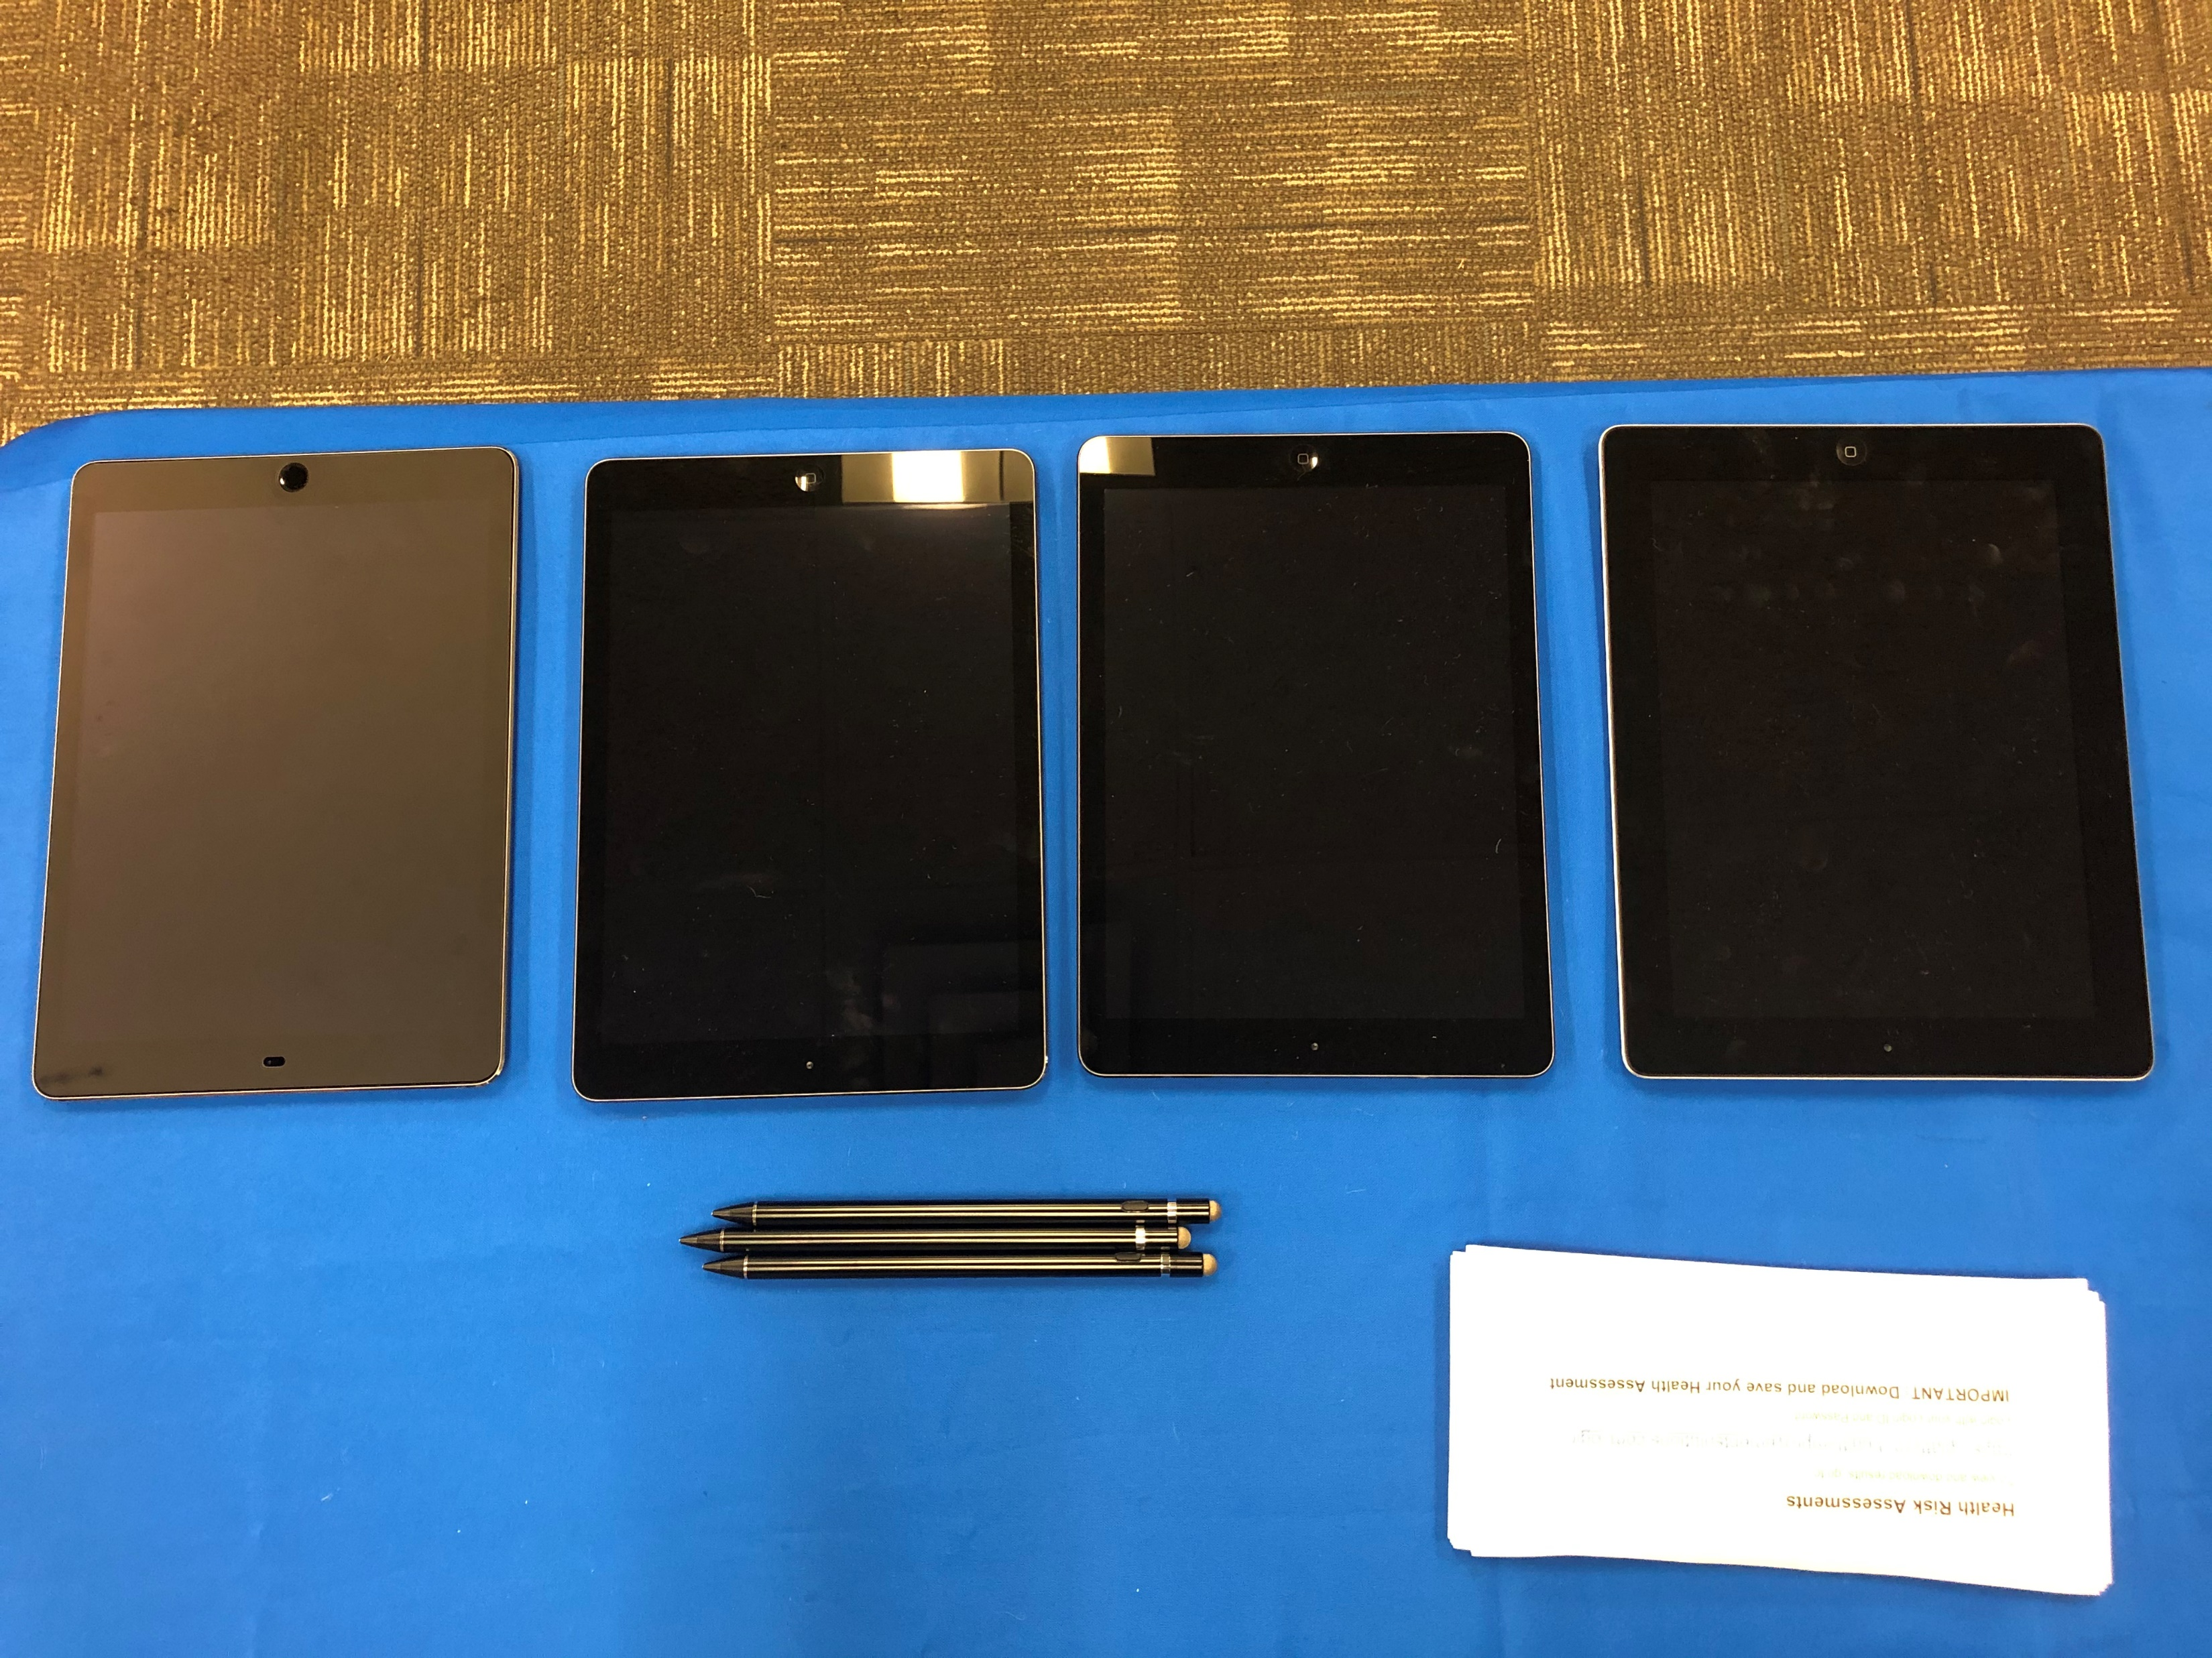
IN THE FIELD OF PLAY: Services and Resources
Workplace Offerings
Prevention and Health Education Trainings
LGRMS Training
Anthem Resources, Toolkits, and LiveHealth Online
Health Risk Assessments (HRAs)
LGRMS HRA: Electronic and Paper
Types of HRAs: (1) Health Assessment, (2) Short Health Assessment without Biometrics, (3) Financial Health, (4) Financial and General Health, (5) Short Financial and General Health without Biometrics, and (6) Coping & Resilience
HRA Request Form and Eligibility File
Anthem BCBS HRA: Online through Anthem Portal
LocalGovU E-Learning
Online training courses with topics in: Health Promotion & Wellness, Employee Safety, Corrections, Law Enforcement, and Management
Safety National
Training and education, including classes and seminars on safety and risk control topics geared toward managers, supervisors, and employees
Notes:
Utilize the services available to you.
Pictures - Liberty County: Health Fair and HRAs
HRA - Ability to adjust the questions on the HRA to get the data you need
•LocalGovU – They offer online training courses with topics in: Health Promotion & Wellness, Employee Safety, Corrections, Law Enforcement, and Management. Classes are provided at no cost to ACCG & GMA Risk Management Fund Members.
•If you have an account already set up, you can go through the Workers’ Comp side to find a training most relevant to what you are looking for. If you do not have an account set up, go to this link: https://www.lgrms.com/Online-Training.aspx, and there’s a number you can call to get started.
•Safety National – They offer training and education, including classes and seminars on safety and risk control topics geared toward managers, supervisors, and employees. Safety National Website (training and other resources) are all free to ACCG & GMA Members.
•LGRMS sponsored a webinar on Safety National. Here is the link to the webinar recording: https://attendee.gotowebinar.com/recording/6460624077807545857.

Slide 24
IN THE FIELD OF PLAY: Services and Resources
Workplace Offerings
Behavior Change and Disease Management Programs
Team Building
Heart Health 6-Week Program
Freshstart Tobacco Cessation
Healthy Workplace Consultations and Honors
Wellbeing Program Action Planning
Workplace Health Audit
HRA Group Summary Report Analysis
Eudaemonia Award Program*
Notes:
Utilize the services available to you.
•Walk Georgia
The WalkGeorgia.org website was decommissioned on December 31, 2020. This difficult decision was made due to an aging website infrastructure and resource limitations. Walk Georgia appreciates all program participants over the years and their commitment to leading a healthy life! Please visit related UGA Extension resources at:
•https://extension.uga.edu/topic-areas/food-health/nutrition-health.html
•https://www.fcs.uga.edu/extension/health
•https://www.fcs.uga.edu/extension/food (Update with Maria information)

Slide 25
LINE OF SCRIMMAGE: Gain Yards
Place the contents of your presentation here!
Add bullet points etc.
Second point here
Third point here
Grant Requirements
Yard 1. Designate a Health Promotion Champion
Yard 2. Attend the Health Promotion Champion Training workshop
Yard 3.
Distribute an initial Grant Press Release to local media and all employees announcing support of the program
Implement at least two communications to employees promoting the Anthem Blue Cross Blue Shield 24/7 NurseLine and four other Anthem health communications during the year
Yard 4.
Complete Health Risk Assessment (HRA)
HRA Results Review
Yard 5.
Implement a Workplace Wellness Policy
Participate in Wellbeing Committee Meetings
Notes:
Let the Grant help.

Slide 26
LINE OF SCRIMMAGE: Gain Yards
Grant Requirements
Yard 6. Offer at least two health promotion programs to all employees
Examples: immunization program (flu shots), health trainings, lunch and learns, cancer screenings, CPR/First-Aid training, tobacco use reduction program, nutrition-weight programs, stress management programs, etc.
Yard 7. Create a 12-month Action Plan for the workplace wellbeing program; including awareness, communications, prevention and behavior change programs
Yard 8.
Mid-Point Check (Due January 1)
Year-End Report (Due June 1)
Receipts (Due June 1)
Grant Requirements Checklist (Due June 1)
Yard 9. Attend at least one other LGRMS HPS Regional Training class during the current Grant year
Notes:
Let the Grant help.

Slide 27
LINE OF SCRIMMAGE: Gain Yards
Grant Year Timeline
Start of Current Grant Year…………………………………….………………………………………………………………….July 1, 2022
Health Promotion Champion Training Workshop……………………………………………………………….September 2022
12-Month Action Planning……………………………………………………………..Schedule with Your HPS Representative
Monthly Forum Call……………………………………………………………….……………………………………………Exact Dates TBD
Mid-Point Check Due……………………………………………………………..…………………………………………….January 1, 2023
HPS Regional Training………………………………………………………..…………………………..Spring 2023 (Exact Dates TBD)
Year-End Report Due (Report, Checklist, Receipts)…………………………………………………….……………..June 1, 2023
End of Current Grant Year…………………………………………………………………………………….…………………June 30, 2023

Slide 28
LINE OF SCRIMMAGE: Gain Yards
Grant Monetary Distribution
ACCG
All award recipients will receive 50% of their initial grant amount at the Health Promotion Champion Training Workshop. The remaining 50% will be received after the Mid-Point Check has been submitted.
GMA
All award recipients will receive 50% of the initial grant amount via mail after the Health Promotion Champion Training Workshop. The remaining 50% will be received after the mid-point check has been submitted.

Slide 29
LINE OF SCRIMMAGE: Gain Yards
Grant Funds Usage
PPE
Exercise equipment (Commercial Grade)
Healthy food for Training
Door prizes
Sunscreen
Ergonomic chairs (only if have the Ergonomics training offered through LGRMS)
Reusable lunch totes
Pedometers
Tobacco cessation aids (only if have the Tobacco Cessation training offered through LGRMS)
Keyboard wrist support (only if have the Ergonomics training offered through LGRMS)
Water
Blood pressure cuffs
AED
Computer desk (only if have the Ergonomics training offered through LGRMS)
Hand sanitizer

Slide 30
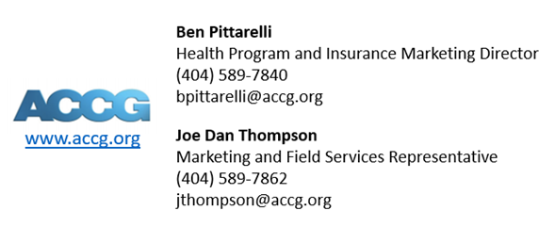
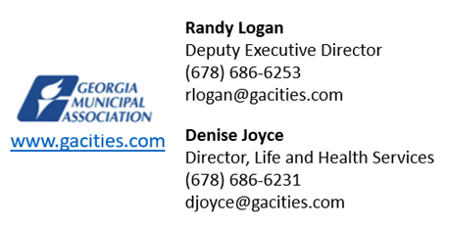
SPECIAL TEAMS
Notes:
There is technique involved, fortitude, and a specific skill set that caters to the pro wellbeing game itself. And these Special Teams have it all to help you get the "W".

Slide 31
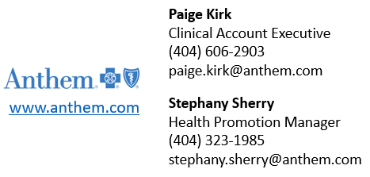
SPECIAL TEAMS
Notes:
There is technique involved, fortitude, and a specific skill set that caters to the pro wellbeing game itself. And these Special Teams have it all to help you get the "W".

Slide 32
TOUCHDOWN!
“Employers who can connect their people to a sense of purpose and invite them to rise to the challenge will not only give them a sense of direction that will protect their mental health, but also will allow them to emerge stronger from the crisis as a result” (Seidl, 2020). Although we’ve made it to the end zone, it doesn’t mean that our game is over.
Wellbeing is unending. We're tackling our way into 2023!
Be on the lookout for the Monthly Forum Calls and 12-Month Action Planning!
Notes:
Workplace wellbeing programs make healthy living, stress-less living that much easier by empowering employees.
“Employers who can connect their people to a sense of purpose and invite them to rise to the challenge will not only give them a sense of direction that will protect their mental health, but also will allow them to emerge stronger from the crisis as a result” (Seidl, 2020). Although we’ve arrived at the checkered flag, it doesn’t mean that our race is over.
Wellbeing is unending.

Slide 33
ACTIVITY: Action Plan
Plan from November 2022 to June 2023
For every month:
Choose a topic
Then specify one dimension/area to focus on
List strategies (activities/events) of how to accomplish
Each group member will receive:
1 Resource Packet (Health Topic Calendars, List of Dimensions/Areas, Wellbeing Strategies, and Action Planning Form from November 2022-June 2023)
Notes:
Will do action planning meetings in September/October, so we’ll start with November 2022 and go to June 2023
Use the tools/resources/services within the packet to help create your Action Plan for every month
Fill up your notes with every detail, every coaching point, and every possible way that you can show your employees a level of execution that meets the demands of the pro wellbeing game.
Give out packets

Slide 34
THANK YOU!
QUESTIONS?

